Slide 1
Building capacity for teen pregnancy prevention in the pacific islands
Judith f. Clark, MPH
Executive Director
Hawaii Youth Services network

Slide 2
Hawaii Youth Services Network
Statewide coalition of youth-serving organizations
Pacific Islands training and technical assistance provider
Working on teen pregnancy prevention in:
Hawaii since 2005
Northern Mariana Islands since 2012

Slide 3
Program goals
Reduce the risk of unplanned pregnancy and sexually transmitted infections and increase the likelihood of successful transition to adulthood for youth
Increase the number of adolescents that abstain from sex, delay initiation of sex, use effective contraception and disease prevention if sexually active, and have fewer sexual partners.
Reduce the teen birth rate
Increase capacity of organizations to select, implement, and evaluate evidence-based, culturally appropriate approaches to teen pregnancy and STI prevention.

Slide 4
Curricula Selection criteria
Suitable for Asian/Pacific Islander (API) youth
Length of curricula fits time available
Medically accurate
Interactive/engaging for students
Works in school-based setting

Slide 6
Parent, Community, Stakeholder Support

Slide 7
Parent night meetings
“I am . . . proud to announce that my young adolescent boys and I have greatly benefited from such vital program. . . I want you to know how important it is for your children to be in this program. ”
--Father of a student who completed the sex education program.

Slide 8
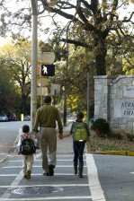
Positive messaging
“Just as we teach our children to cross the street safely, we must teach our youth how to make healthy decisions about their sexual health”

Slide 9
Meetings with key stakeholders
Showing U.S. Senator Mazie Hirono a map of communities with highest teen birth rates.

Slide 10
Challenges

Slide 11
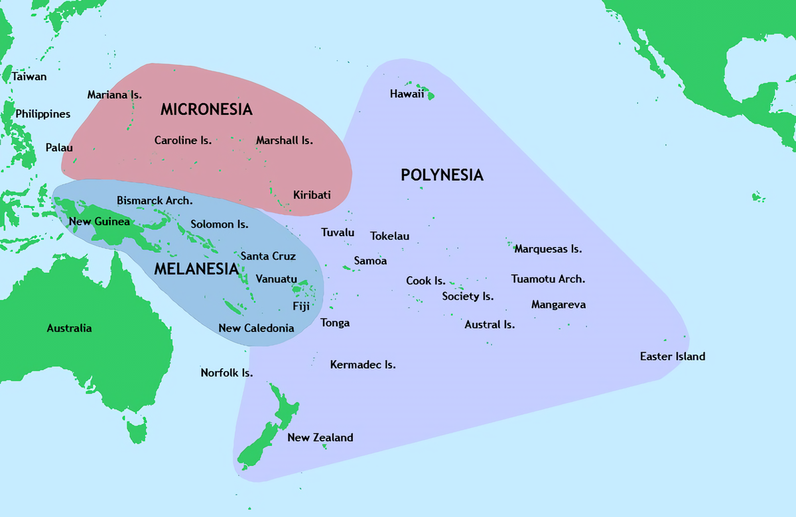
Distance & Time Zones
4,000 miles from CNMI to Hawaii; 20 hour time difference.
9,000 miles from CNMI to Washington DC; 14 hour time difference

Slide 12
Transportation
Can’t drive from one island to another
Cost and time for transport
6 seat airplane. My transportation between islands

Slide 13
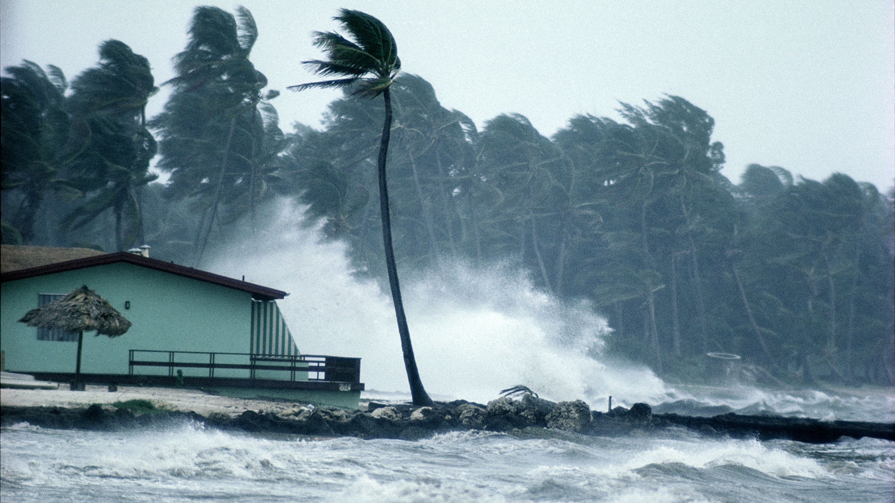
Environment and weather
Frequent typhoons, tropical storms, earthquakes, tsunami alerts
“Termites ate the wooden demonstrators over the summer.”

Slide 14
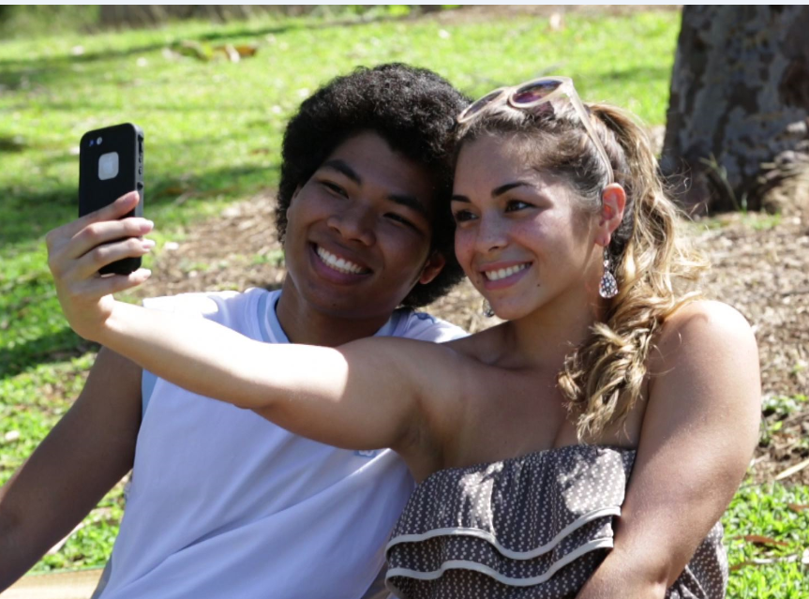
Culture and Values
Educational materials don’t reflect local cultures.
Limited English comprehension – Many bilingual & immigrant families.
Families don’t discuss sexual health with children.
Religious beliefs.

Slide 15
Solutions
Adapt materials to fit local culture or create your own.
Build internal capacity in program development, organizational management, community engagement
Recognize that you will never know everything about another culture – and show that you are always ready to learn a little more!

Slide 16
Solutions
Be adaptable. Include a quality improvement process and use data to fine-tune your program.
Build community and key stakeholder support. Find out what the community wants and needs; support those goals; remove the barriers.
Plan for sustainability from day one.

Slide 17
Outcomes in the northern mariana islands
2011 - 2017

Slide 18
Teen Birth Rate cut in half

Slide 20
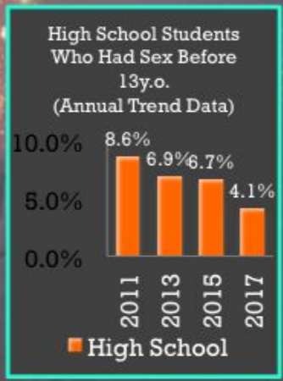
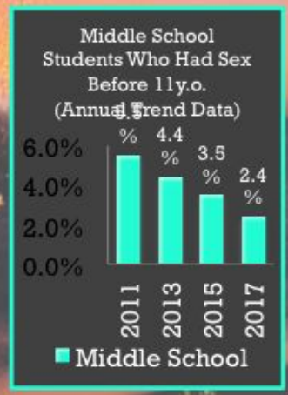

Slide 21
