Slide 1
Talking Story with Kupuna: Connecting Past, Present, and Future through Facilitated Life-Review
A Ho‘a Presentation by
Lori Daniels, Ph.D., LCSW

Slide 2
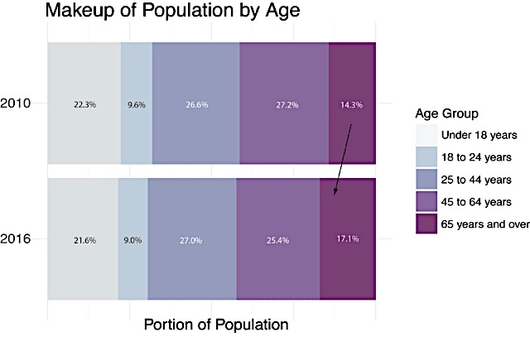
Notes:
Did you know that since 2010, Hawaii has experienced a 25% increase in older adult residents who are over 65? It’s called the Silver Tsunami and already, the total number of Hawaii residents over age 65 is about 3% higher than 8 years ago.

Slide 3
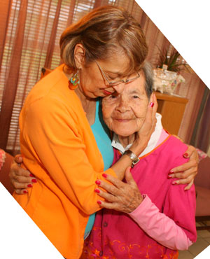
Notes:
The impact the older adult population on our healthcare resources cannot be understated. But social workers can help improve the quality of older adults’ lives, because our Pacific Islands culture models for us Aloha, Ohana, and Talk Story.

Slide 4
Notes:
Specifically, “Talk story” (as you know) is an essential part of our connection to each other. But, did you know that Talk Story can also facilitate emotional healing when it comes to working older adults?

Slide 5
Notes:
In a possible merger of West meets the Pacific Islands, both Talk Story and the natural inclination to reminisce provide opportunities for aging older adults – our kupuna - to share their memories.

Slide 6
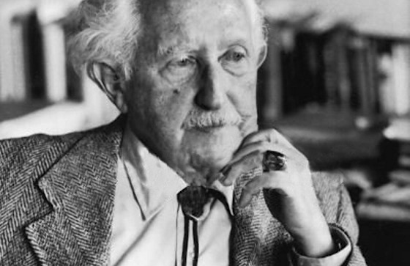
Notes:
You may recall that the last stage of Erickson’s Psychosocial Stages of Development is known as “Ego Integrity vs. Despair,” and can make the difference between healthy aging or isolation and bitterness. Achieving one’s Ego Integrity means that older adults, should be encouraged to share their memories.

Slide 7
Notes:
Robt Butler (1963) helped providers realize that older adult sharing of their memories may actually be a developmental process in preparation for their final years and dying more comfortably

Slide 8
Notes:
Butler shifted the paradigm of reminiscence - recognizing memory sharing as a healthy and natural process of aging. If older adults reflect on the times they’ve positively contributed to their families, friends, and society – they have Ego Integrity.

Slide 9
Notes:
However, if memories are not shared, then Erickson’s theory states that the result may be emotional Despair; the inability to integrate more painful experiences from one’s past. They remain stuck in the tragedies, losses, and regrets.

Slide 10
Notes:
Should painful memories remain to fester within people’s thinking about themselves, then the aging process becomes more challenging during their final years, and the end of their lives can be emotionally difficult

Slide 11
Notes:
Years ago, Gerontological experts learned that providing opportunities for older adults to share their memories can have tremendous value toward healthier aging. Tapping into the natural inclination to reminisce, interventions such as facilitated reminiscing and life-review were developed.

Slide 12
Notes:
Life-review is the same as an autobiography. It’s can be a conversation, or through photographs, or written down, or recorded. No matter the method, older adults are provided a chance to share about their full life from birth, childhood upbringing, young and middle adulthood, to present day.

Slide 13
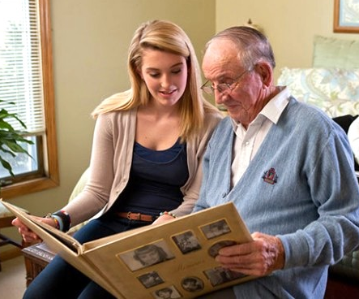
Notes:
Facilitated L-R structures the conversation between the practitioner and client. Anecdotes of their unique memories are central to the conversation. For my research, I split prompting questions into pre-military life, military life, and post-military life; in order to titrate the subjects’ L-R disclosures. Other group members listened, and reminisced as well about similar experiences.

Slide 14
Notes:
Using Talk Story as a method of life-review helps clients not only share their stories, but maintains the premise that THEY are the experts in their own lives. This is consistent with social work’s value of self-determination. Therefore, during the therapy groups, I merely facilitated the sharing of their various stories.

Slide 15
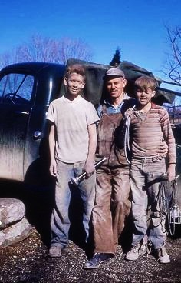
Notes:
Each client’s story was not only fascinating, but extremely informative, with extensive details far surpassing any psychosocial history, because it wasn’t a formal “fill out the form” process; instead, it was telling their story – in their words. Much of this in-depth information was essential for the clients in resolving significant recollections related to the war-zone during subsequent sessions.

Slide 16
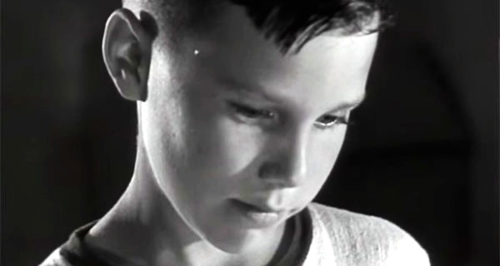
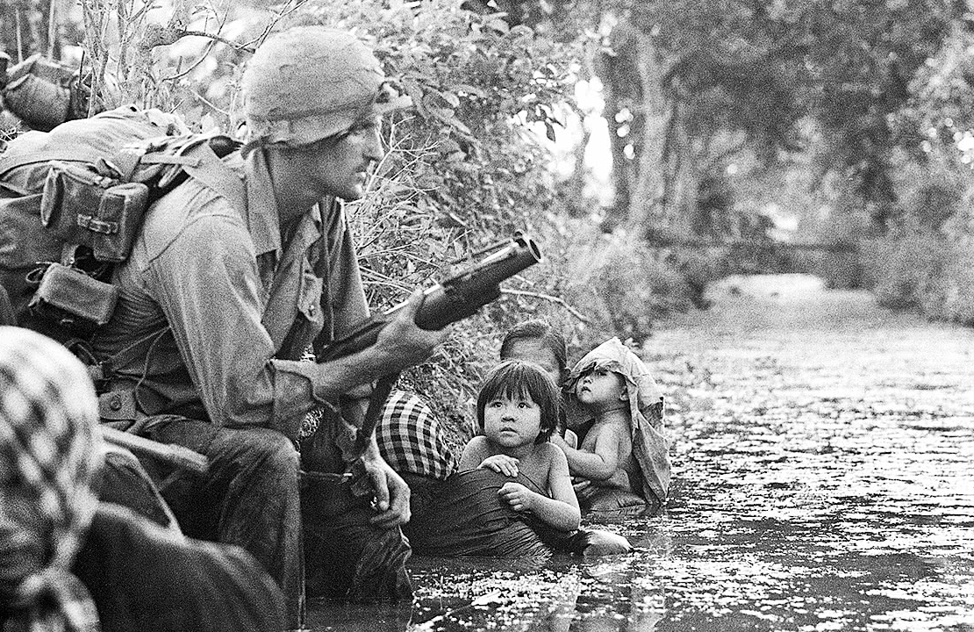
Notes:
By having the background information about their life stories prior to military service, my role shifted to listening for possible connections of their past childhood challenges with the traumatic experiences that occurred during the young-adult portion of life review.

Slide 17
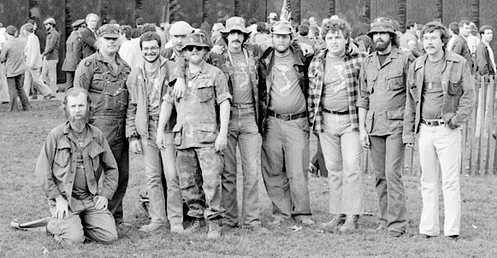
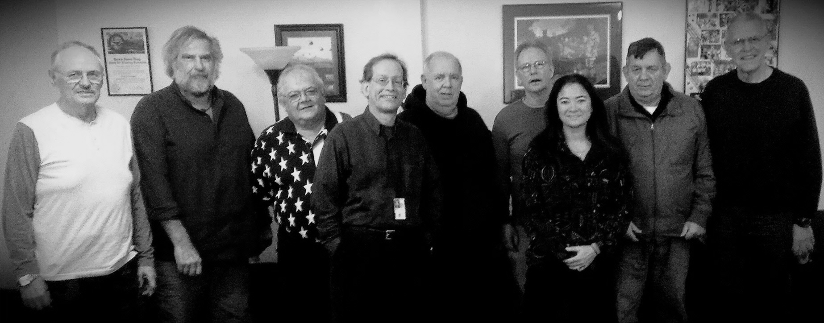
Notes:
Before the life-review process, clients weren’t aware of the connections between their childhood experiences, young adult war-zone experiences, and their post-war, older adult experiences. The group meetings helped illuminate these connections.

Slide 18
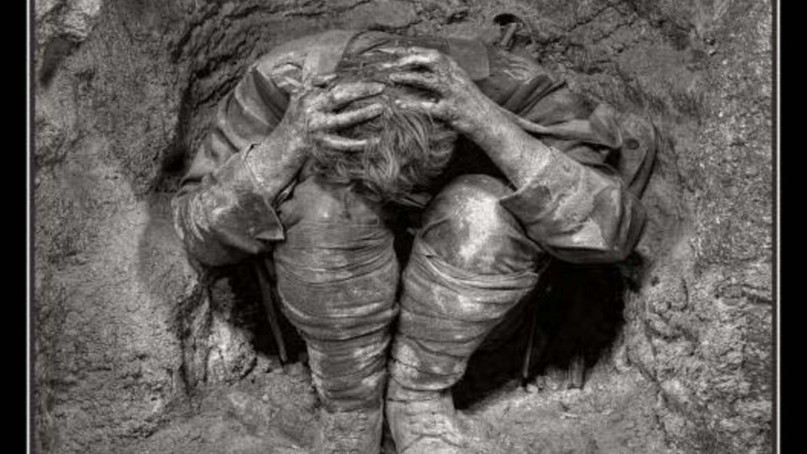
Notes:
For several of the group members, they learned that they had been harboring negative thoughts about themselves after traumatic war experiences of horrific incidents - devoid of a life-span perspective and context. This kept them stuck in their traumatic stress symptoms.

Slide 19
Notes:
However, life-review helped them “connect the dots” between childhood, young adult war experiences, transitioning out of the military, and the years leading up to seeking therapy. The result was that several subjects broke free of their stuck thinking patterns; and no longer defined themselves by their traumatic memories.

Slide 20
Notes:
But see themselves as they truly were (and continue to be): compassionate, caring human beings.
Which is what this is ultimately about: helping older adults acknowledge the good that they’ve done in the world for others. If VN War veterans can shift their regretful thinking toward more productive overall self-evaluation, then you certainly can help your clients do the same.

Slide 21
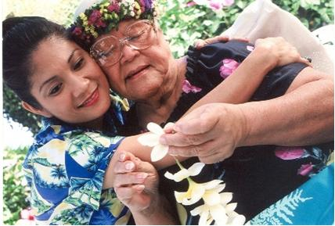
Notes:
I encourage you to learn more about facilitated life-review and to open up opportunities to Talk Story with our kupuna. It doesn’t require special training, is inexpensive to do, can build a very strong rapport with older adults, and It may make a big difference for them toward a healthier aging journey.

