Slide 1
S
E
E
D
S

Slide 2
Day One
Women arrive from prison wearing blue worn out tee shirts, gray over-sized shorts, sometimes that’s all they have
Others carry a black plastic trash bag liner holding the rest of their personal property
They all carry their old memories, experiences, and old “version of normal”

Slide 3
Our population
Over half are domestic violence survivors
Over 80% are mothers
Over 60% have children under 18 years
Over 50% are Native Hawaiian or Pacific Islanders
Almost all are local with families and local ties

Slide 4
Unpacking
Their troubles are often displayed on their faces
For some, they are seasoned and mask their pain
Either way, what they share is their pain

Slide 5
New Normal
SEEDS, a model of brain health developed by Dr. John Arden, provides a framework to help facilitate the creation of a new normal
It offers a simple to understand platform for residents to cultivate and practice healthy living habits

Slide 6
SEEDS
Elements of Brain Health
  S social connectivity
  E education
  E exercise
  D diet
  S sleep

Slide 7
Impact
One year pilot:
93% of residents reported developing healthier lifestyle habits through engaging with SEEDS

Slide 8
Greatest excitement was generated around social connectivity and diet, healthy food, nutrition

Slide 9
Social Connectivity
Positive relationships are the most widely recognized factor in creating and maintaining resilience and a sense of well being.
Contributes to earned secure attachment, a sense that the world and people are safe.
Contradicts the isolation of interpersonal trauma
Contributes to post traumatic growth

Slide 10
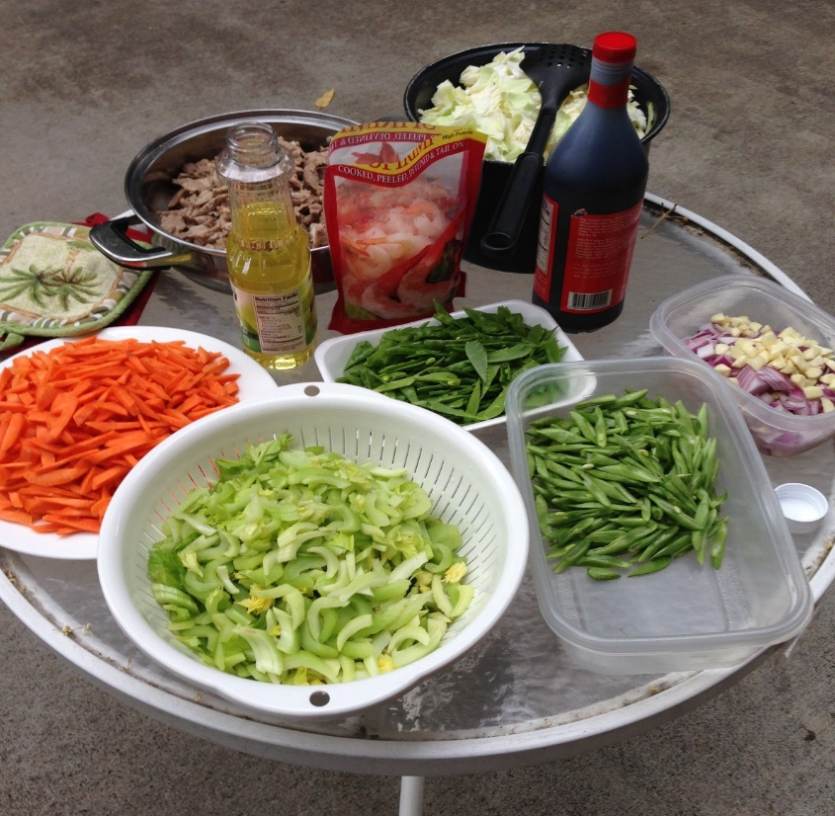
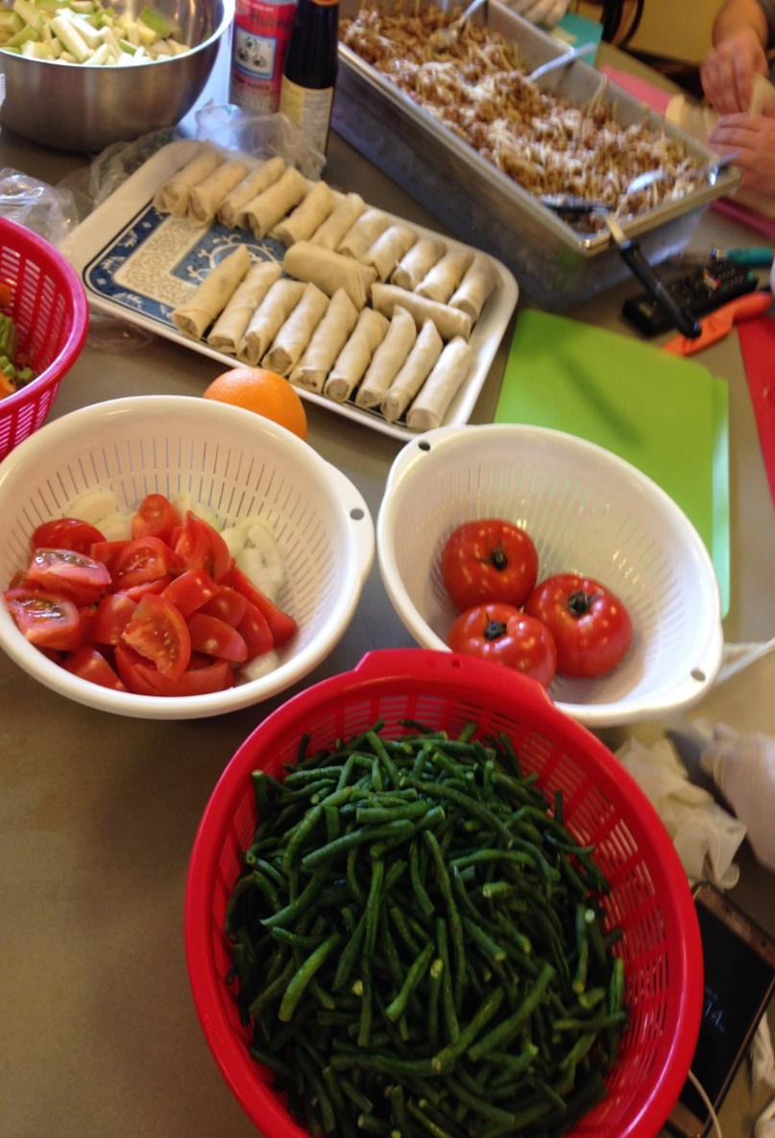
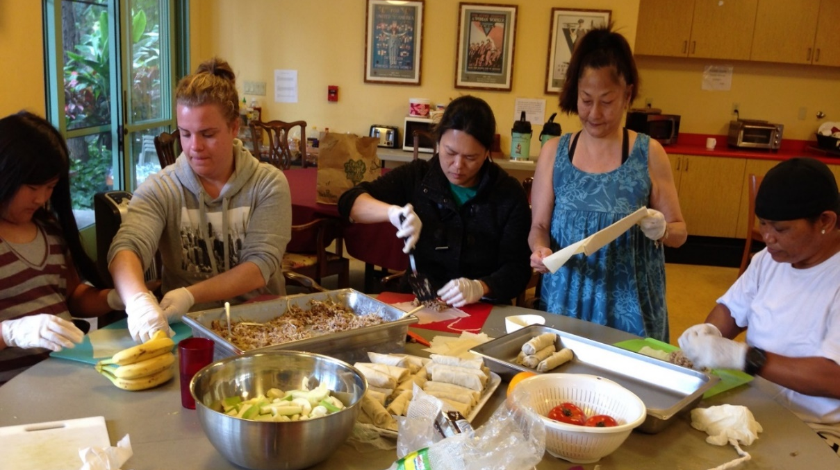
Cooking with Friends

Slide 11
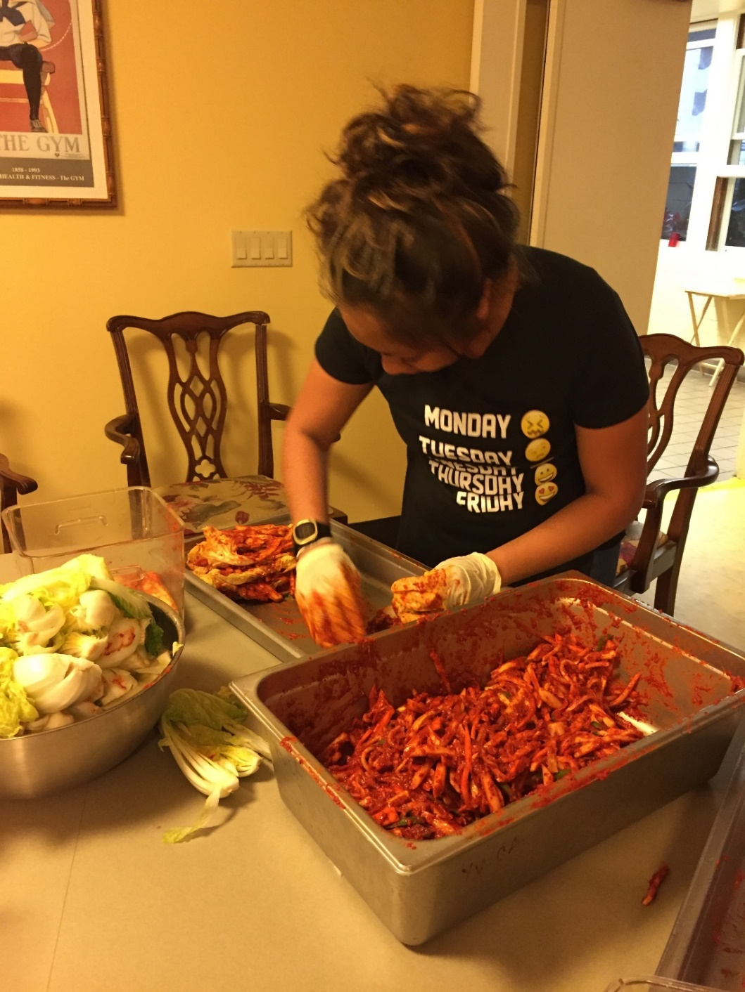
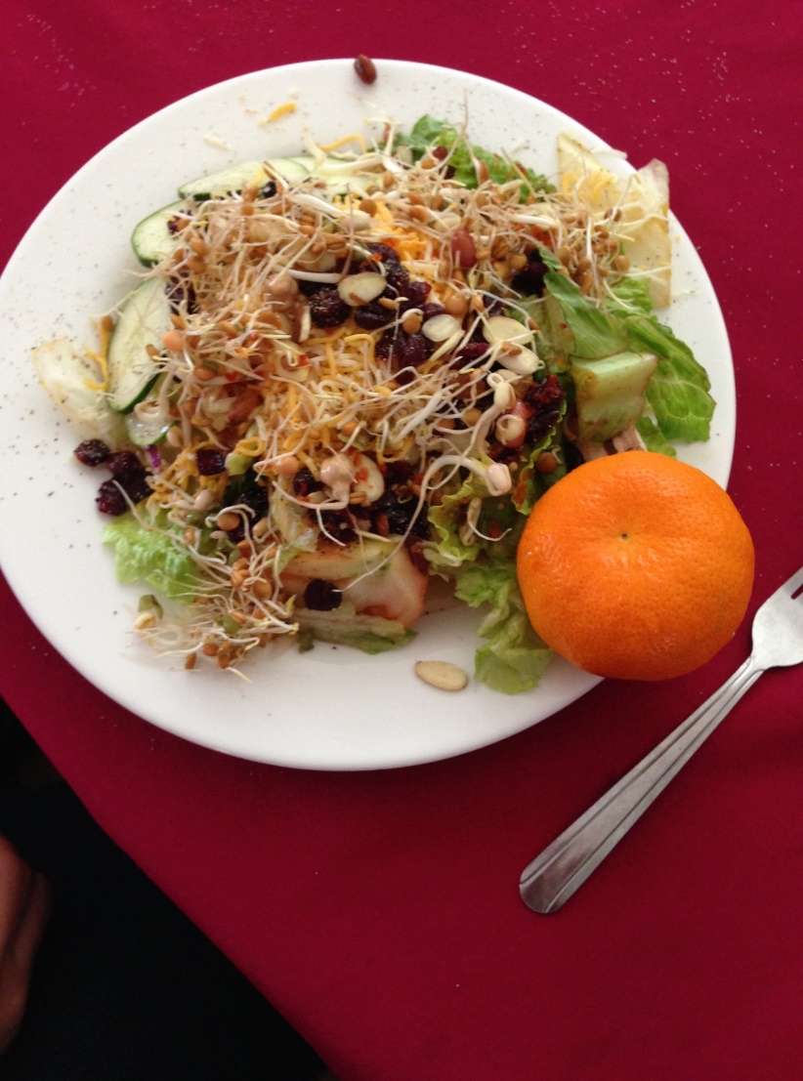
Cook and Learn

Slide 12
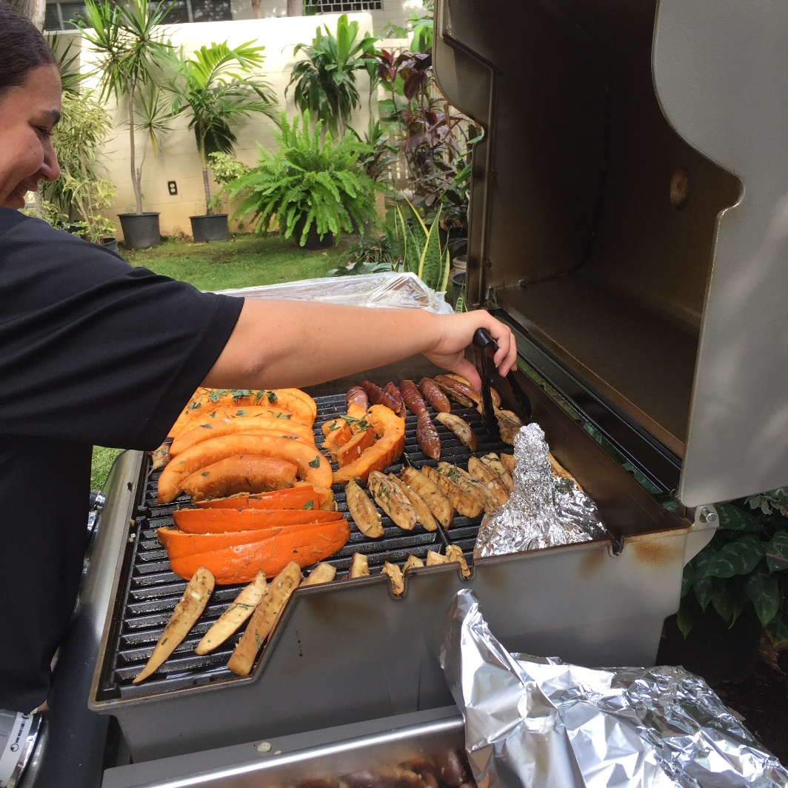
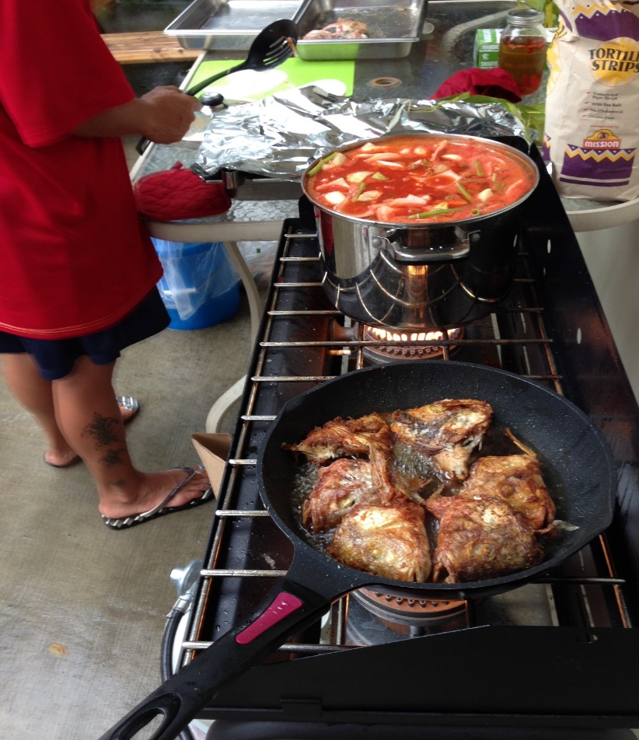
Melanie and Al

Slide 13
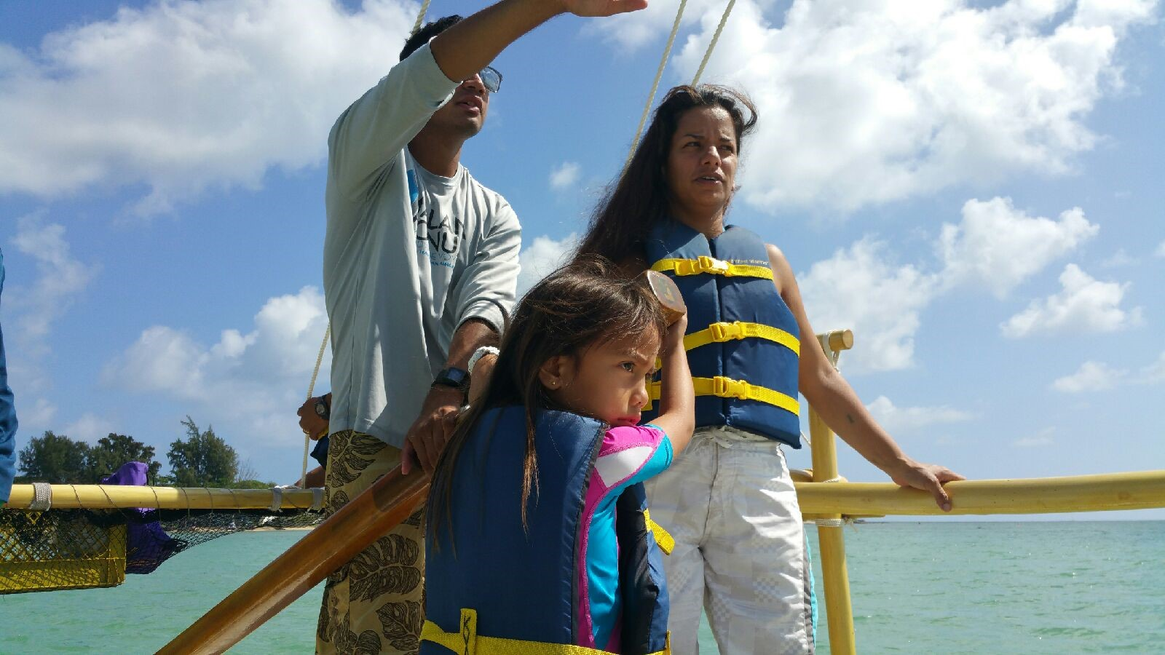
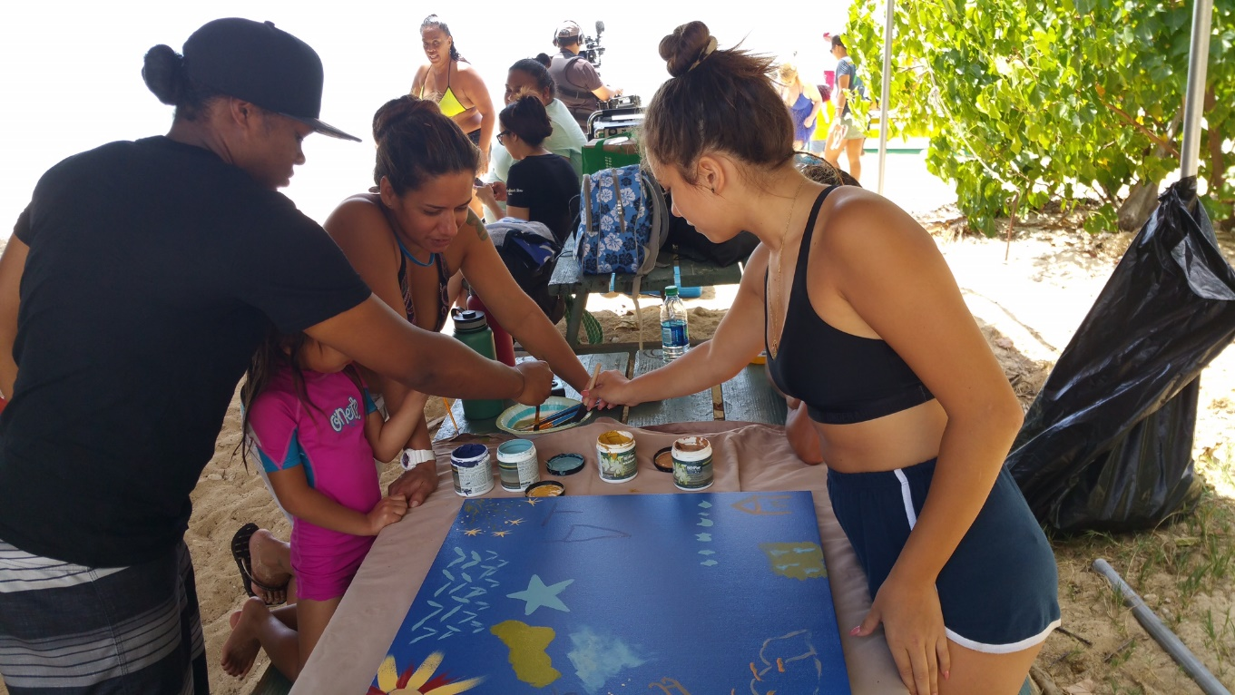
Connecting
with
Family

Slide 14
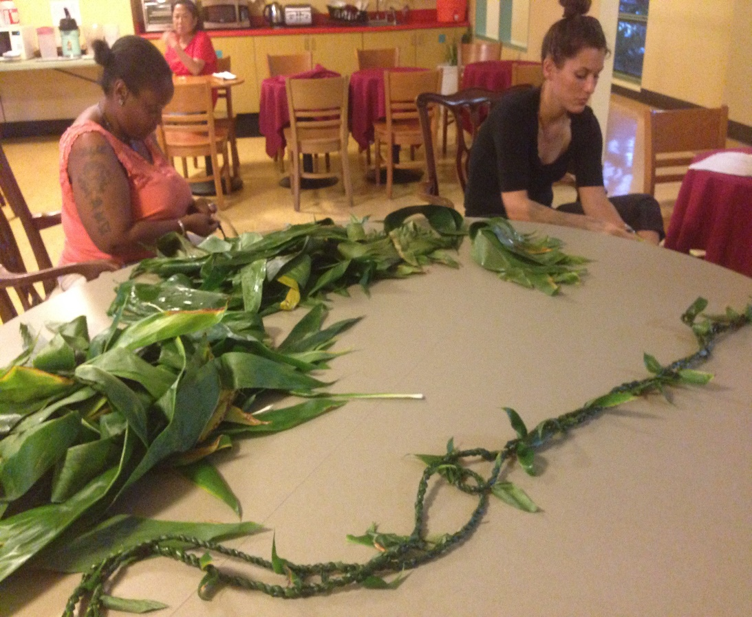
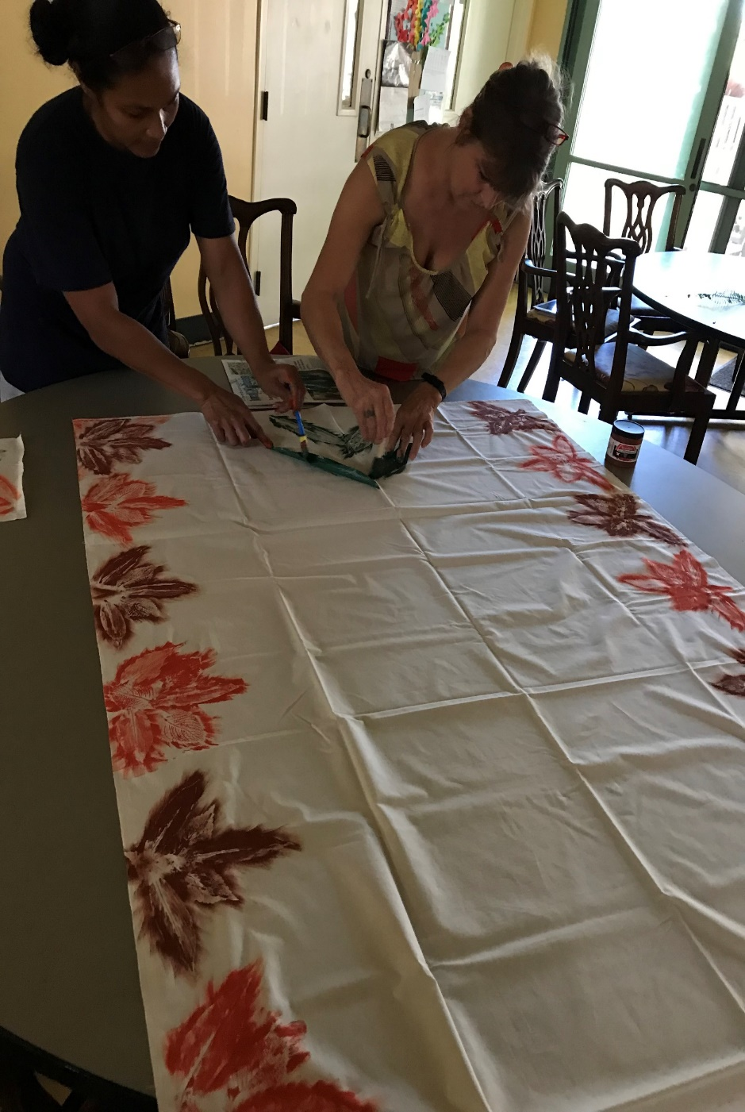
Hale o Hina Culture
Gift Giving

Slide 15
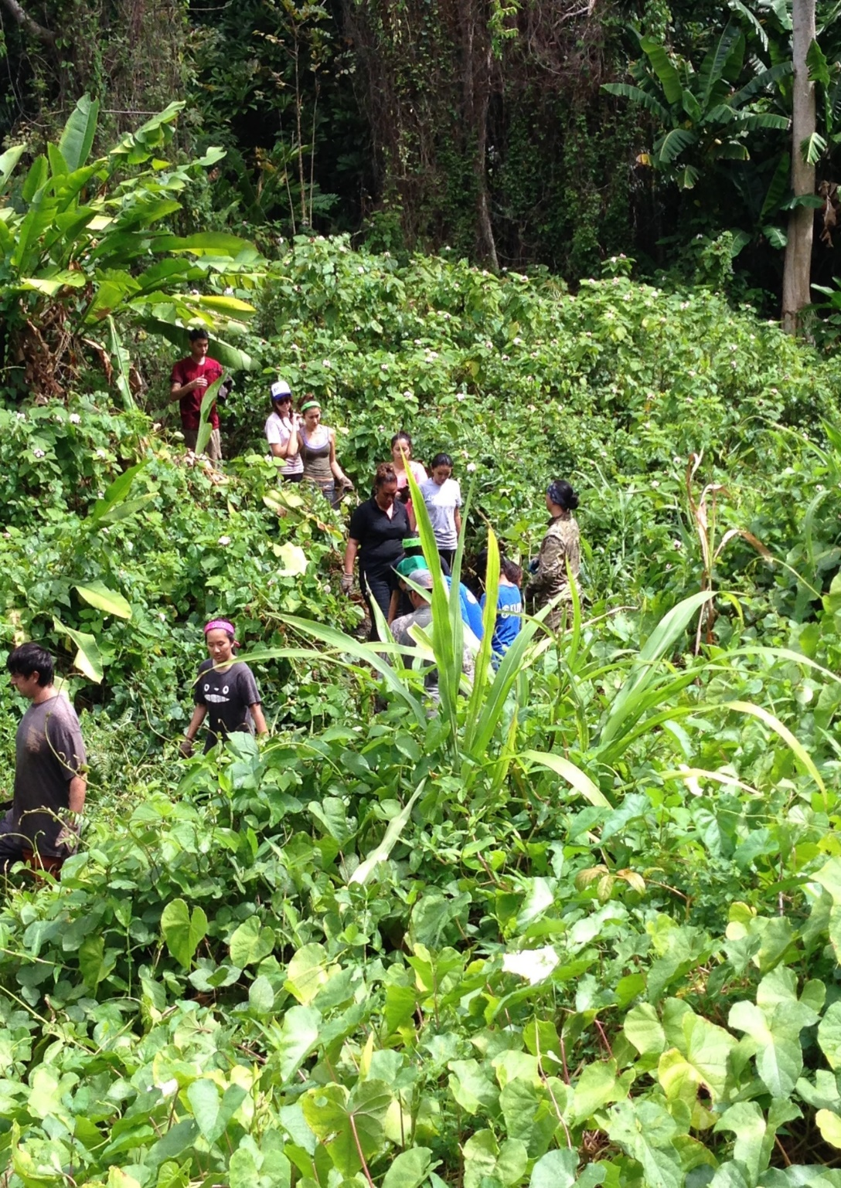
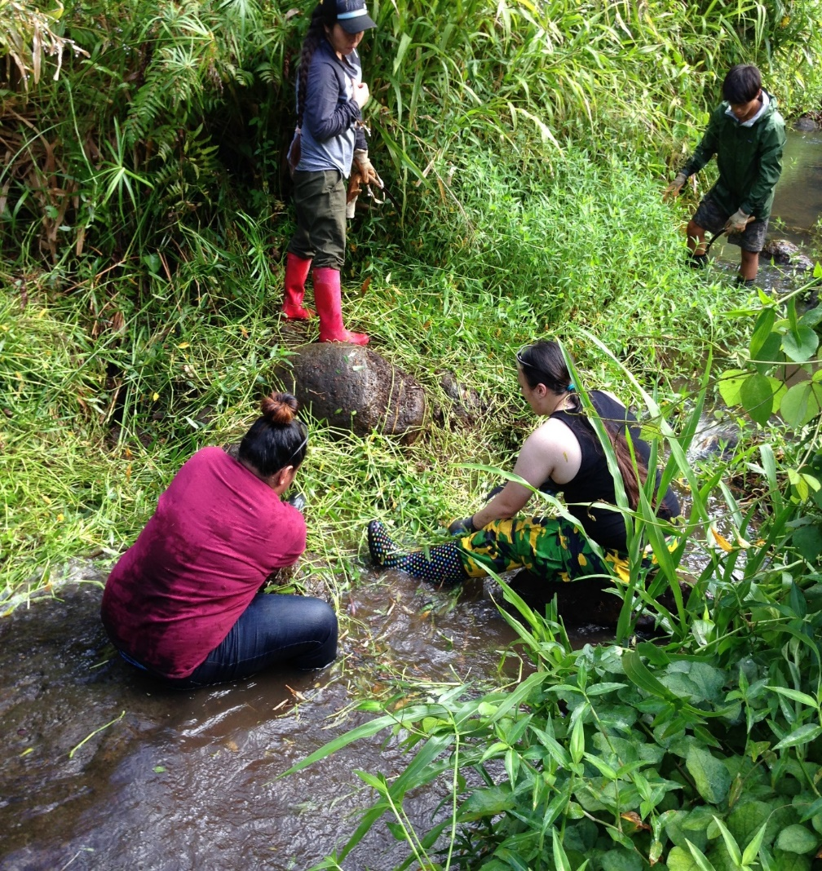
Ahupua`a

Slide 16
Ko`olaupoko

Slide 17
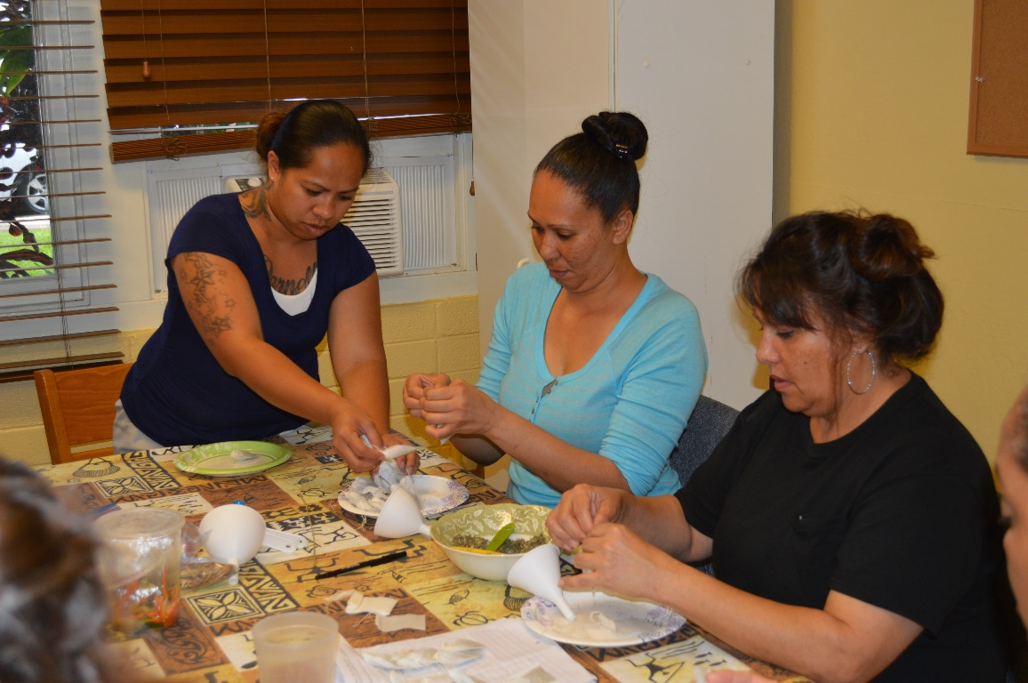
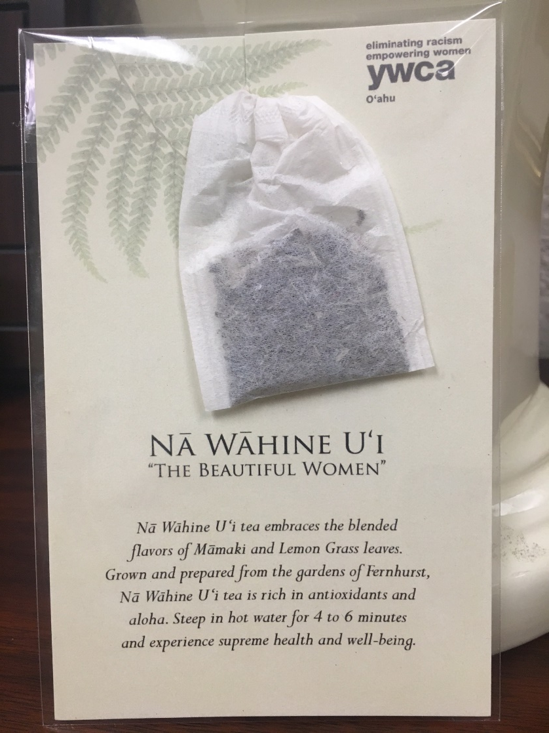
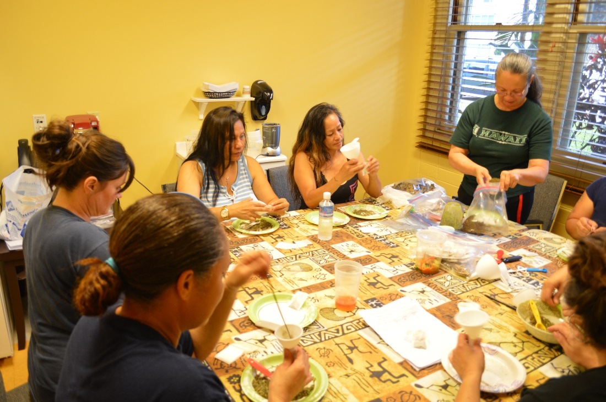
Video
Na Wahine `Ui
https://youtu.be/cUuUMl5cWiM

Slide 18
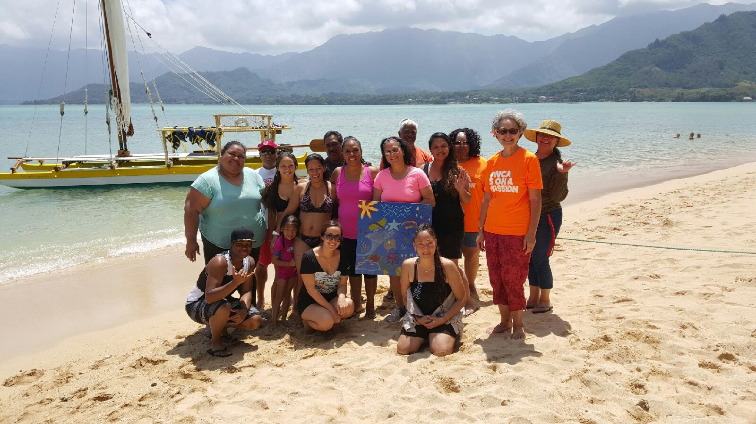

Mahalo for Supporting our Efforts!
Cooke Foundation, Ltd.
Consuelo Alger Foundation
First Presbyterian – G.I.F.T.
G.N. Wilcox Trust
Harris United Methodist Church
HMSA Foundation
H.T. Hayashi Foundation
Office of Hawaiian Affairs
Queen Liliukalani Trust
Rotary Club of Honolulu
Rotary Club of Honolulu Sunset
Waikiki Health Center
Women’s Fund of Hawaii

Slide 19
Additional SEEDS Info/data
Planning, Development, Results

Slide 20
Planning and Development
Collaborative planning with women was built in
They helped shape the entire initiative
Developed a leadership positon, resident leaders orient new women
Incorporated check-ins with case managers during bi-monthly follow ups
Developed a simple survey tool to collect data
Used Dedoose, multi media platform designed by social scientists to review and analyze data
Received guidance from consultant/evaluator

Slide 21
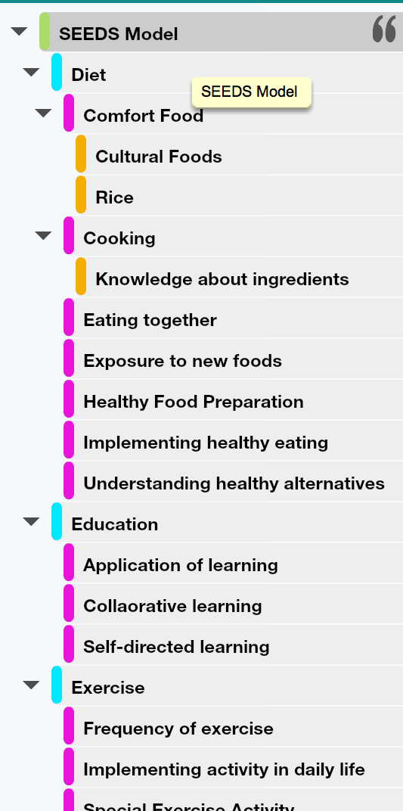
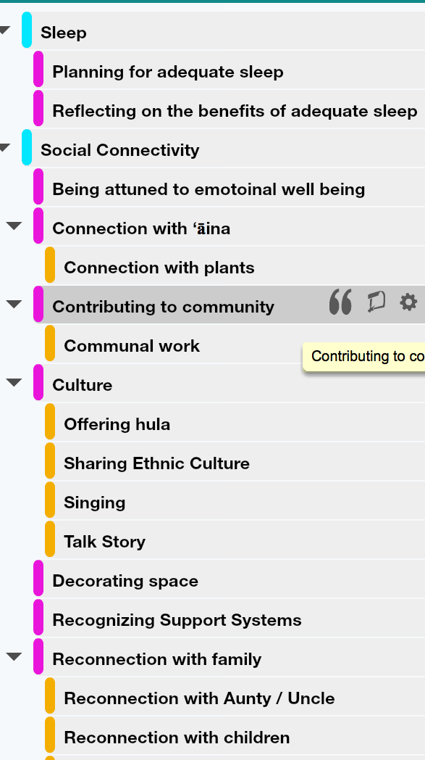
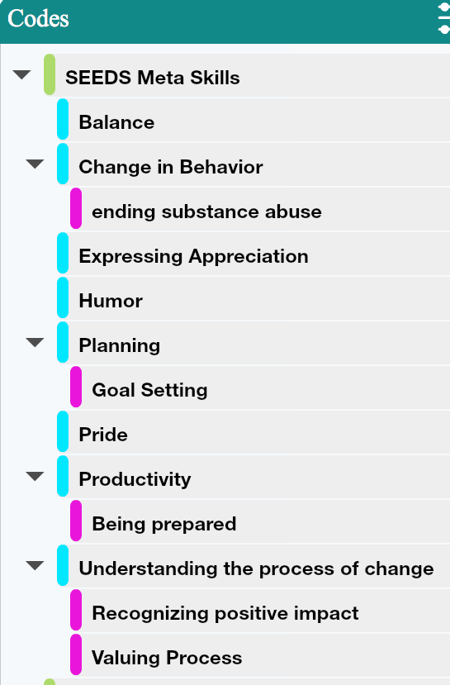
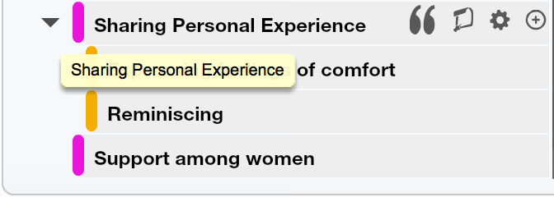
Results
Robust findings
Meta skills emerged
Themes, sub- themes, and categories arose.

Slide 22

