Slide 1
Joining Sustainability and Practice
Learning from reflection and example

Slide 2
Statistics

Slide 3
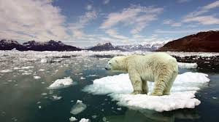
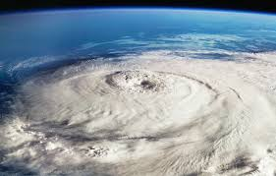
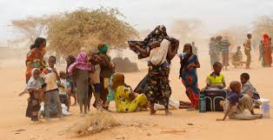
Images

Slide 4
Predictions
If emissions follow business-as-usual, there is a 93% chance that global warming
Will exceed 4 degrees Celsius at the turn of the century
Tens of millions of people will be forced to leave their homes in
The next decade because of climate change – creating the
World’s biggest refugee crisis ever.
Without significant changes in methods, Midwestern and southern states
Could see declines in crop yield by as much as 10% in 20 years.

Slide 5
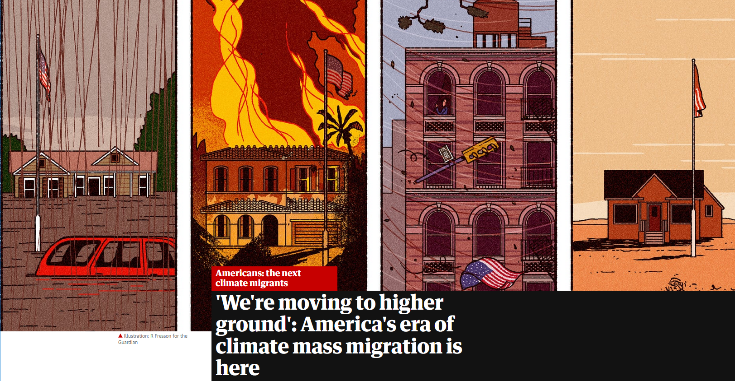
Stories

Slide 6
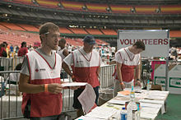
Response?

Slide 8
Culture and Worldview
Culture
Artifacts – things observable
Espoused values – consciously recognized as right/wrong
Basic assumptions (worldviews) hold about nature of reality
All aspects of culture in a society are outward expressions of those worldviews
Current state of planet effects our individual and collective behavior guided by those worldviews
Change needed requires dramatic change in culture at worldview level
Notes:
All aspects of culture that constitute a given society are outward expressions of those internally held worldviews. The current state of the planet can be attributed to the effects of our individual and collective patterns of behavior as guided by our fundamental worldviews. The change that is necessary to turn the tide against the trends of degradation will require a dramatic change in culture at the level of worldview. Systems theory – this is a big lever of change.

Slide 9
Reflection on Your Worldview
Connectedness to Nature Scale (shortened) | Strongly Strongly Disagree Neutral Agree
I often feel a sense of oneness with the natural world around me | 1 | 2 | 3 | 4 | 5
I recognize and appreciate the intelligence of other living organisms | 1 | 2 | 3 | 4 | 5
I often feel disconnected from nature | 1 | 2 | 3 | 4 | 5
I often feel a kinship with animals and plants | 1 | 2 | 3 | 4 | 5
I feel as though I belong to the Earth as equally as it belongs to me | 1 | 2 | 3 | 4 | 5
When I think of my place on Earth, I consider myself to be a top member of a hierarchy that exists in nature | 1 | 2 | 3 | 4 | 5
My personal welfare is independent of the welfare of the natural world | 1 | 2 | 3 | 4 | 5
I have a deep understanding of how my actions affect the natural world | 1 | 2 | 3 | 4 | 5

Slide 10
Reflection on Your Worldview
Relationship between humans and nature
How would you describe nature and how would you describe the boundary between humans and nature
What is the role of nature in human wellness/unwellness?
What were the messages you have received that informed these beliefs?

Slide 11
Comparing Worldviews
Dominant Worldview
Indigenous Worldview
Growth is good
Land can be owned by people
Nature exists as an expanse of resources to be applied for human purposes
Humans are at the top of the evolutionary ladder
Take only what you need with gratitude
The land is sacred
Humans are part of the environment
Ancestors are present
Cognitive baseline for considering what is appropriate/inappropriate course of action

Slide 12
Profession of Social Work
Our origin stories began at same time as growth economies took off – our profession is deeply influenced by that culture
Questions
What aspects of the worldview of the profession are in concert with sustainability and what are potential barriers?
What would social work practice that incorporates sustainability look like? Are any of you practicing in this way?
What would a social work job that truly marries wellbeing of planet and people look like?

Slide 13
Action?

