Slide 1
Community Voices: An Organizational Best Practice
2018 NASW Hawaii Conference
Ke Ola Mau Loa I Ka Moananui: Advancing Wellbeing in the Pacific
Queen’s Conference Center |Honolulu, HI
October 4-5, 2018

Slide 2
Papa Ola Lōkahi: Our Mo‘olelo
E Ola Mau, The Native Hawaiian Health Needs Assessment:
Three key findings
Native Hawaiian Health Care Act (PL100-579)
reauth: Native Hawaiian Health Care Improvement Act (PL 102-396)
Raise the health status of Native Hawaiians to the highest possible level
How does POL accomplish its kuleana?

Slide 3
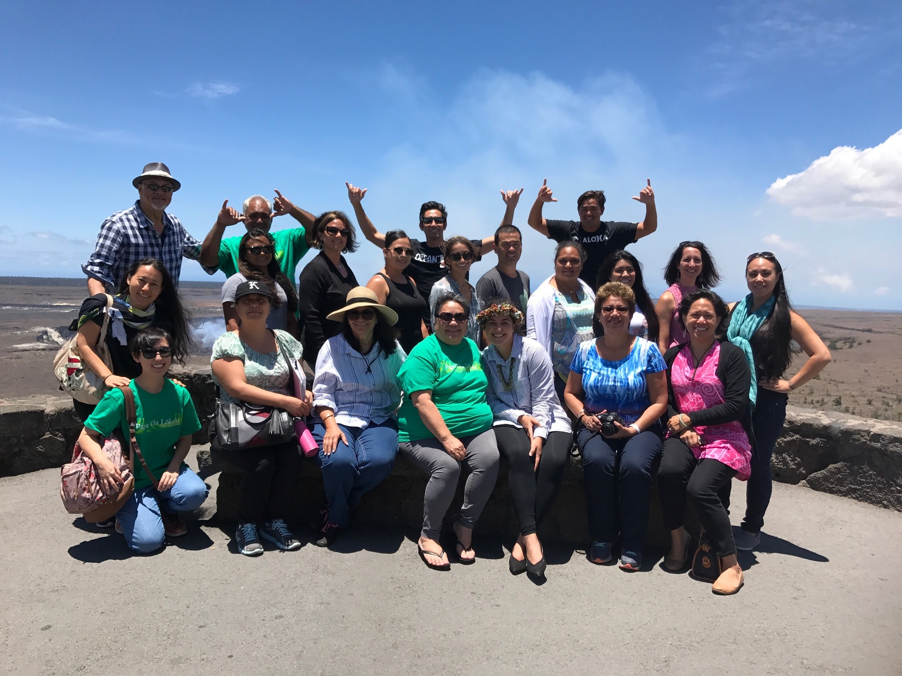
Native Hawaiian Health Scholarship Program
Guidelines adopted from the National Health Service Corps
Successful advocacy/policy initiatives
Key program accomplishments:
26 years, 270 + scholarships, $24+million
178 completed service obligations
167 remain employed in their discipline
Kuleana of Kanaka Maoli health professionals?
Huaka‘i 2017, Hawai‘i Island
Native Hawaiian Health Scholarship Program
Notes:
-26 years, 270+ scholarships, $24+ million
-178 completed service obligation
-167 remain employed in their discipline

Slide 4
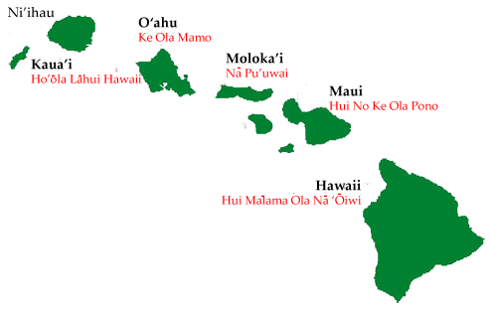
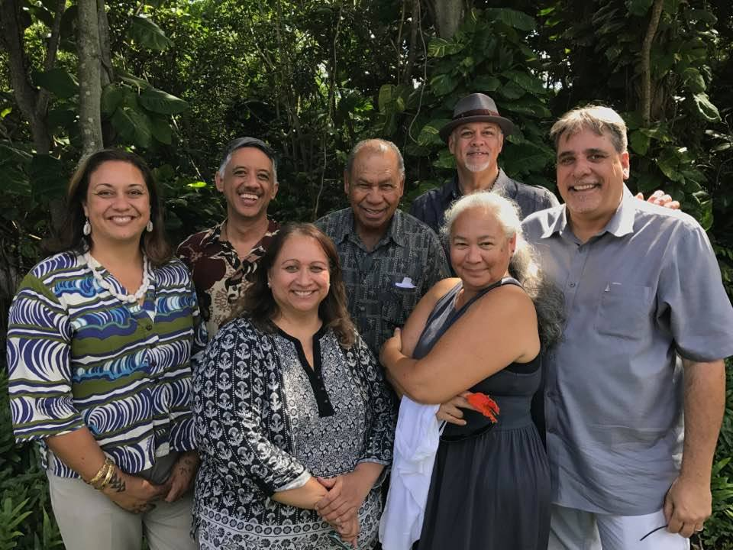
Native Hawaiian Health Care Systems
Healthy ‘ohana → healthy haumāna
5 systems, servicing 7 islands
Overview of services/programs*:
- Medical - Dental/Oral
- Behavioral Health - Traditional Healing
- Adult Day Care - Wellness/Fitness
- Pharmacy - Outreach/Enabling/Enrollment
- Transportation - Simply Healthy Café
Executive Directors, Kaua‘i 2017

Slide 5
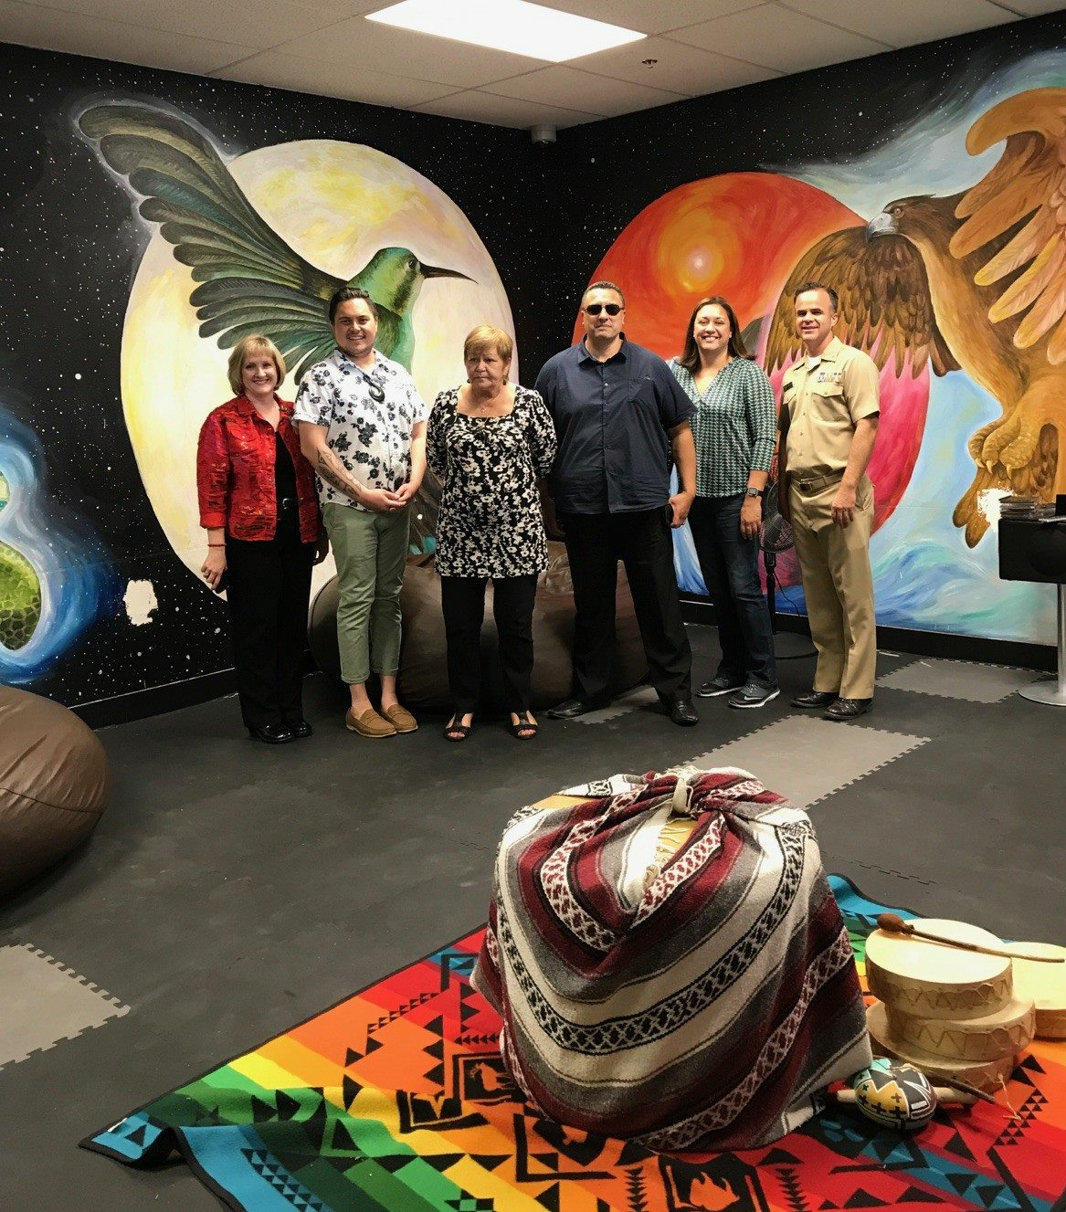
Papa Ola Lōkahi: Continuous Advocacy
All levels of government: Federal / State / County / Neighborhood:
Advocacy on behalf of NH health, well-being
Participation in working groups/task forces
Outreach and engagement with other systems to address:
Education
Housing
Economic stability
Food security etc.
Presence at local, national and international conferences/gatherings
Sheri Daniels, POL ED
Indigenous Peoples Conference, Arizona 2017

Slide 6
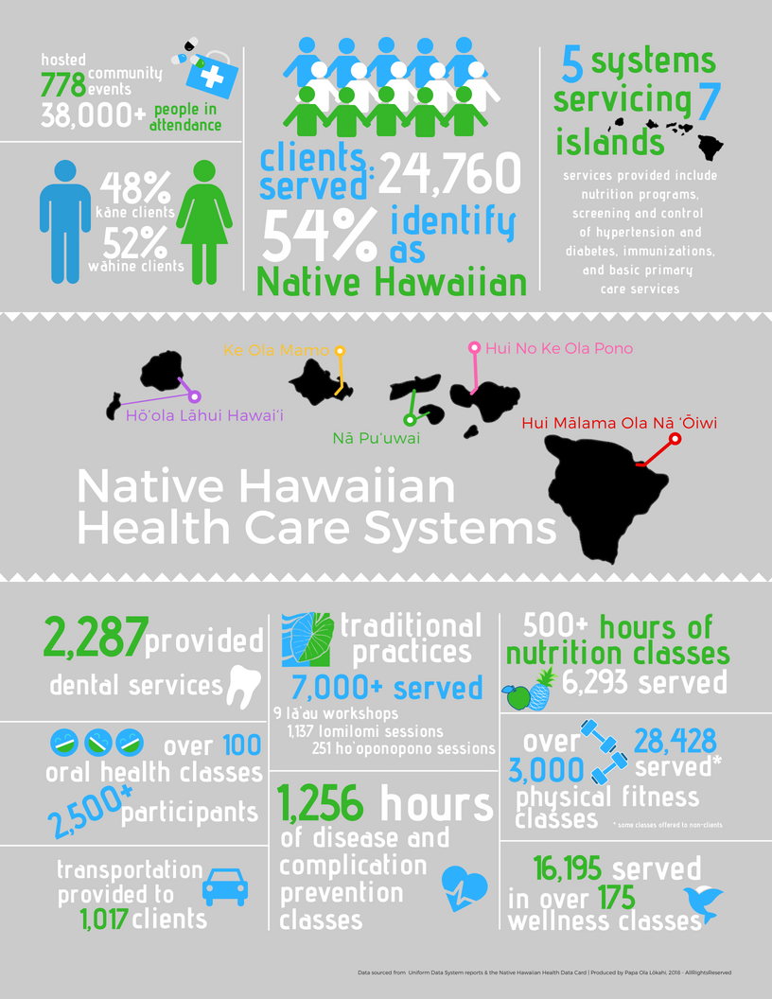

Slide 7
Community Voices: Background
The Community Voices project was a response to Papa Ola Lōkahi’s Pulse Survey that surveyed the health needs of our Native Hawaiian communities.
Community members, state-wide were interested in the availability and accessibility of Native Hawaiian healing practices.

Slide 8
Purpose: Community Insight
Collecting data from our communities to help drive the conversations with policy makers and researchers

Slide 9
Objectives
Design a survey to capture the knowledge capacity of Native Hawaiian practices to ensure health and wellbeing
Validate community needs regarding Native Hawaiian health practices
Measure level of confidence in practices and assess areas to educate

Slide 10
Steps to Community Insight
Develop a survey tool based on what is already known within your agency
Use a maximum of 16 questions with room for comments
Keep it anonymous
Collect demographic data: gender, native y/n, age, zip code
Use simple language
Have hard copy (paper/pen) and electronic forms (website, email, iPad, text messages)
Attend events that already exist and are gathering places for your communities

Slide 11
Notes:
Example of Survey in Survey Monkey.

Slide 12
Notes:
Example of an email for the email blasts.

Slide 13
Email Survey Collection
We are conducting a survey of community members to understand their involvement and confidence in Hawaiian Healing Practices.
The survey takes all of two minutes and we have included the online version for your review and email dissemination.
If there are events that we can attend to share the survey we will bring all the materials.
https://www.surveymonkey.com/r/QHMB8VB

Slide 14
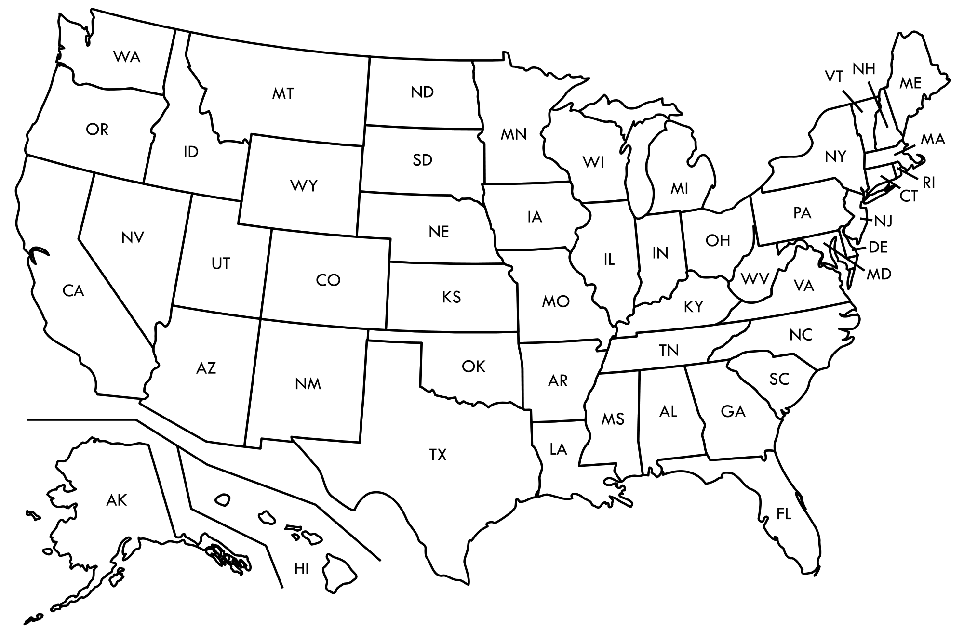
Community Event Collection Points

Slide 15
Total Responses
We collected a total of 1056 responses.
Notes:
(Star) We collected a total of 1056 surveys. (N=1056)

Slide 16
Beginning Date | Ending Date | Description of Event | Location | Staff
Saturday, July 15, 2017 | Sunday, July 16, 2017 | California Civic Club(s) Hoʻolauleʻa | Alondra Park, CA | Emily and Sheri
Thursday, August 24, 2017 | Thursday, August 24, 2017 | I Ola No Emmalani | Honolulu, Oahu | Emily
Tuesday, September 5, 2017 | Tuesday, September 5, 2017 | I Ola No Emmalani | Honolulu, Oahu | Emily and Trina
Saturday, September 9, 2017 | Sunday, September 10, 2017 | LV Civic Club Hoʻolauleʻa | Las Vegas, NV | Emily and Alohi
Saturday, September 16, 2017 | Saturday, September 16, 2017 | Family Gathering | Keaukaha, Hawaii | Alohi
Saturday, September 30, 2017 | Saturday, September 30, 2017 | Lanai Aloha Festival | Lanai City, Lanai | Emily, Alohi, Trina
Saturday, September 30, 2017 | Saturday, September 30, 2017 | I Ola No Emmalani | Honolulu, Oahu | Trina
Sunday, October 1, 2017 | Sunday, October 1, 2017 | Children and Youth Day | Honolulu, Oahu | Trina
Thursday, October 5, 2017 | Thursday, October 5, 2017 | I Ola No Emmalani | Honolulu, Oahu | Emily and Trina
Monday, October 9, 2017 | Wednesday, October 11, 2017 | CNHA Convention | Honolulu, Oahu | POL Staff
Friday, October 13, 2017 | Friday, October 13, 2017 | Children and Youth Summit | Honolulu, Oahu | Trina
Tuesday, October 31, 2017 | Friday, November 3, 2017 | AHCC Convention | Seattle, WA | POL Staff
Thursday, November 16, 2017 | Thursday, November 16, 2017 | Survey Input | Honolulu, Oahu | Trina
Friday, November 17, 2017 | Friday, November 17, 2017 | Emailed; Texting Surveys | Honolulu, Oahu | Trina
Tuesday, November 28, 2017 | Tuesday, November 28, 2017 | HNKOP Lomi Open House | Wailuku, Maui | Alohi
Friday, December 8, 2017 | Saturday, December 9, 2017 | HNKOP Maui Outreach | Wailuku, Maui | Emily and Trina

Slide 17
Native Hawaiian Responses
78% of total responses were Native Hawaiian.
Notes:
(Star) 78% of the total surveys collected were completed by Native Hawaiians.

Slide 18
Hawaii and the Continent
We collected a total of 1056 responses.
83% of responses were from islands Hawaii & 17% from continent.
78% of total responses were Native Hawaiian.
Notes:
(Star) Of the 824 Native Hawaiian responses 83% were from the islands of Hawaii and 17% were from the continent.

Slide 19
Learnings Along the Way
Setting a goal for how many surveys to collect
Requires at minimum two staff (it took all of our staff assisting at one point or another)
Technology can be sporadic in remote areas always have a back up (pen/paper/clip boards)
This process takes time (8 hours = collecting 2 surveys)

Slide 20
Influence of Community Voices
Data from CV showed us that NHs were interested in learning more about traditional healing practices.
CV data has assisted POL in its advocacy to members of congress outside of the Hawai‘i delegation in addition to other influential community members.
Conversations that occurred during 1st round, led to 2nd survey regarding enabling services.

Slide 21
Nā Nīnau/Manaʻo Questions or Comments?

