Slide 1
NASW Hawaii Conference
October 4, 2018
Queenʻs Conference Center e
Ke Ola Mau Loa I Ka Moananui Advancing Wellbeing in the Pacific
Hoʻopono:
An Adaptive Intervention of Hoʻoponopono to Empower Children and Families

Slide 2
E Hō Mai…E Hoʻomalu Kākou
E hō mai ka ʻike mai luna mai e
  Grant us the knowledge from above
O nā mea huna noʻeau no nā mele e
  Concerning the hidden wisdom of songs
E hō mai, E hō mai, E hō mai
Grant Us, Grant Us, Grant Us
Aunty Edith Kanakaʻole
Notes:
oli is commonly used at the start of an event or small gathering to focus a groupʻs energies and ultimately carry out the kuleana (responsibility) they have undertaken. It is recommended that haumana (students) use this chant to help them seek knowledge and clear their minds of any negativity.

Slide 3
E Hoʻokamaʻaina kākou
E Hō Mai
E Hoʻomalu Kākou
Moʻokuauhau ʻOhana
Moʻokuauhau Hoʻoponopono
Moʻokuauhau Hoʻopono
Notes:
Hoʻoponopono is a spiritual and cultural practice passed through generations by our beloved ancestors who now sleep beyond the thin veil that separates them from us.

Slide 4
E Nā Kamalei Lupalupa:
Thriving Hawaiian Children
We believe in the resiliency of Hawaiian children.
We advocate for their wellbeing and build them pathways to thriving lives.

Slide 5
Liliʻuokalani Trust: Practice Framework
A Cultural Perspective
Lawe I ka maʻalea a kūʻonoʻono. Take wisdom and make it deep.
Culturally Resonant
Child-Focused, Family Centered, Community Based
Holistic Wellbeing: Pua Liliʻu
Trauma Informed
Ecosystem Approach

Slide 6
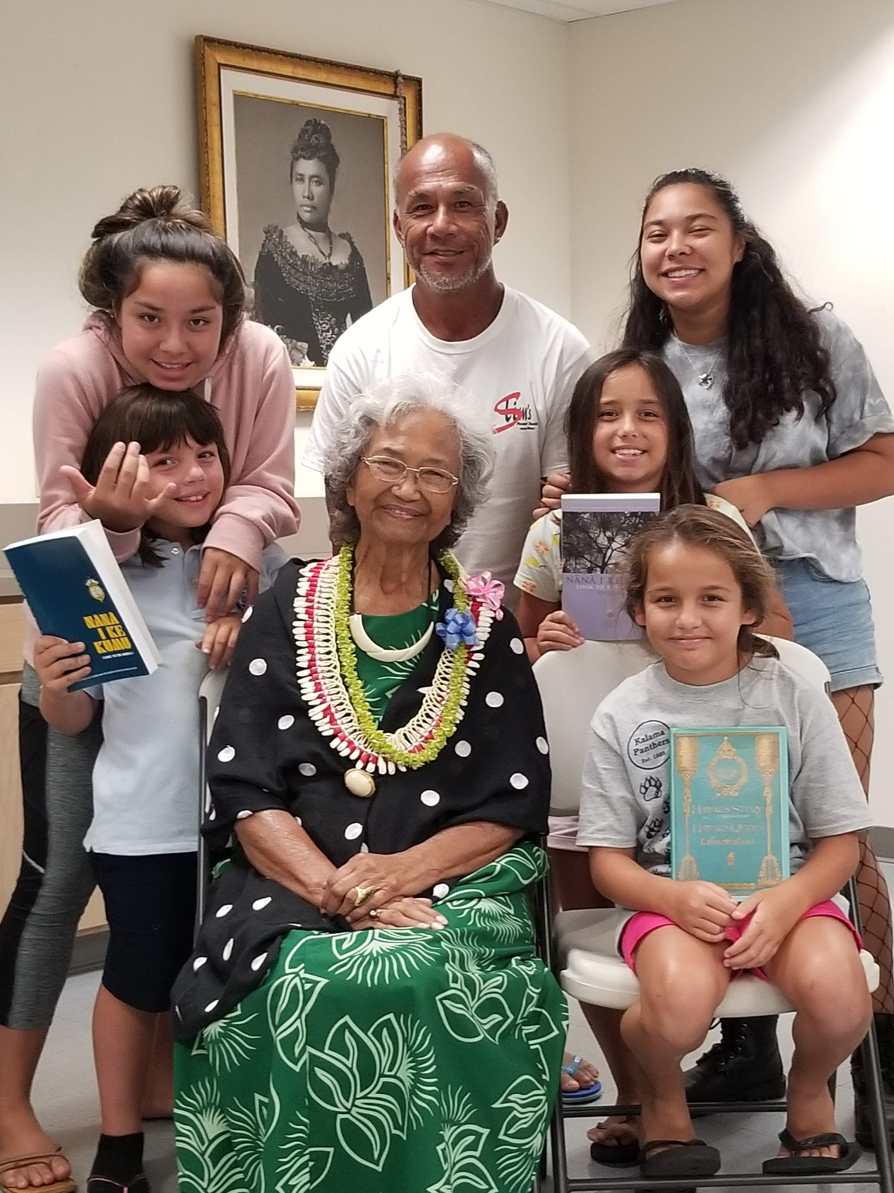
Family Strengthening Model
Research affirm family is the most crucial influencer in a childs life
Our work is most effective when working in the context of the family
Most effective to help individuals in families gain skills:
  Interact positively with other members & collectively grow in their own identities
  Families need opportunities to interact with each other in positive ways and “practice” their skills
Family cohesion is a matter of constantly:
  Refining individual skills
  Practicing skills with each other
  Finding opportunities to be successful together

Slide 7
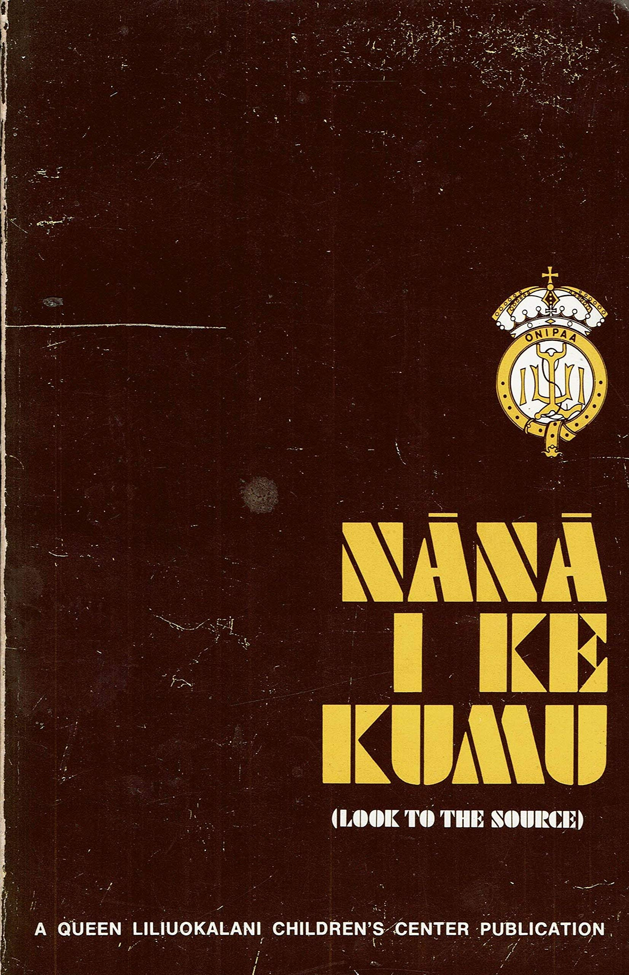
Cultural Practices: Promote Wellbeing
Hoʻoponopono
Setting to right; to make right; to correct; to restore and maintain good relationships among family, and family and supernatural powers. The specific family conference in which relationships were ”set right” through prayer, discussion, confession, repentance and mutual restitution and forgiveness.
Culturally Relevant
Efficient & Effective Practice to nurture lokahi (harmony)
Facilitates resolve amongst & conflict resolution

Slide 8
Hoʻopono: Kaʻaiʻai Paglinawan & Matuʻu Pulotu
Hoʻopono empowers families to solve issues and maintain harmony within the family by using an adapted, traditional practice for modern times.
Outcomes are focused on developing healthy communication, increasing positive coping skills while decreasing negative coping skills, identifying strengths individually and as ʻohana, and learning a Hawaiian/spiritual practice

Slide 9
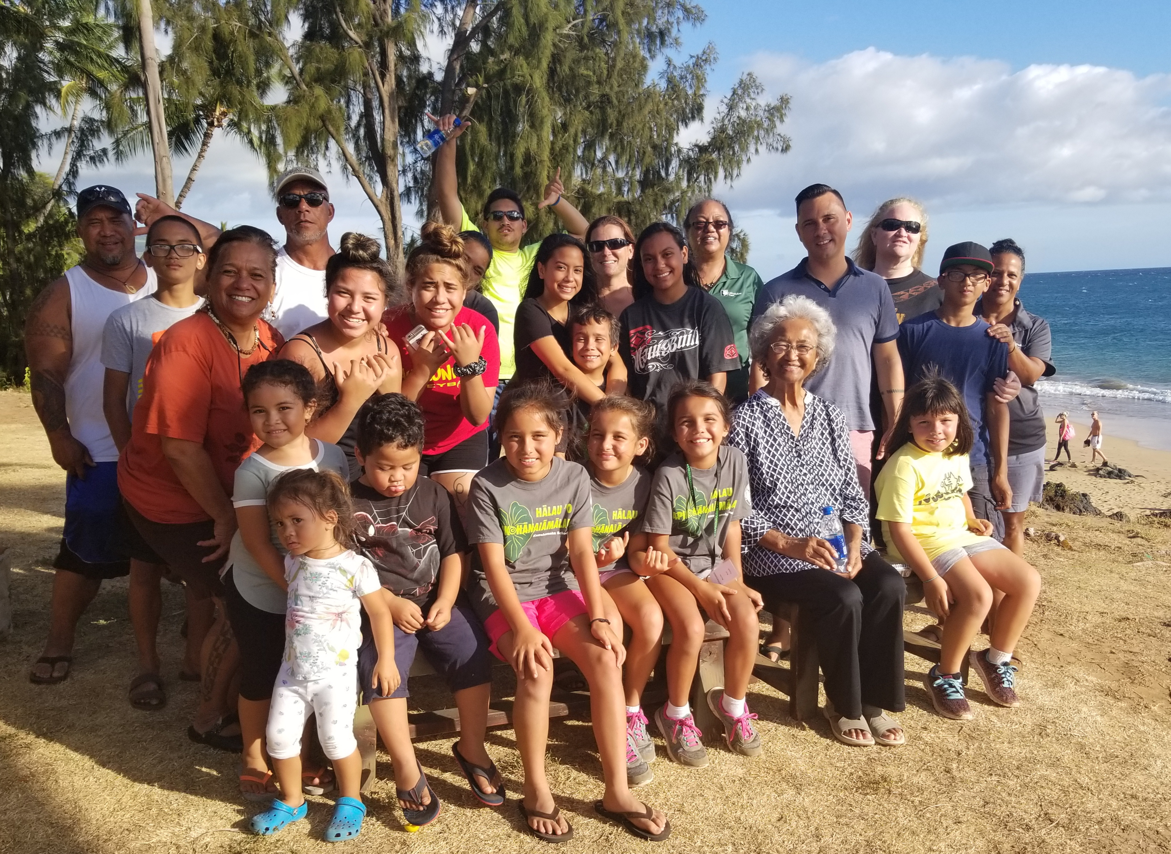
Hoʻopono = Family Strengthening
Consonant with family strengthening & culturally competency literature
  Grounded in Native Hawaiian values
  Tailored & attentive to individual family needs
  Intentional & immersive experiences (ma ka hana ka ʻike)
  Empower Families: Restoring & Reconnecting families to Hawaiian cultural values & practices
  ʻOhana Sustainable
  Cohort (pilina, ʻohana support & collective sense of belonging)

Slide 10
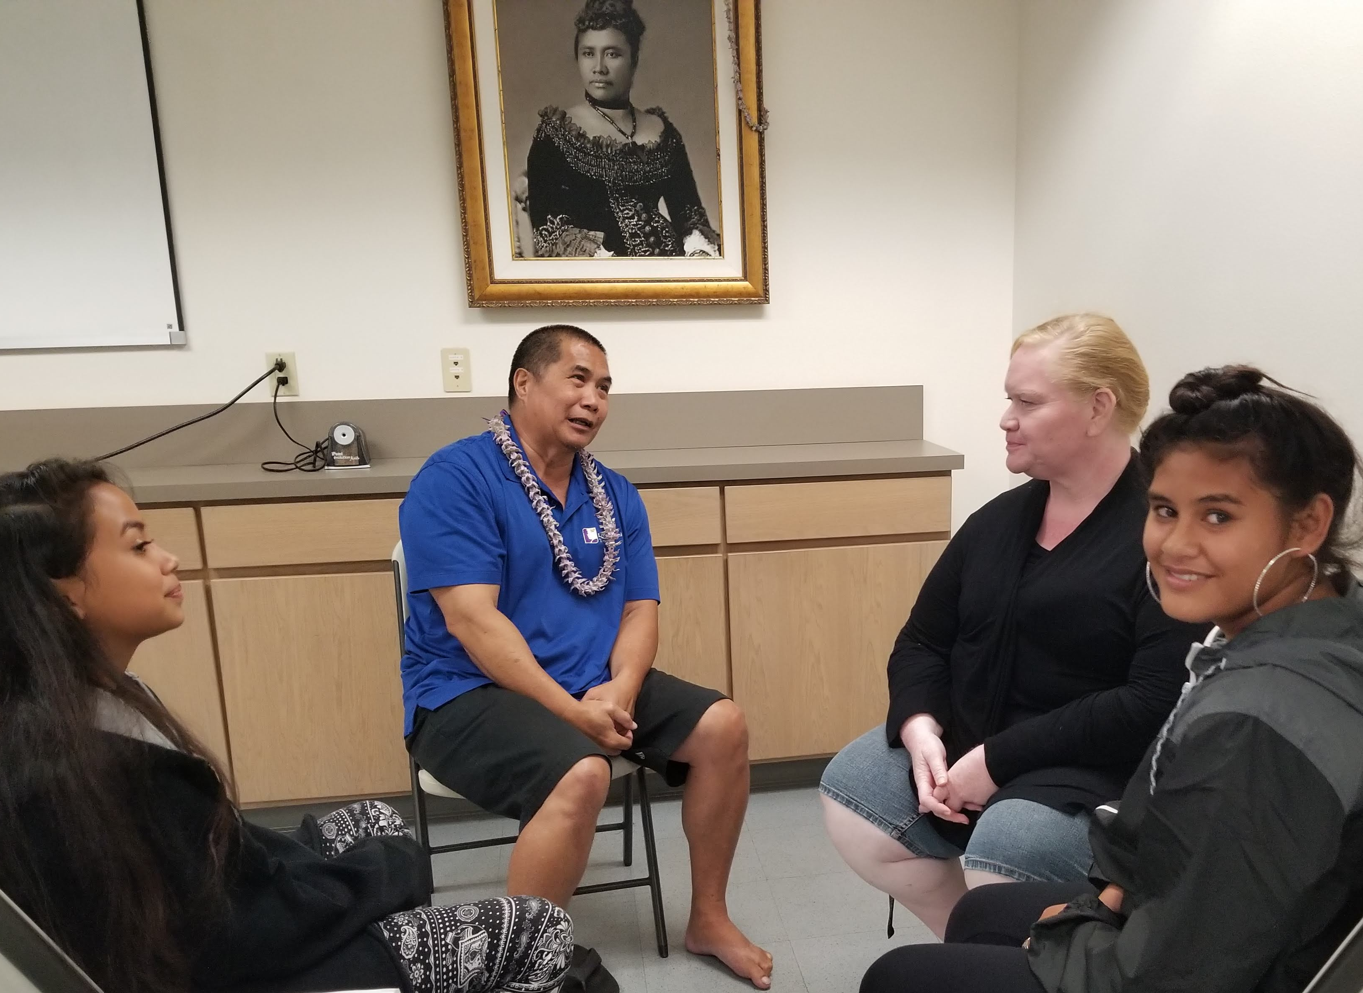
Hoʻopono ʻOhana Recruitment
Commitment to Hoʻopono
  Attendance & participation
Open & willingness to learn & change
Capacity & interest in self-awareness
Aptitude for spirituality: belief in a higher power
Trusting relationship between worker & ʻohana
Notes:
Maui & Hale ʻAha

Slide 11
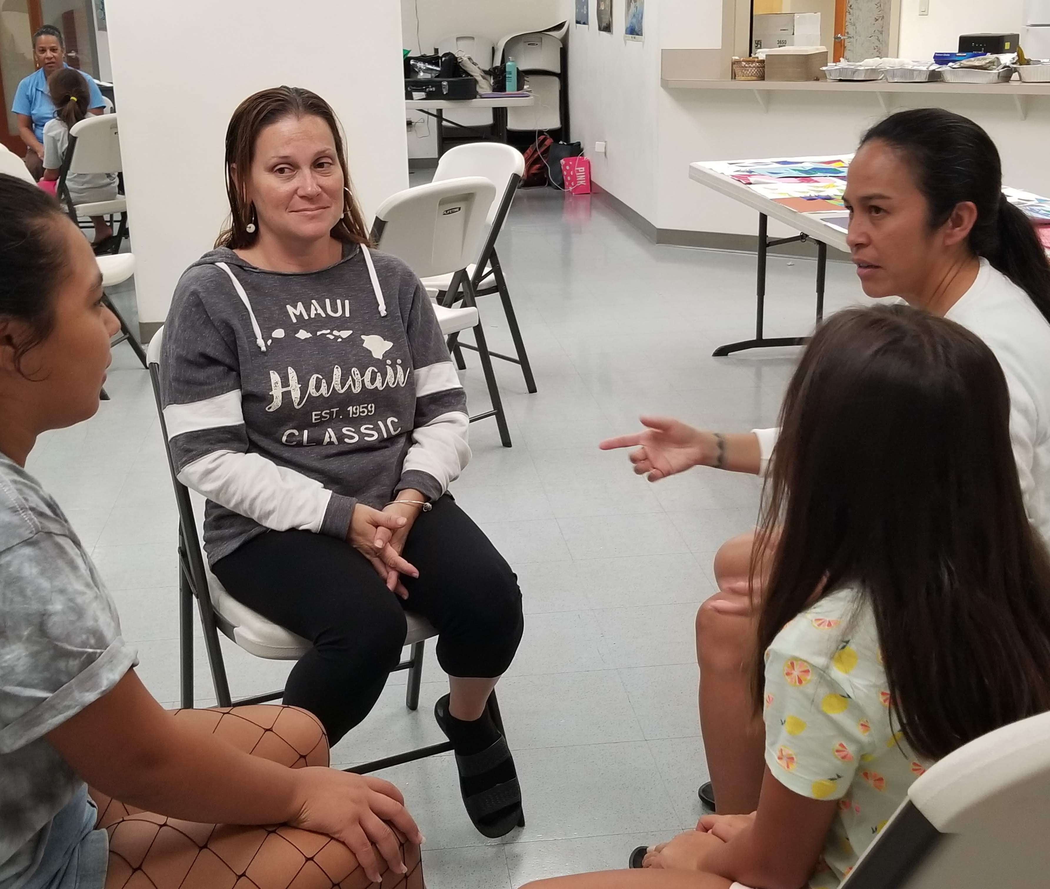
Essential Attitudes & Procedure
Hoʻopono with true intentions
Participation comes from naʻau/sincere
ʻOiaʻio (genuineness)
Haʻahaʻa (humility)
No secrets
One issue at at time
Communication directed to poʻo
Talk about issue, not act it out
Speak with ALOHA for understanding
Pule: value spirituality, sets the tone, establishes ʻohana agreement to the presence of a greater power

Slide 12
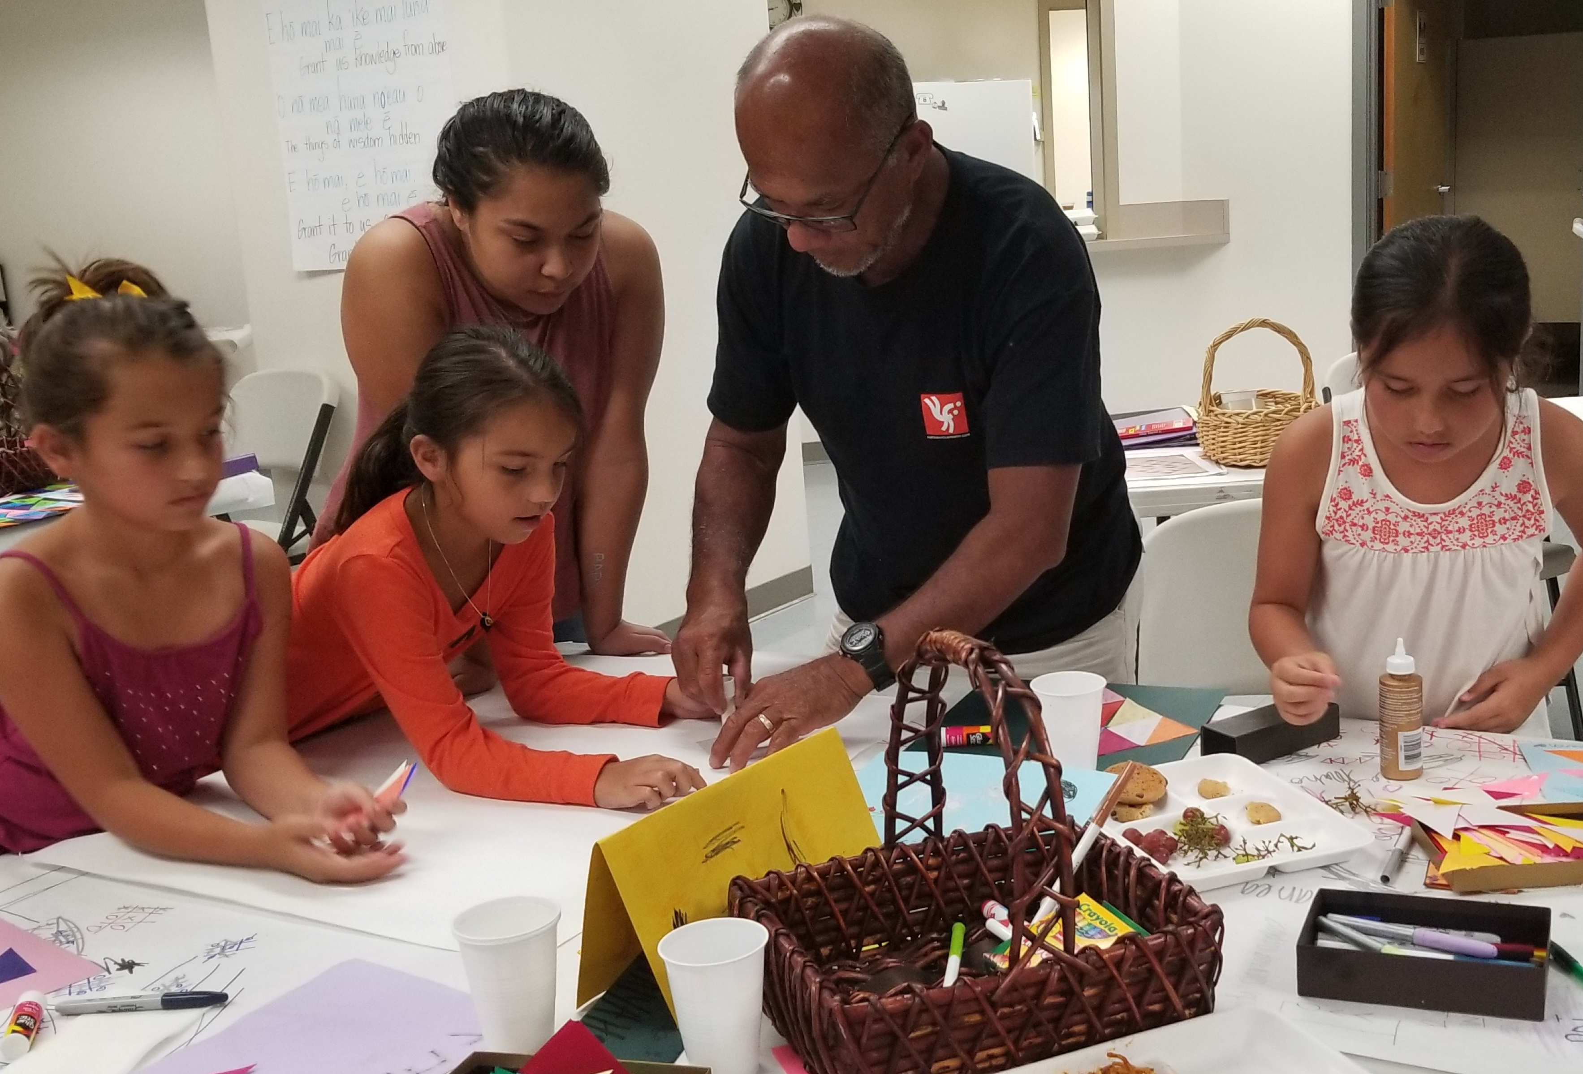
Intervention that empower children & families
Activities rooted in foundational principals of Hoʻoponopono
offer hopeful experiences families grow from.
ʻOhana are invigorated & inspired by the use of a culturally relevant, efficient and effective practice.

Slide 13
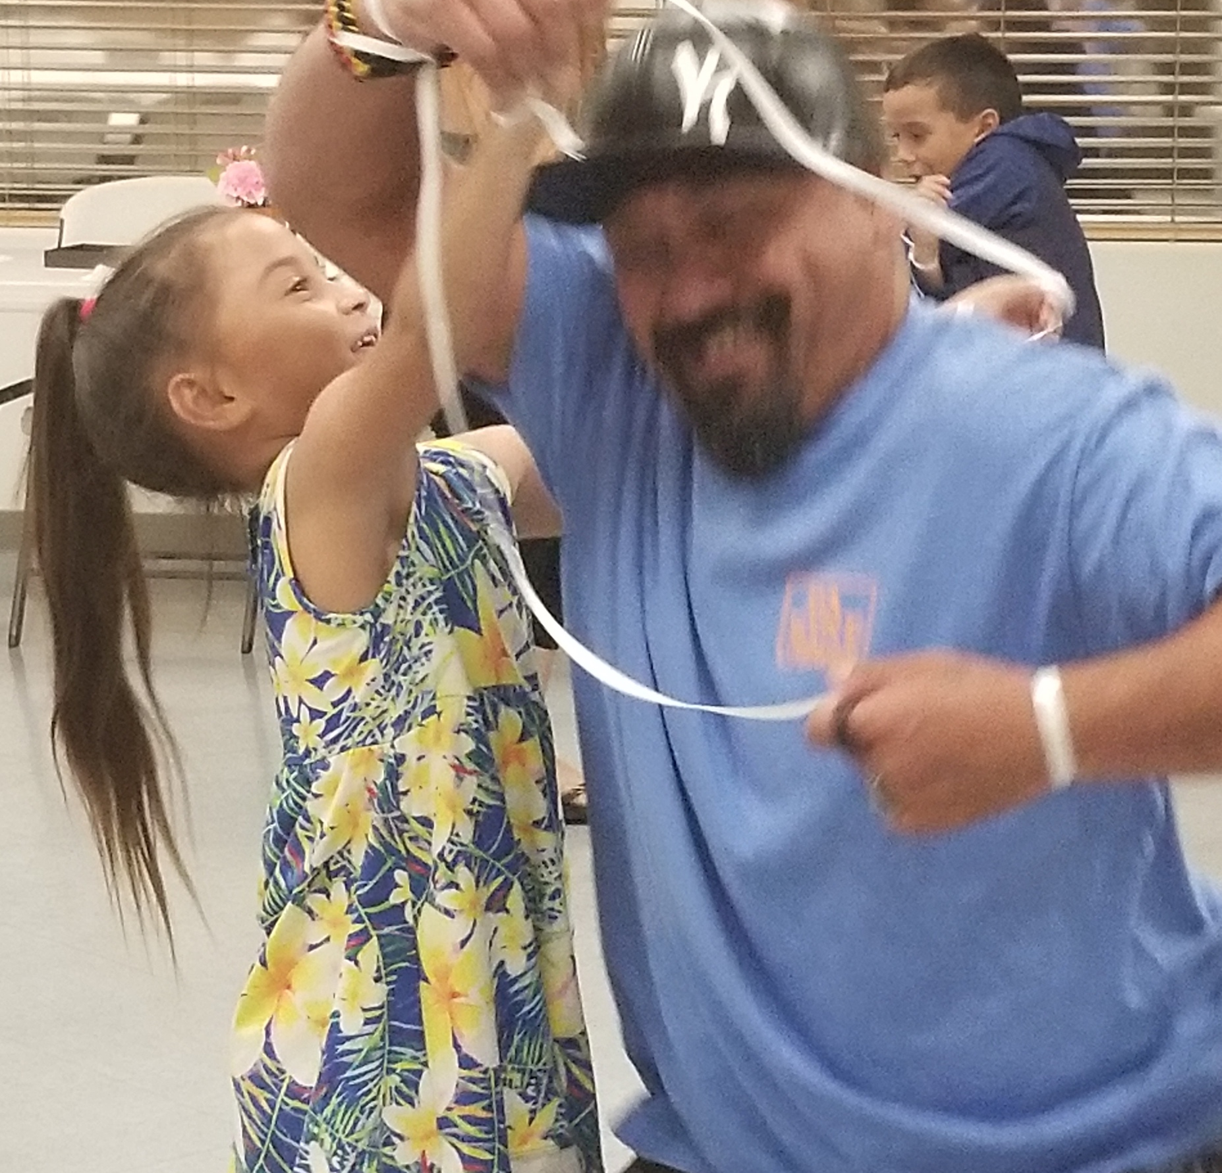
Hoʻopono Experiences
Pule
Moʻokuauhau: Kuʻu Inoa
Pua Liliʻu
Lokahi: Personal & ʻOhana Triangle Activity
Pono Triangle
Plate of Life: Stressors Activity
Nā moʻolelo, Huakaʻi, Queen Liliʻuokalani
Balloons Afloat
Kū & Hina
Communication: Hawaiian Games
Knots of rope (hala & hihia)
Hoʻoponopono: mihi (apology) kala (forgiveness) & ʻoki (release)
Hoʻoponopono Video
Role Play & Hoʻopono Practice

Slide 14
Hoʻopono: Hawaiian Worldview
Pono
Notes:
Hawaiian values are nebulous for our families. Hoʻopono causes to make these concepts explicit and tangible through experiences that allow ʻohana members to feel, understand, and know what these values are in relation and connection to ways that are Hawaiian….oftentimes, universally understood.

Slide 15
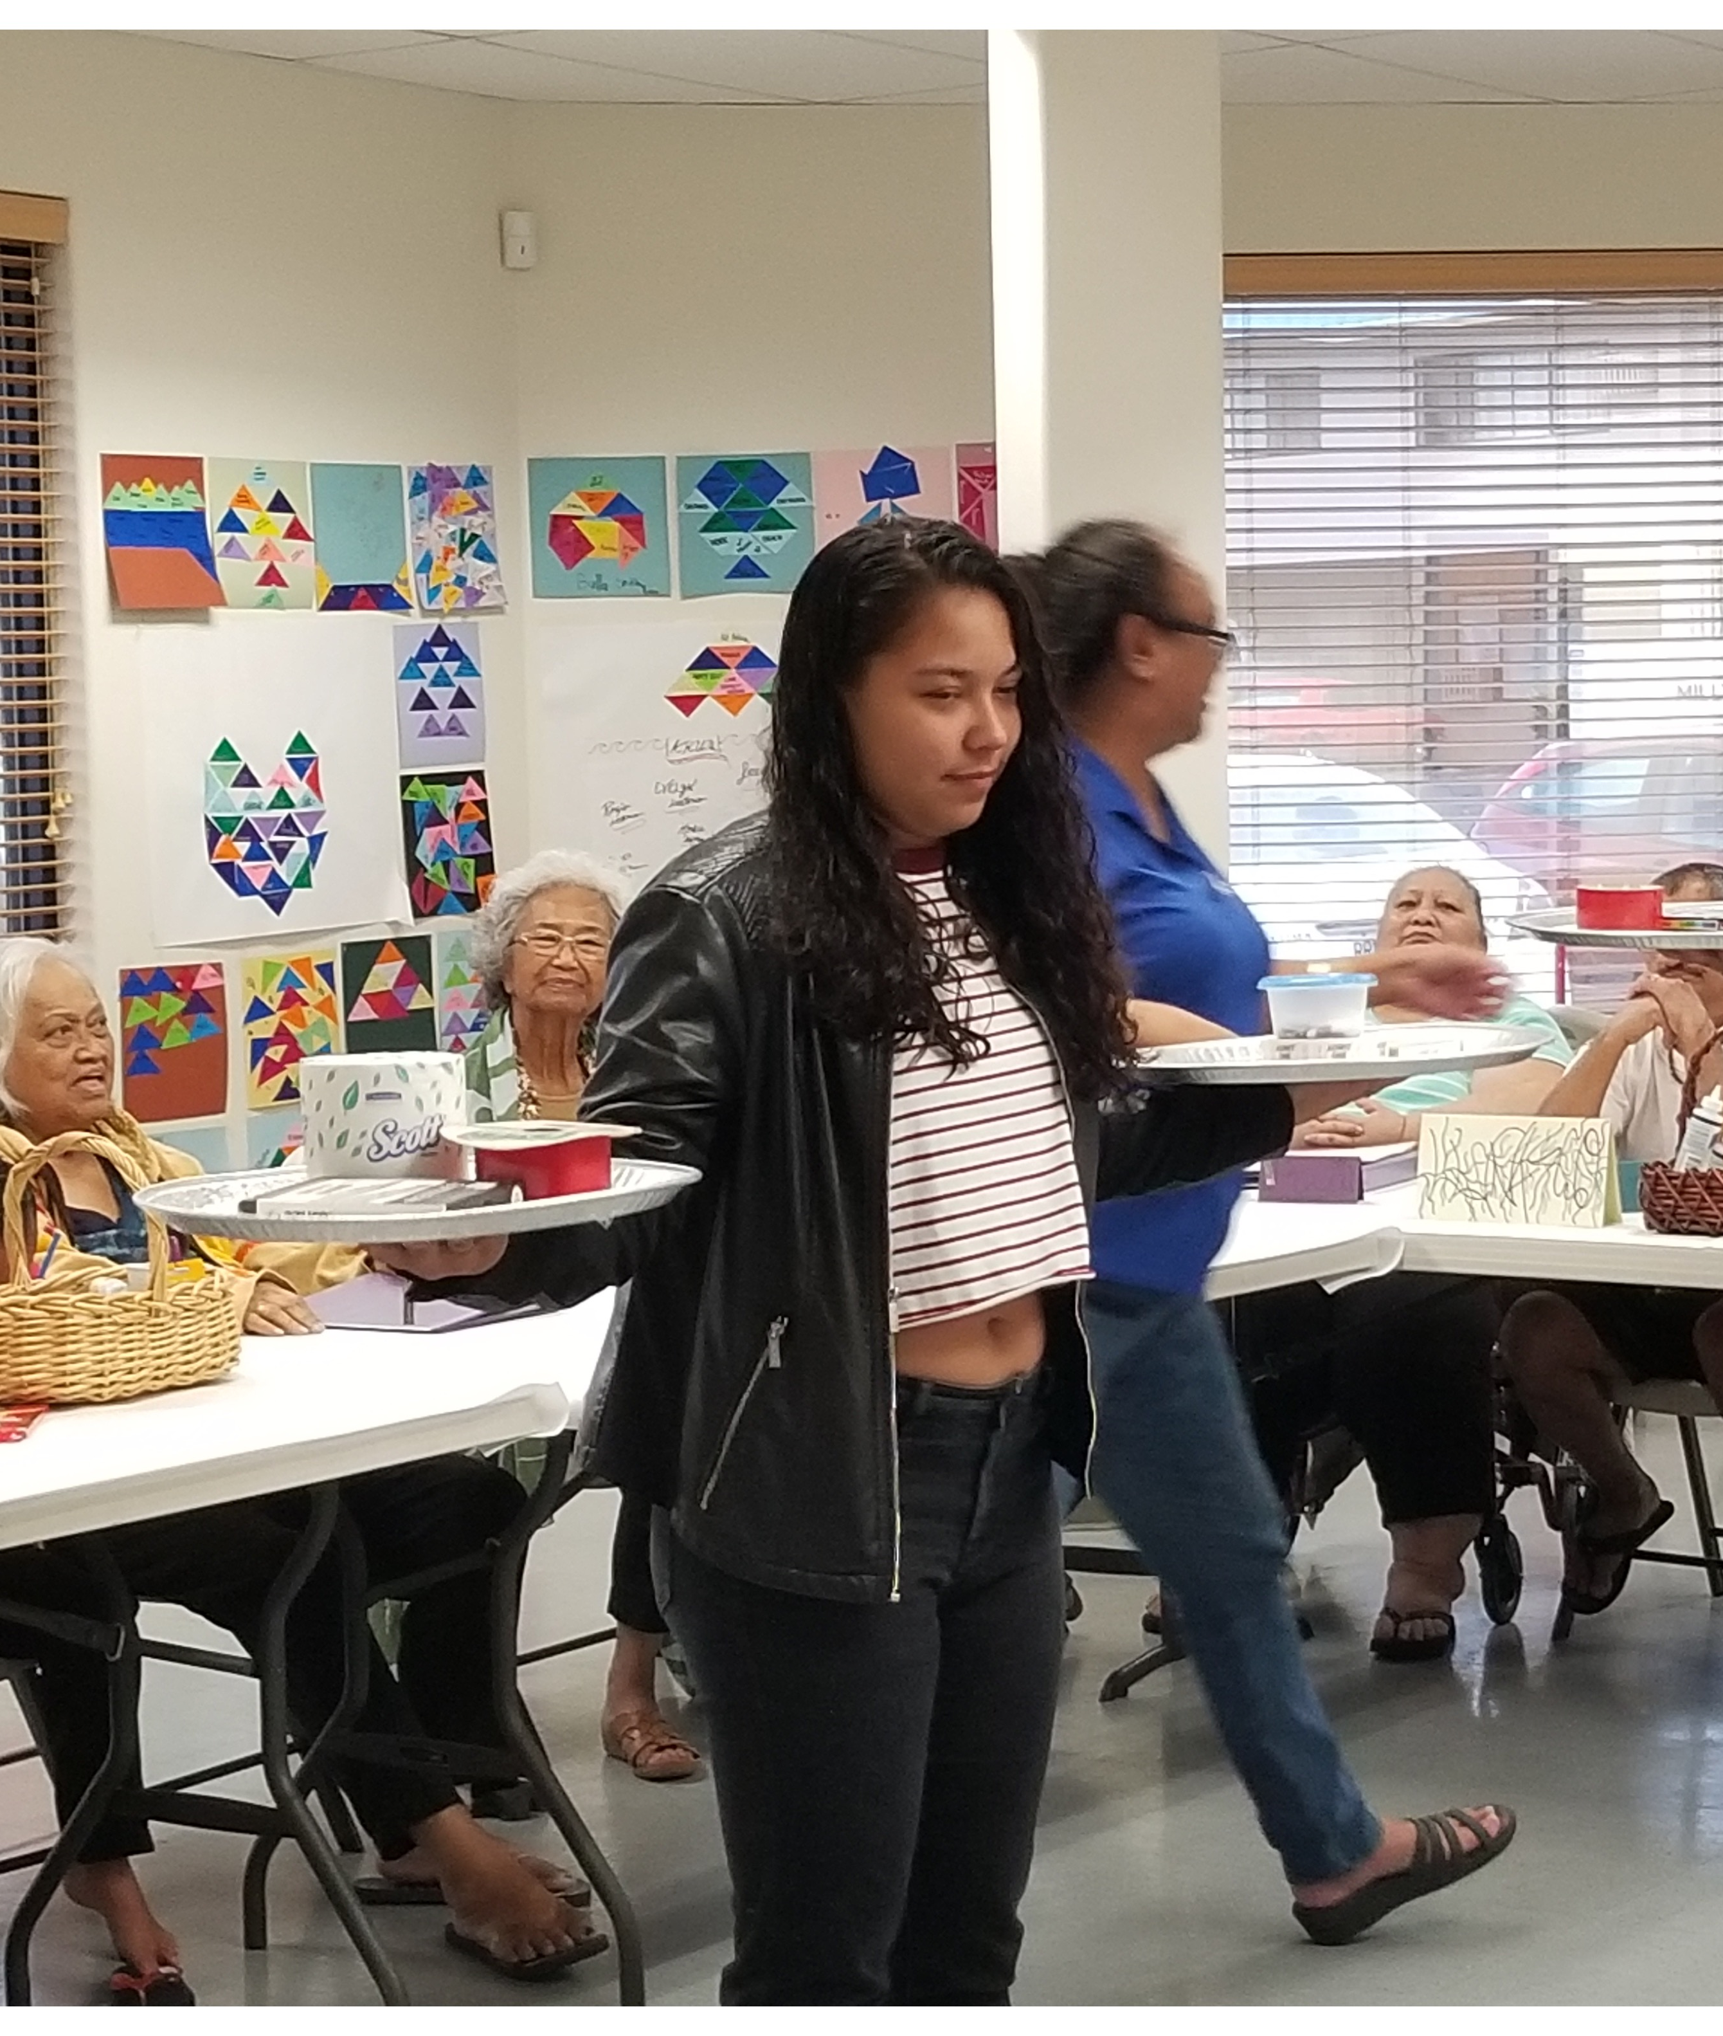
Facilitator Engagement
Create a Safe environment
Validate strengths as a family
Assess ʻohana/individual commitment
Check for correct information
Parents can contribute to the problems
One issue at a time
Communicate through poʻo with aloha & for understanding
All family members have an opportunity to air their issues & share how circumstances impacted them
Notes:
No different from social work engagement

Slide 16
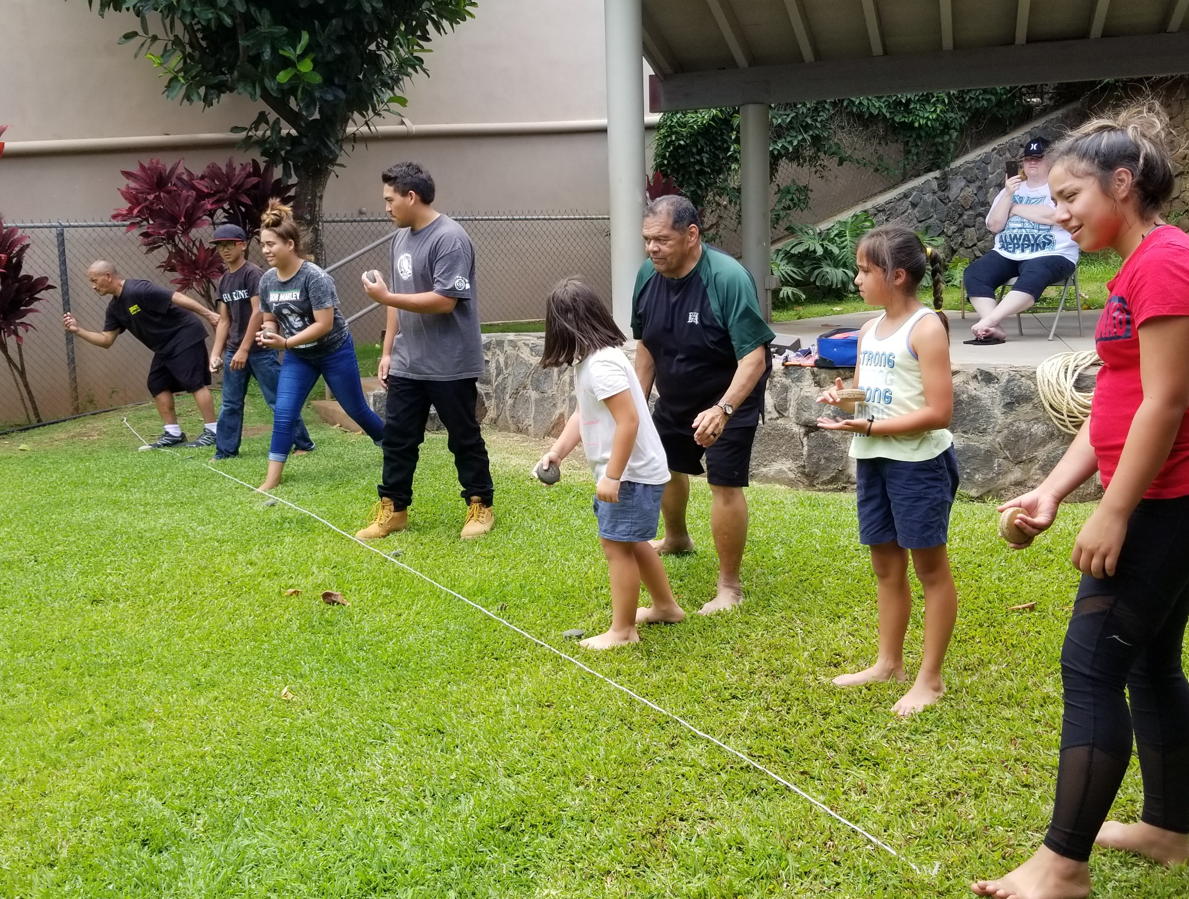
Hoʻopono Components
12 ʻohana sessions & 2 Huakaʻi = 14 sessions
2.5-3 hours p/session & up to 6 hours for Huakaʻi
Orientation: 3 hours
Hawaiian Worldview: Pono and Lokahi 3 hours
ʻOhana/Hawaiian Ways: 3 hours
Communication: 3 hours
Hawaiian Games: 4-6 hours
Huakaʻi/Moʻolelo: 5 hours (Community partners)
Ku/Hina: 3 hours
Essential Attitudes: 3 hours
Role Playing: 9 hours
Mentoring after instructional hours: 9 hours
Debrief/Pani: 3 hours

Slide 17
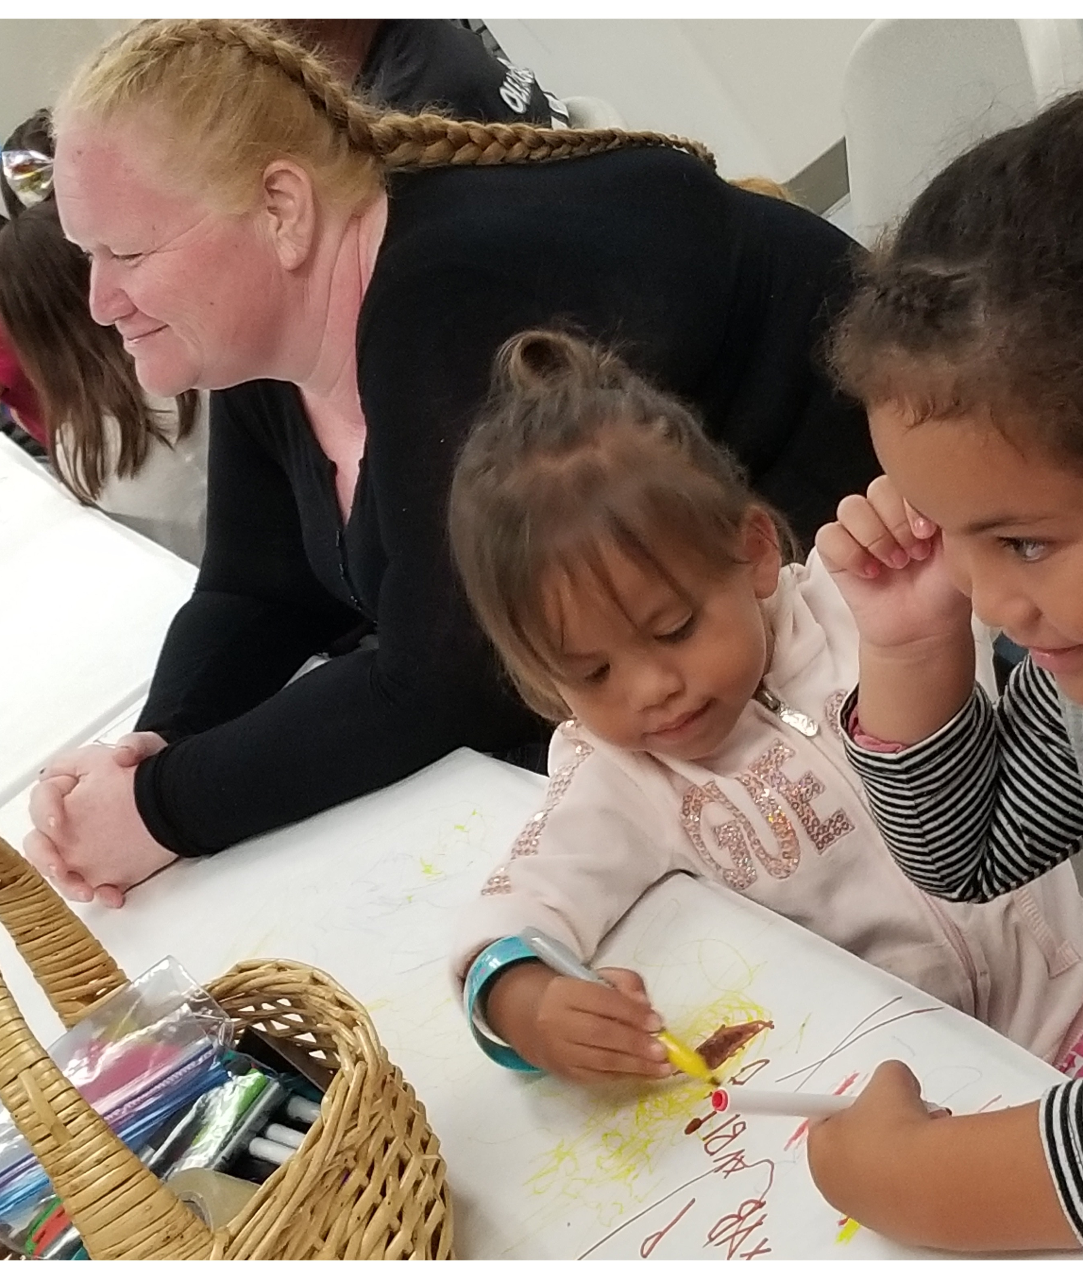
Evaluation
Mixed ages respondents from kupuna to young children.
Makua/kupuna rated strongly agreed, while the kamaliʻi tended to give a rating of agreed.
93% of respondents agreed or strongly agreed that they were very satisfied with the sessions.
96% of respondents agreed or strongly agreed that the sessions brought their family closer together.
96% of respondents agreed or strongly agreed that they learned something useful.

Slide 18
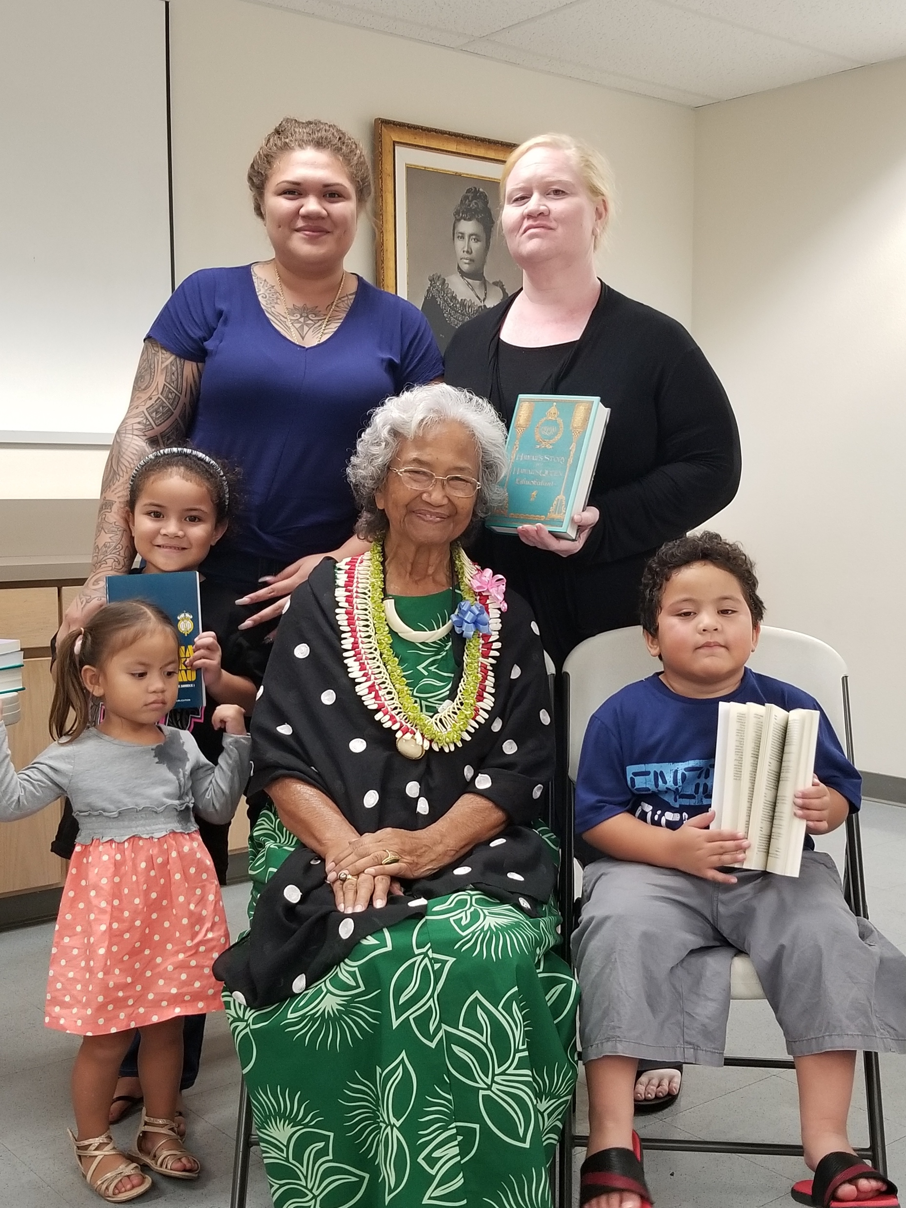
Hoʻopono ʻOhana Comments
Spending time together as an ʻohana and learning about Hawaiian values and culture.
“It has brought me and my family closer together spending time together learning about our Hawaiian culture.” –Kamaliʻi
Learning different moʻolelo about place names
“Hawaiian stories was very helpful in my family life to learn about our history.” –Makua
Building a strong bond with the other families
“The one thing that was helpful in class for me and my family was building a strong relationship with others and my kids.” –Makua
Communicating with each other with aloha
“Speak with love and humbleness to one another!” –Kupuna
“We spend more time talking about how pono works in our family and we use it at home and everywhere we go.” –Kamaliʻi

Slide 19
E hoʻomanaʻo kākou
Families are ready and eager to practice Hoʻopono in their homes. They have been waiting for a process (like Hoʻopono) that resonates with them to address problems and fosters aloha.
Hoʻopono is a healing process that restores places of historical trauma for individuals and ʻohana, willing, waiting and ready to be reconciled.

