Slide 1
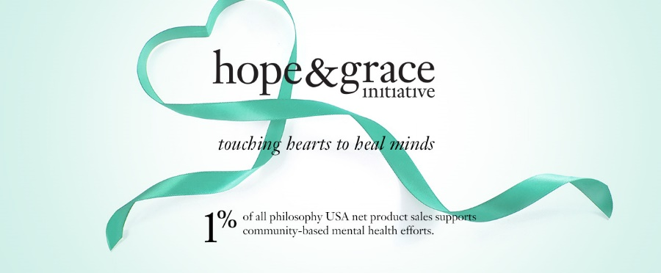
From Pathology to Wellbeing Post Traumatic Growth and Healing
Lorraine Robinson, LSW, ACSW
Kehaulani Coleman
Mahealani Kaawa, MSW
NASW, Ke ola mau loa i ka moananui, Oct. 5, 2018

Slide 2
Each individual has a universal responsibility to shape institutions to serve human needs The Dalai Lama

Slide 3
Ka Hale Ho`āla Hou No Nā Wāhine The home of reawakening for women
Residential reentry program for women exiting prison in Honolulu, Hawaii
Formerly with TJ Mahoney & Associates, now with YWCA Oahu
Mission alignment; empowering women, eliminating racism

Slide 4
Ever evolving framework
We continue to learn from our everyday practice/experience, always keeping up with advances in the field, including neuroscience and the treatment of trauma
Culturally coherent
Strengths based/empowerment focused
Collaborative
Gender responsive
Trauma informed/responsive
Relational

Slide 5
Givens in our Population
Pathway to crime is unresolved trauma
Typically severe
Developmental; occurs during childhood
Interpersonal; most devastating kind of trauma
Usually paired with poor attachment to caregivers
Early attachment wounds can be said to be relational trauma (Diane Poole Heller)

Slide 6
Developmental Trauma Combined Debilitating Effects
Deficits in brain development
Lack of trust and/or a sense of safety in the world
Poor self-regulation

Slide 7
Engaging Hopefulness
Our understanding of how trauma affects the brain and body has transformed over the last 20 years
Martin Seligman, University of Pennsylvania, introduced Positive Psychology as a modality,
Grounded in research exploring qualities that allow individuals to thrive in the face of adversity
For some, by-product of trauma is significant growth, hope, empowerment

Slide 8
Re-engaging Hopefulness
As practitioners, theoretical framework we operate with impacts how we relate to and work with clients
Well known meta analysis outcomes demonstrate greatest factor in effectiveness for therapists is the therapeutic relationship (safety, attunement)
Less well known factor, measure of effectiveness depends on practitioner’s belief in the modality
If practitioner carries a hopeful framework, that is translated/communicated to the client.
When we hold the framework of hope, clients can begin to increase their hope for hopefulness

Slide 9
Post Traumatic Growth (PTG)
Lawrence Calhoun, Richard Tedeschi, University of North Carolina began writing about Post Traumatic Growth (turn of the century)
Approach being embraced by practitioners
Over time, in healing environments/relationships
Loss, trauma or tragedy can lead to a new way of being, a reframe of values and re-envisioning of future possibilities
Growth happens not in spite of the trauma but as a direct result
Meaning and purpose emerge from the experience of trauma
I am more vulnerable than I thought, but much stronger than I ever imagined

Slide 10
Examples of PTG
Gabrielle Giffords, former Arizona Congresswoman, having survived attempted assassination, started a PAC to promote gun control legislation
Megan’s law: parents of 7 year old Megan Kanka crusaded for legislation (passed into federal law) to protect children from sex offenders
Former addicts who become substance abuse counselors

Slide 11
Common Threads
Those who embody PTG are determined to make a difference, don’t want what happened to them to happen to anyone else
Their lives take on new meaning and purpose as a result of their trauma, part of their healing process is to help others and/or prevent trauma from occurring

Slide 12
Quotes that Reflect PTG
I want to be the one in my family that breaks the cycle
Not only do I sit at the table but I am the one who invites people to the table
In my family no one has gone to college, I want to do it for my daughter
When a person who is silenced breaks that silence it is not just for herself but for the collective

Slide 13
Neurobiology of PTG
Neuroplasticity, brain is shaped through experience
Neuro circuitry is strengthened through repetition
Brain is constantly changing
Majority of trauma in our populations interpersonal, occurred in the context of attachment/relationships
That is where the healing has to take place, nurturing safe relationships
Safe relationships can create “earned” secure attachment
Rewires neuro circuitry over time
Notes:
Do a closed eye exercise, tune in to body
Dyad: 1 minute each to share, ask for realizations from group

Slide 14
Optimizing PTG
Importance of creating optimal conditions for individuals to move toward PTG
PTG is practice based, dynamic, happens with continued repetition of mindset, behaviors, nurtured by healthy relationships, environments
PTG is on a continuum, work toward increasing each person’s capacity for PTG, expanding their window of tolerance over time
Belief in strengths; people’s ability to transcend trauma, discover unbidden life lessons as a result of trauma
Notes:
Do a closed eye exercise, tune in to body
Dyad: 1 minute each to share, ask for realizations from group

Slide 15
How we treat people matters!
Create environments with social support; highly correlated with post traumatic growth
Normalizing, creates basis for common humanity, “I am not alone, I am not the only one;” contradicts isolation and shame, engenders healing, moving toward well being
Understanding of overarching approach toward PTG should be incorporated in planning, implementing policy and program activities, conversations, interactions, modeling, etc.
Notes:
Do a closed eye exercise, tune in to body
Dyad: 1 minute each to share, ask for realizations from group

Slide 16
Paradigm Shift Pathology to Well Being
Moving away from deficit based (what is wrong with this person?) to strengths based and empowerment focused, (what strengths can help mobilize this person to move toward greater well being and PTG?)
Dr. John Arden, SEEDS
S social connectivity
E education
E exercise
D diet
S sleep
Simple to understand, remember, embrace; makes sense
Notes:
Do a closed eye exercise, tune in to body
Dyad: 1 minute each to share, ask for realizations from group

Slide 17
Well Being
Dr. Daniel Siegel defines well being using the FACES flow, qualities which promote well being
F flexible
A adaptable
C coherent
E energized
S stable
Looking to nurture those qualities

Slide 18
Cultural and Historical Trauma (CHT)
CHT happens through group membership (indigenous populations; oppression/“isms” racism, sexism, etc., poverty, marginalization, disenfranchisement, etc.)
Anyone can be members of multiple groups
CHT impacts successive generations
Not just about what happened in the past, also about what is still happening today, (retraumatization, insidious)

Slide 19
Cultural and Historical Trauma (CHT)
Healing of CHT contradicts isolation, shame
Moves toward empowerment, rekindling of cultural pride and by extension, personal value
“I am somebody!” “I come from a culture of …..” (cultural values; strength/ compassion, cooperation, etc.)
Current examples (many historical examples)
Black lives matter
Hawaiian immersion schools
Standing Rock
All emerged as a way to take a stand, to change the paradigm and instill hope

Slide 20
Examples of C/H PTG
Queen Liliuokalani
I could not turn back the time for the political change but there is still time to save our heritage. You must remember never to cease to act because you fear you may fail…
Dalai Lama, Desmond Tutu (The Book of Joy)
The Dalai Lama would have never become a world spiritual leader without being chased out of his cloistered kingdom
Nelson Mandela
As I walked out the door toward the gate that would lead to my freedom, I knew that if I didn’t leave my bitterness and hatred behind, I’d still be in prison

Slide 21
Self Compassion, Self Talk
Growing awareness of the importance of how we treat ourselves, internally talk to ourselves
Kristen Neff, Harvard University, pioneering researcher in the field of self compassion
With self compassion, we give ourselves the same kindness and care we’d give to a good friend. Instead of mercilessly judging and criticizing [ourselves] for various inadequacies or shortcomings, self-compassion means we are kind and understanding when confronted with personal failings.

Slide 22
Hallmark of PTG is Self Compassion
PTG advocate, trauma therapist Lisa Ferentz: I believe there’s nothing more powerful than the way we talk to ourselves about ourselves. What’s new for me [as a trauma therapist] is listening not only to the trauma narrative … but…really listening to how [the client] talks about their narrative. Is there shame? Is there self-blame?
Self compassion is correlated to post traumatic growth; nurturing/encouraging self compassion (and practicing it ourselves) contributes to PTG

Slide 23
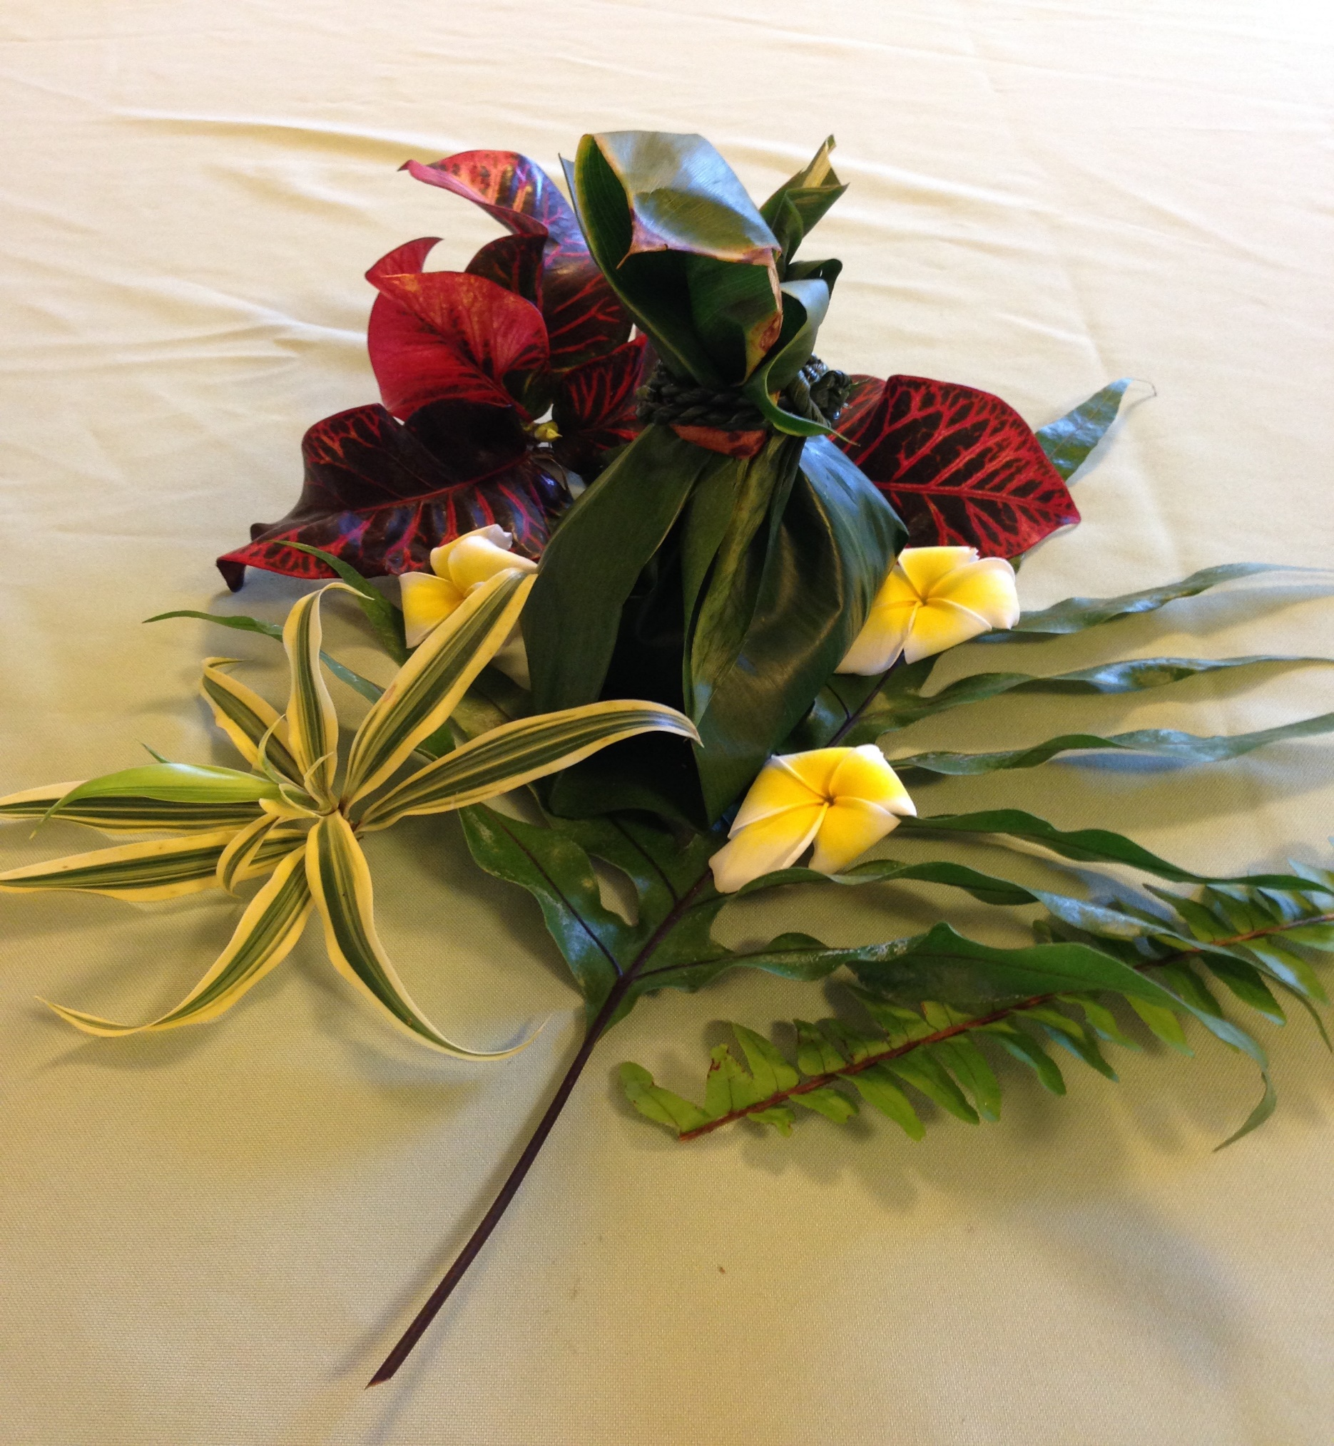
Hope is a
Renewable
Resource

