Slide 1


YWCA IS ON A MISSION
YWCA is dedicated to eliminating racism, empowering women and promoting peace, justice, freedom and dignity for all.

Slide 2

The oldest and largest women’s organization in Hawaii started in 1900.

Slide 3
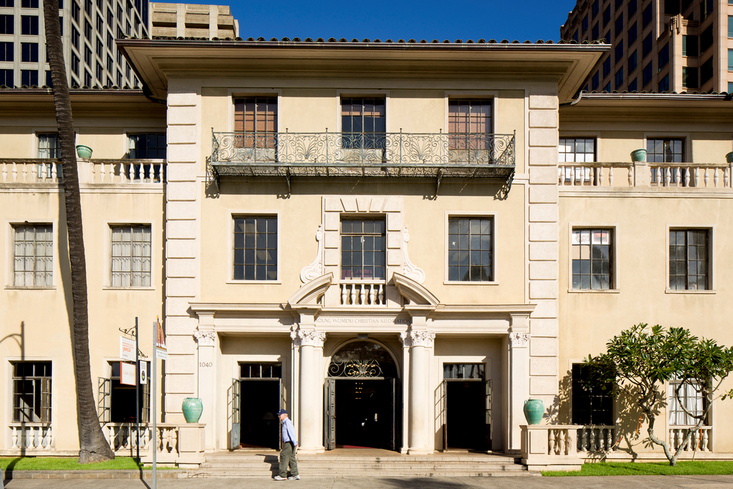
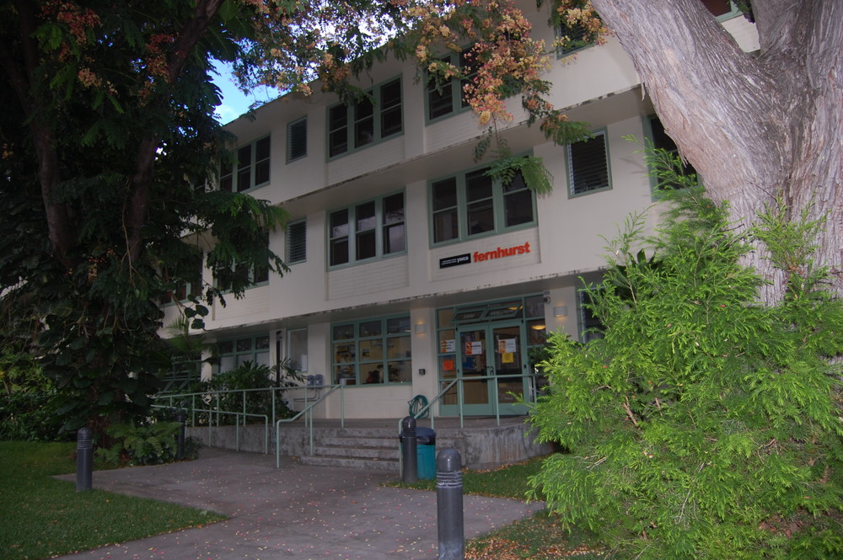
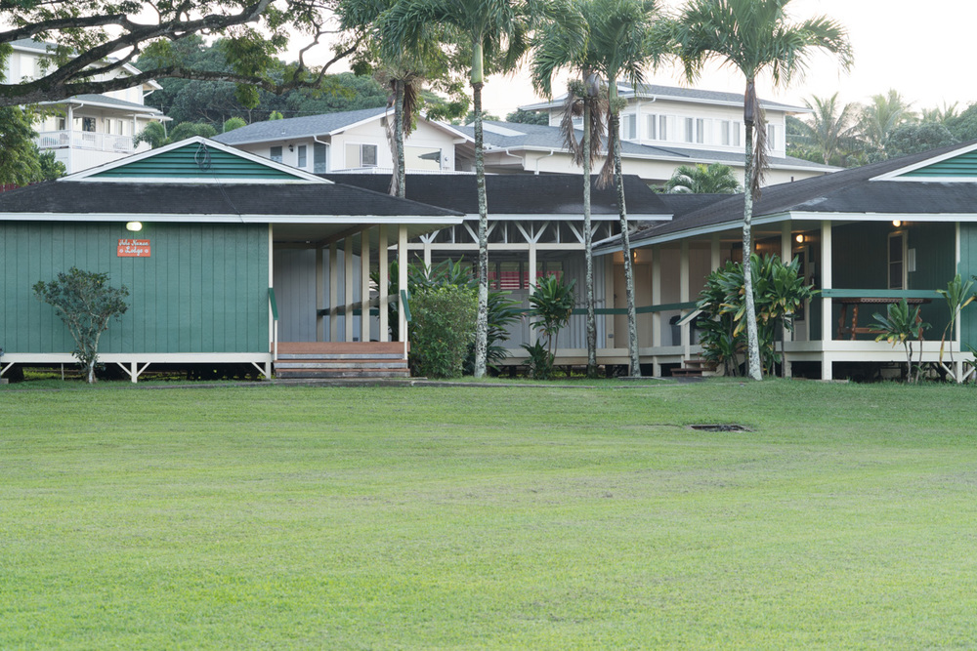
3 YWCA Facilities That Serve Our Mission
Laniakea
Downtown
Fernhurst
Residence
Kokokahi
Camp & Retreat

Slide 4
YWCA Programs That Serve Our Mission
Aquatics
Fitness Center & Classes
Camp & Family Events
Dress for Success
Transitional Housing
Work Furlough
Patsy T. Mink Center for Business & Leadership
Advocacy

Slide 5
YWCA Economic Advancement Programs
      Dress for Success
      Transitional Housing
      Work Furlough

Slide 6
YWCA Economic Advancement Programs
Serve Women Who Are:
Unemployed, underemployed, hard-to-employ
Domestic violence survivors
Divorcees
Illness survivors
Homeless
Reentering society from prison

Slide 7
YWCA Economic Advancement Programs
1. be financially independent.
2. have employability skills.
3. have positive coping skills.
4. have access to positive social support networks.
5. have access to obtain affordable, permanent housing.
Support Women To:

Slide 8
Dress for Success Honolulu
Workforce Development Programs

Slide 9
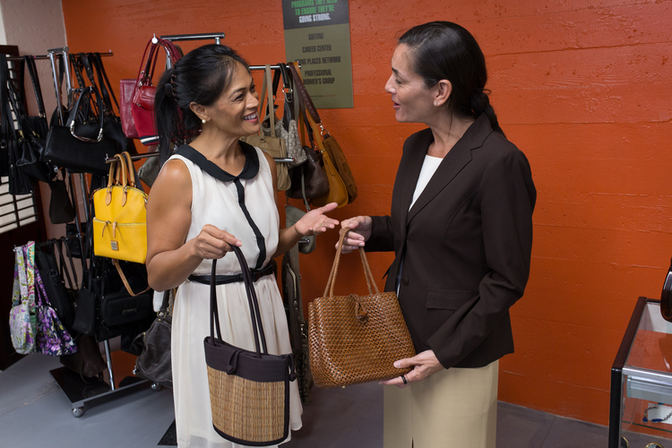
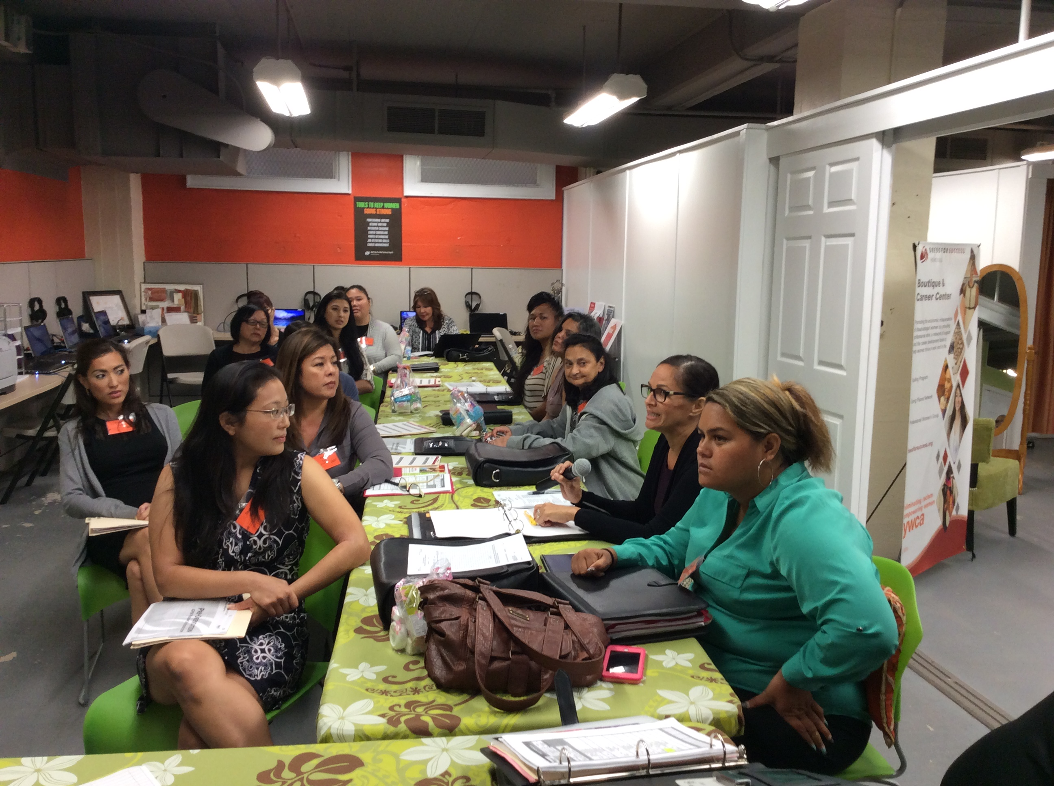
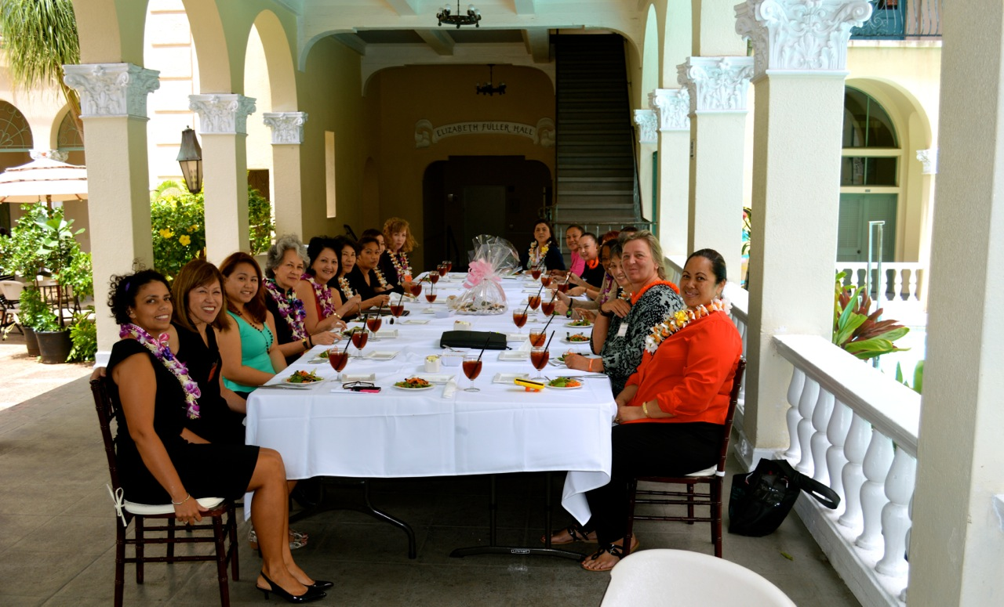
Dress for Success Honolulu
Job Retention & Career Development
Suitings
Job Readiness

Slide 10
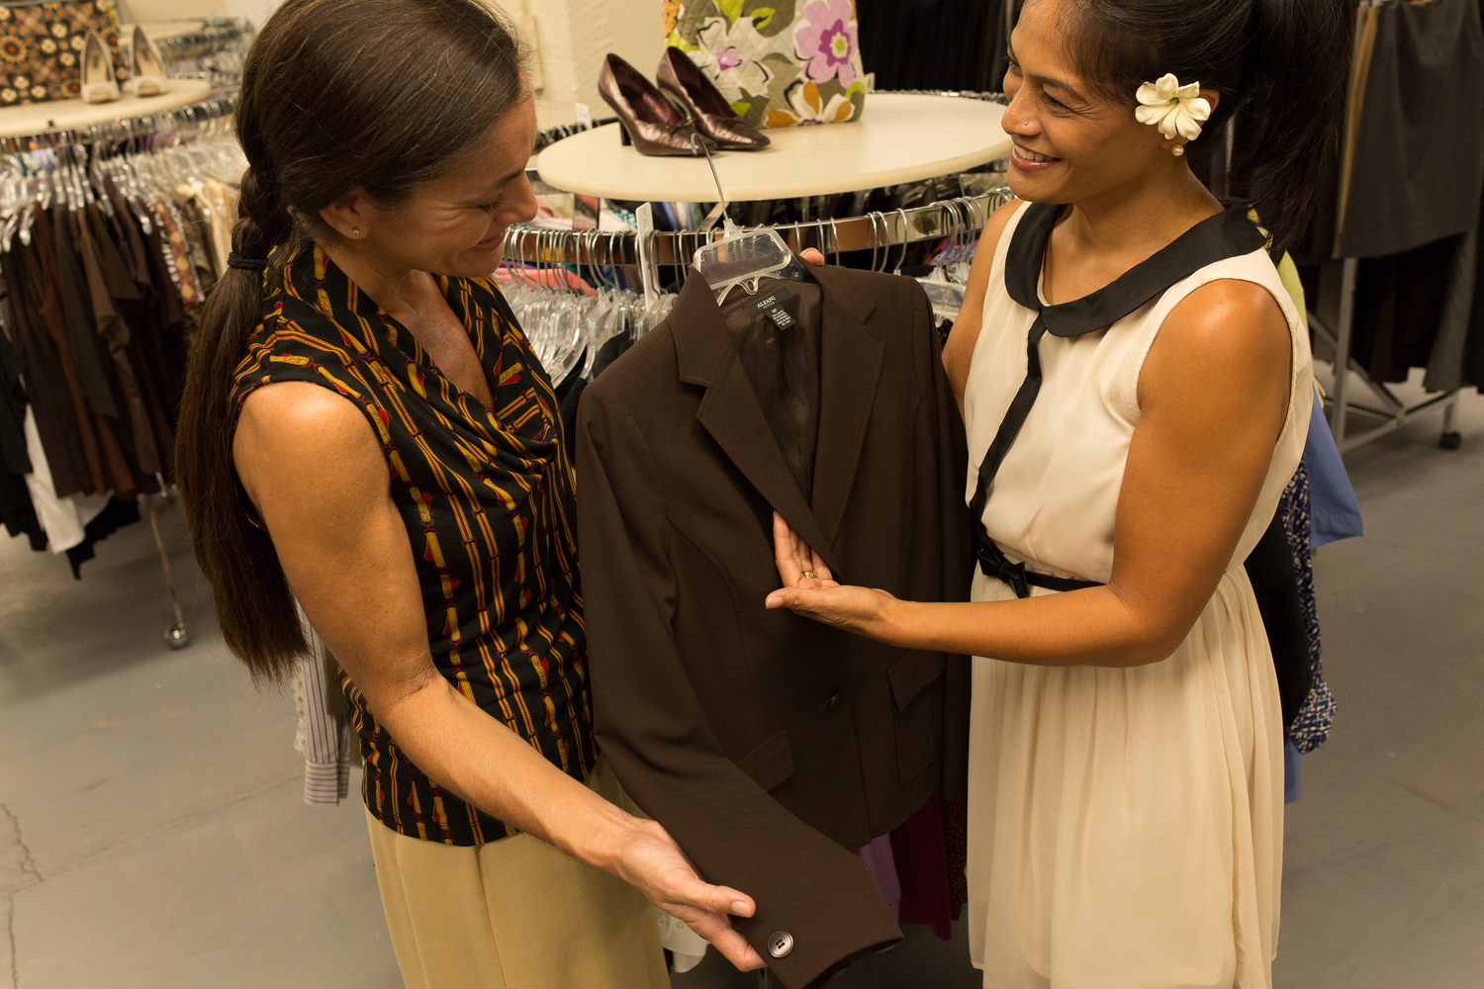
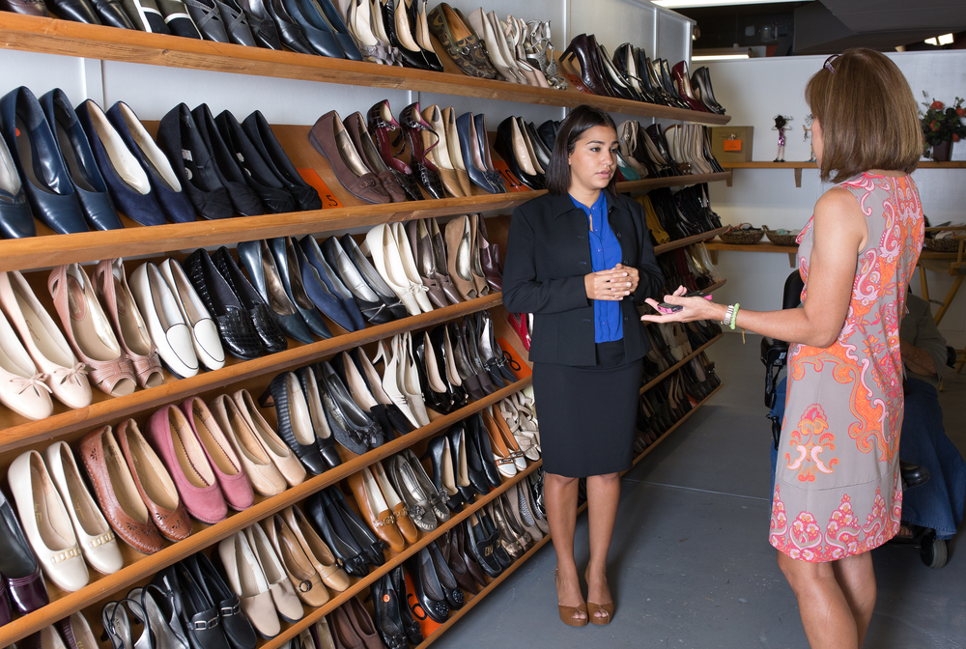
Suiting Program (2003)
Over 6,400 Suitings

Slide 11
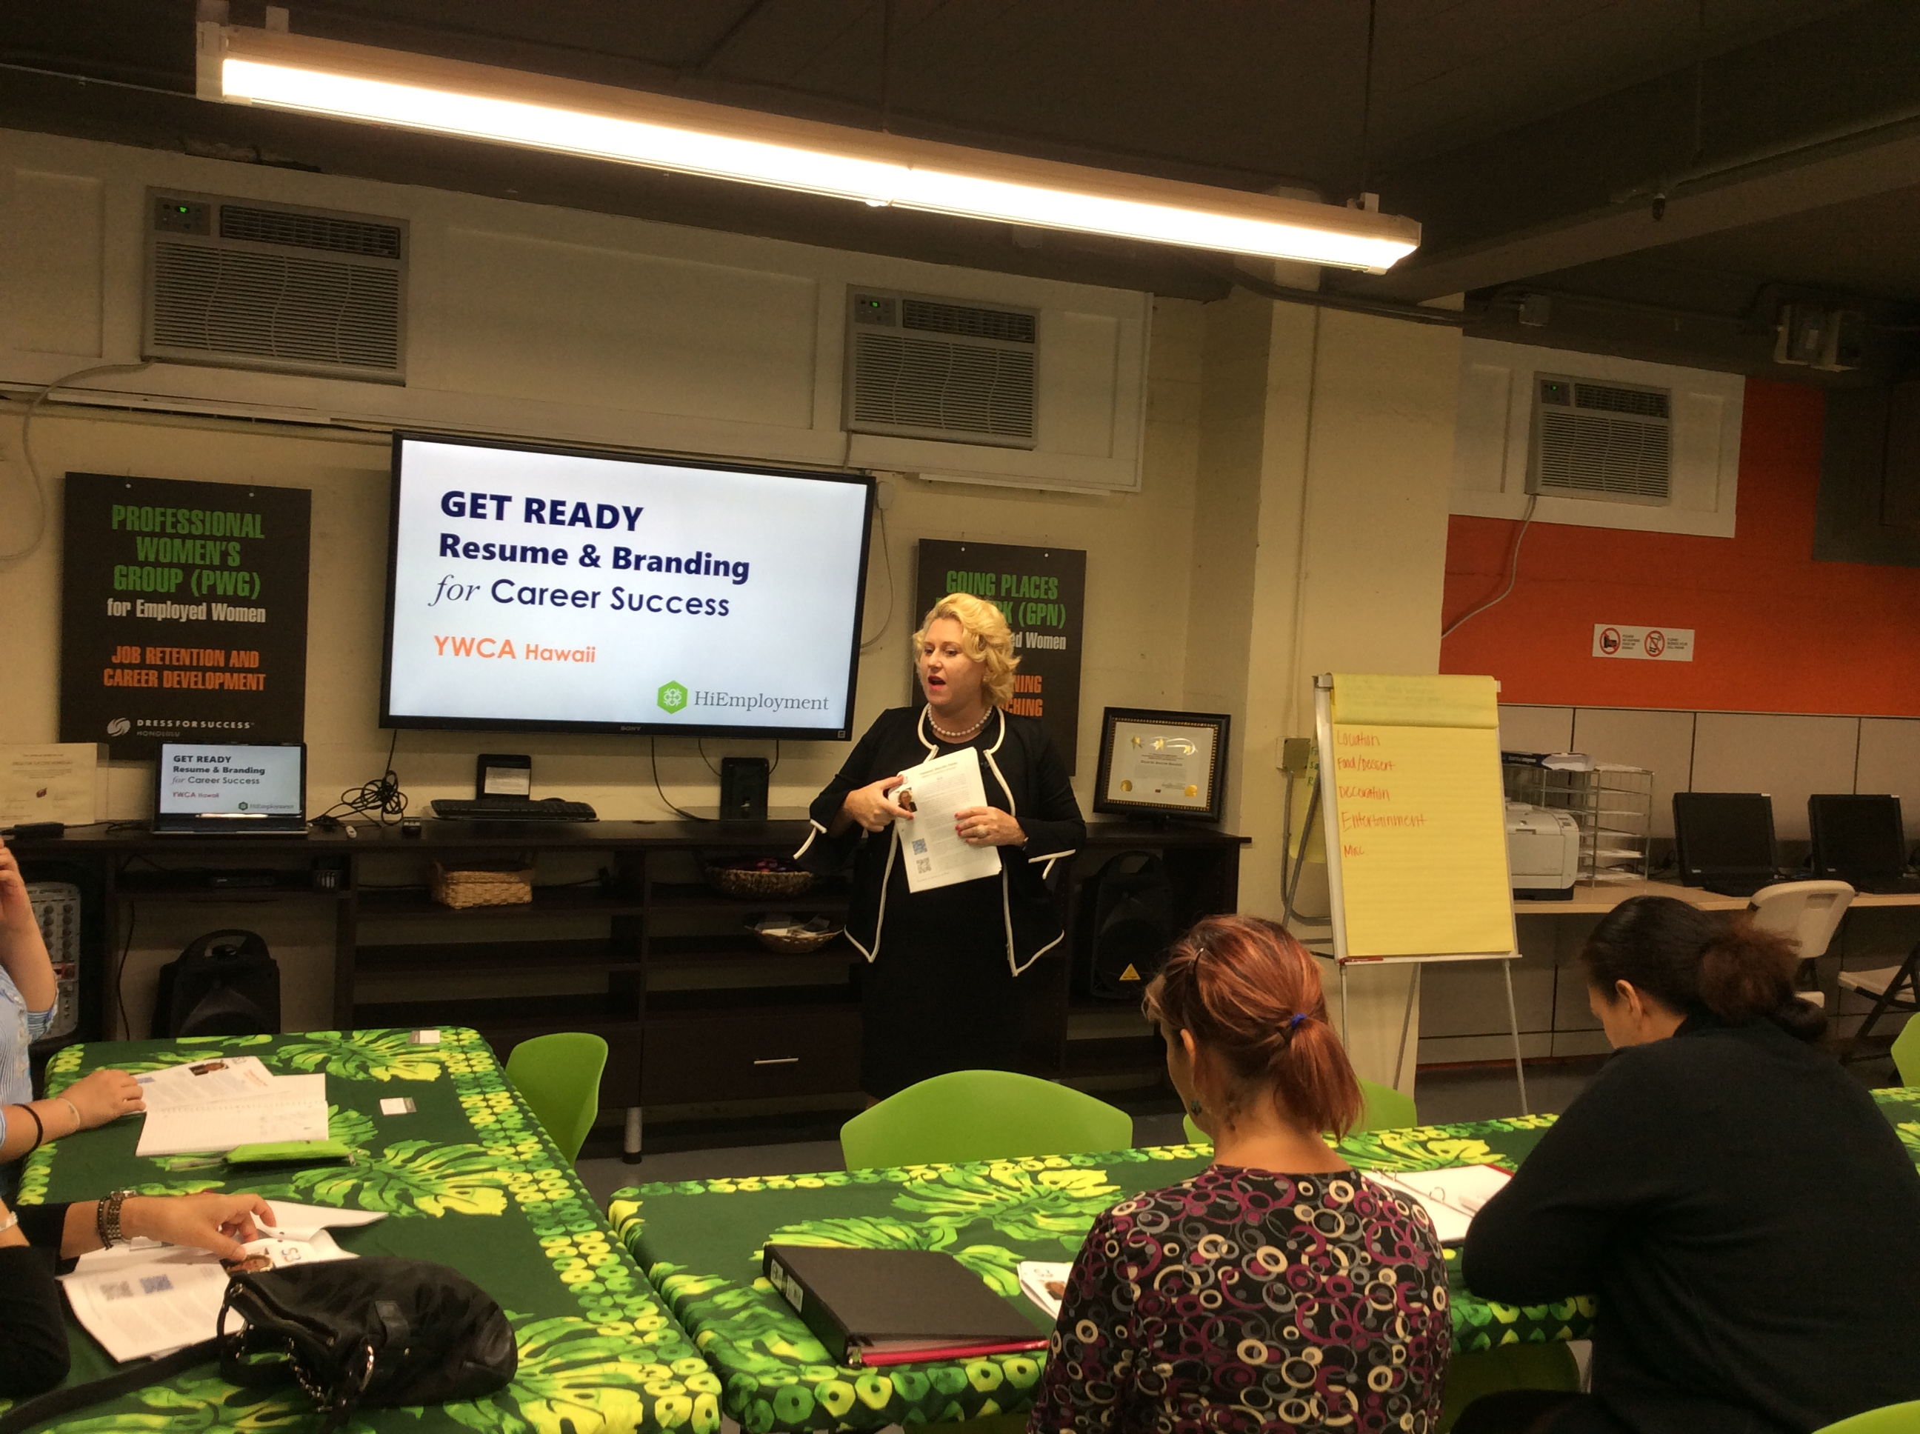
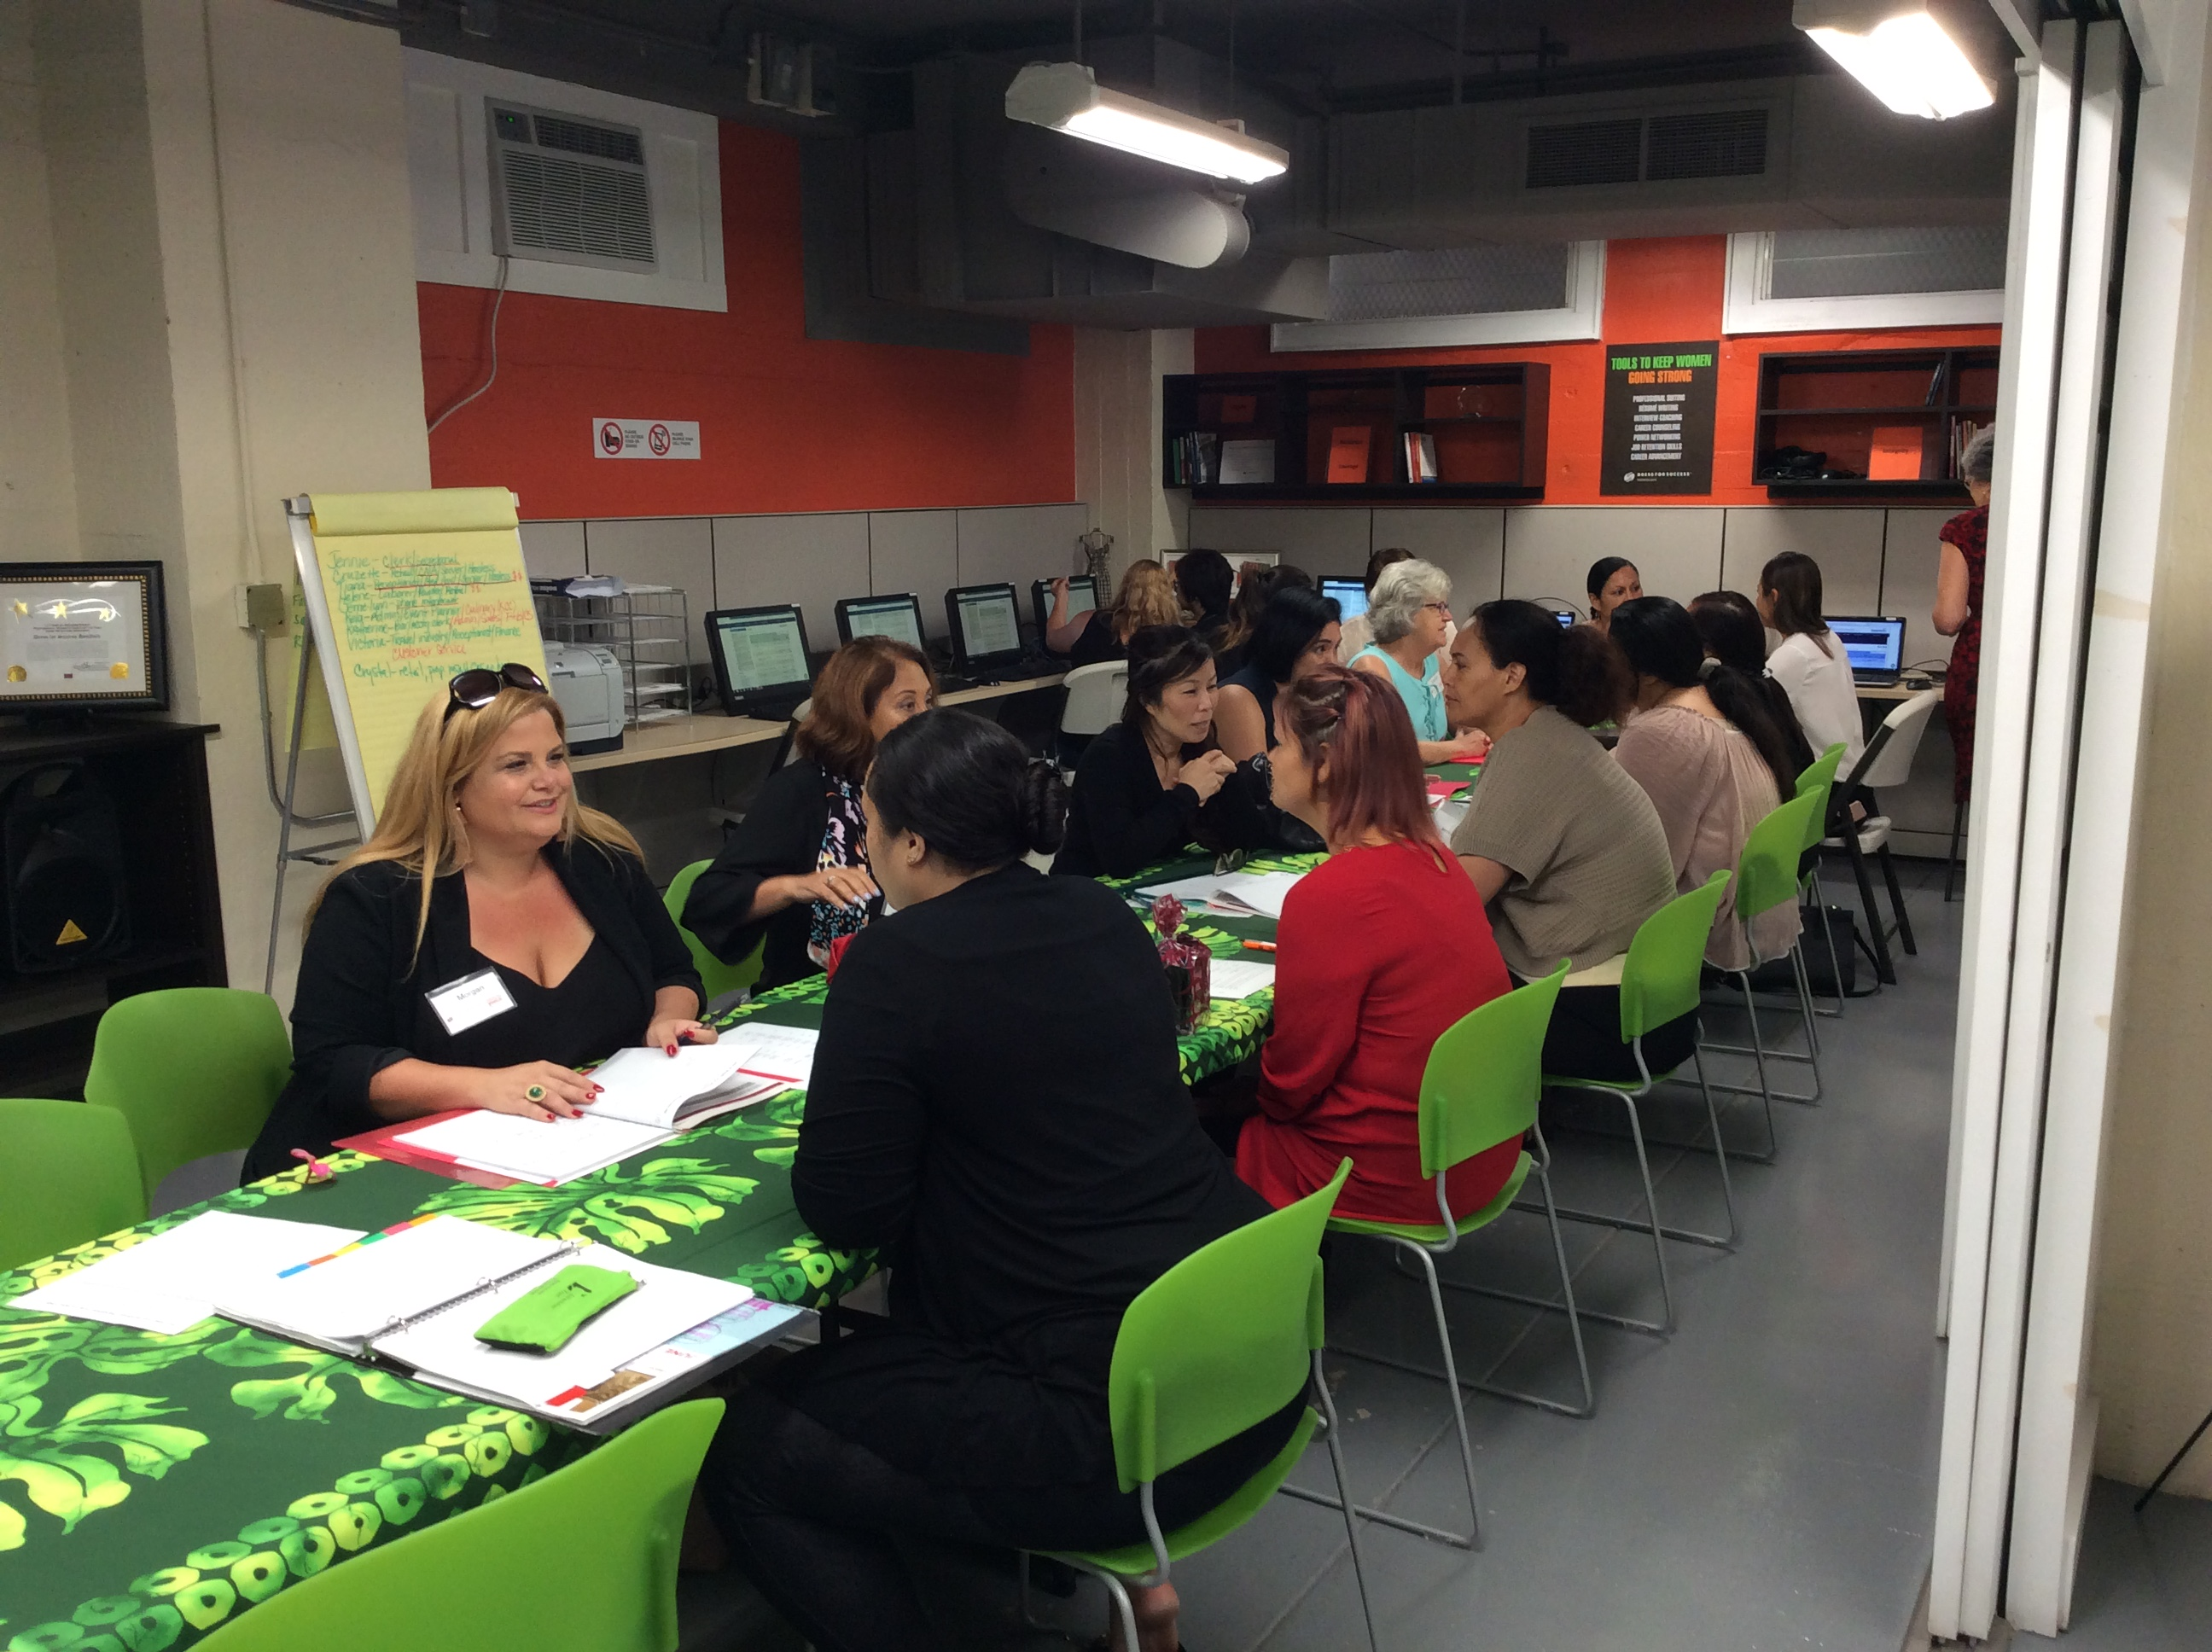
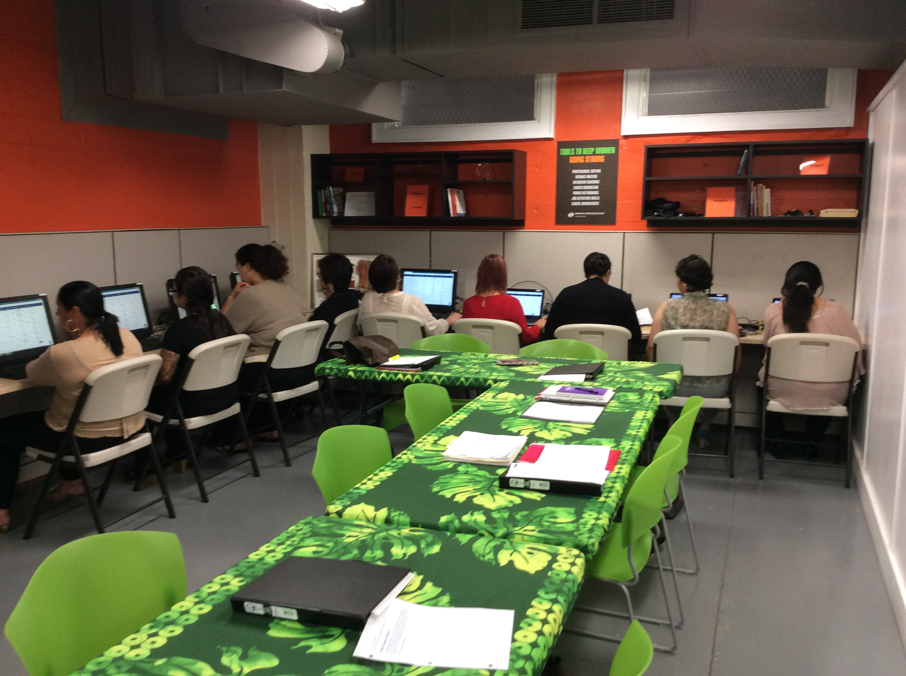
Rise!
8-week job readiness program every client has their own job coach

Slide 12
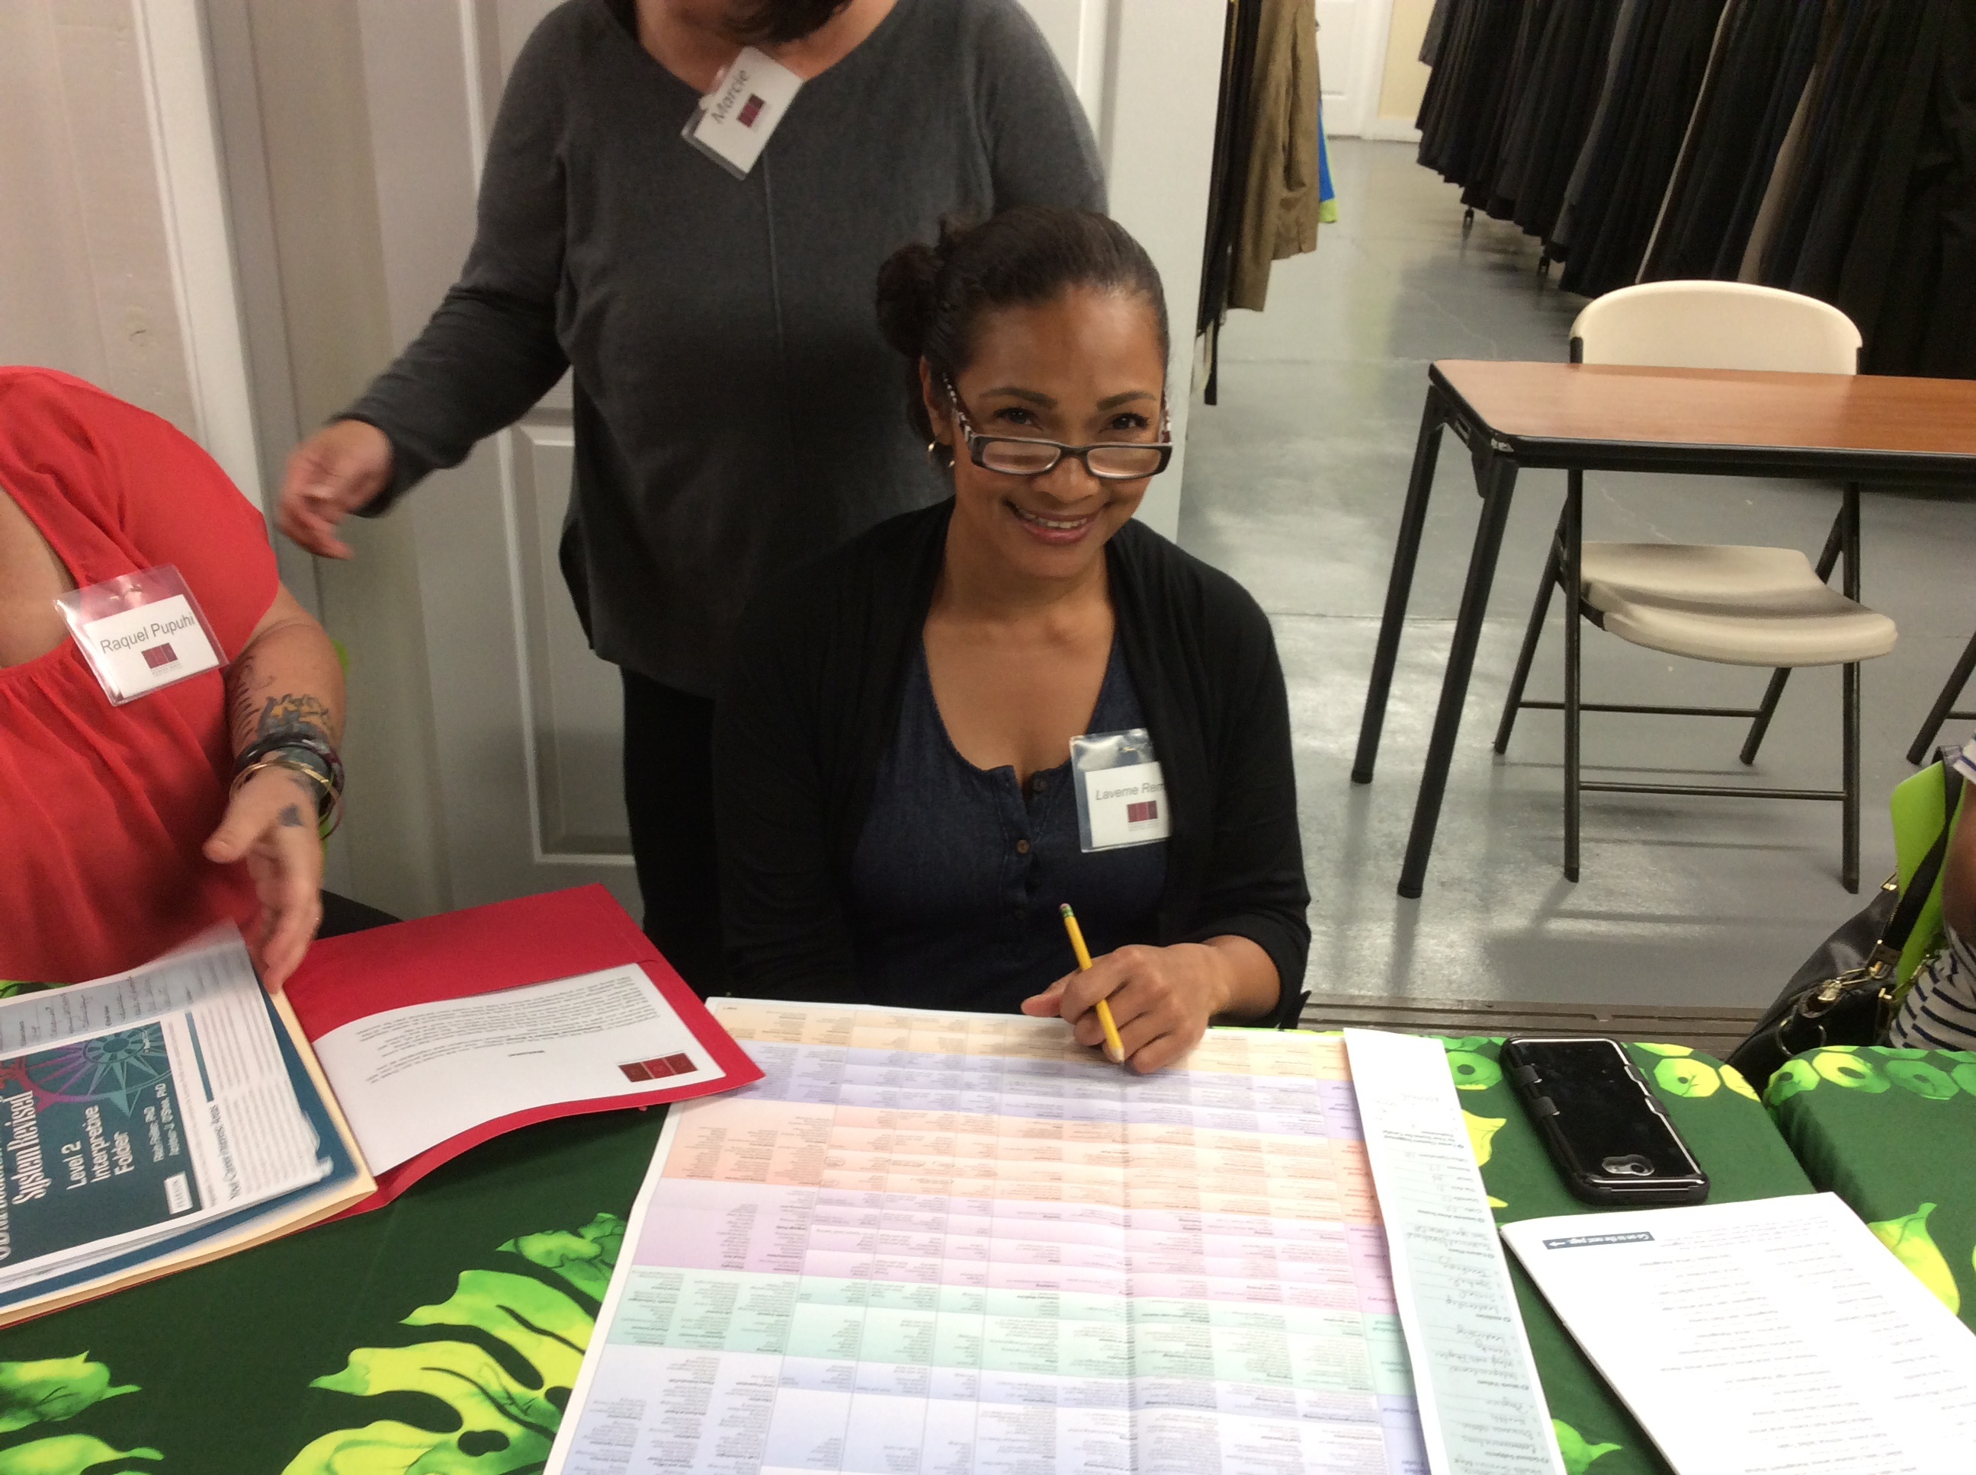
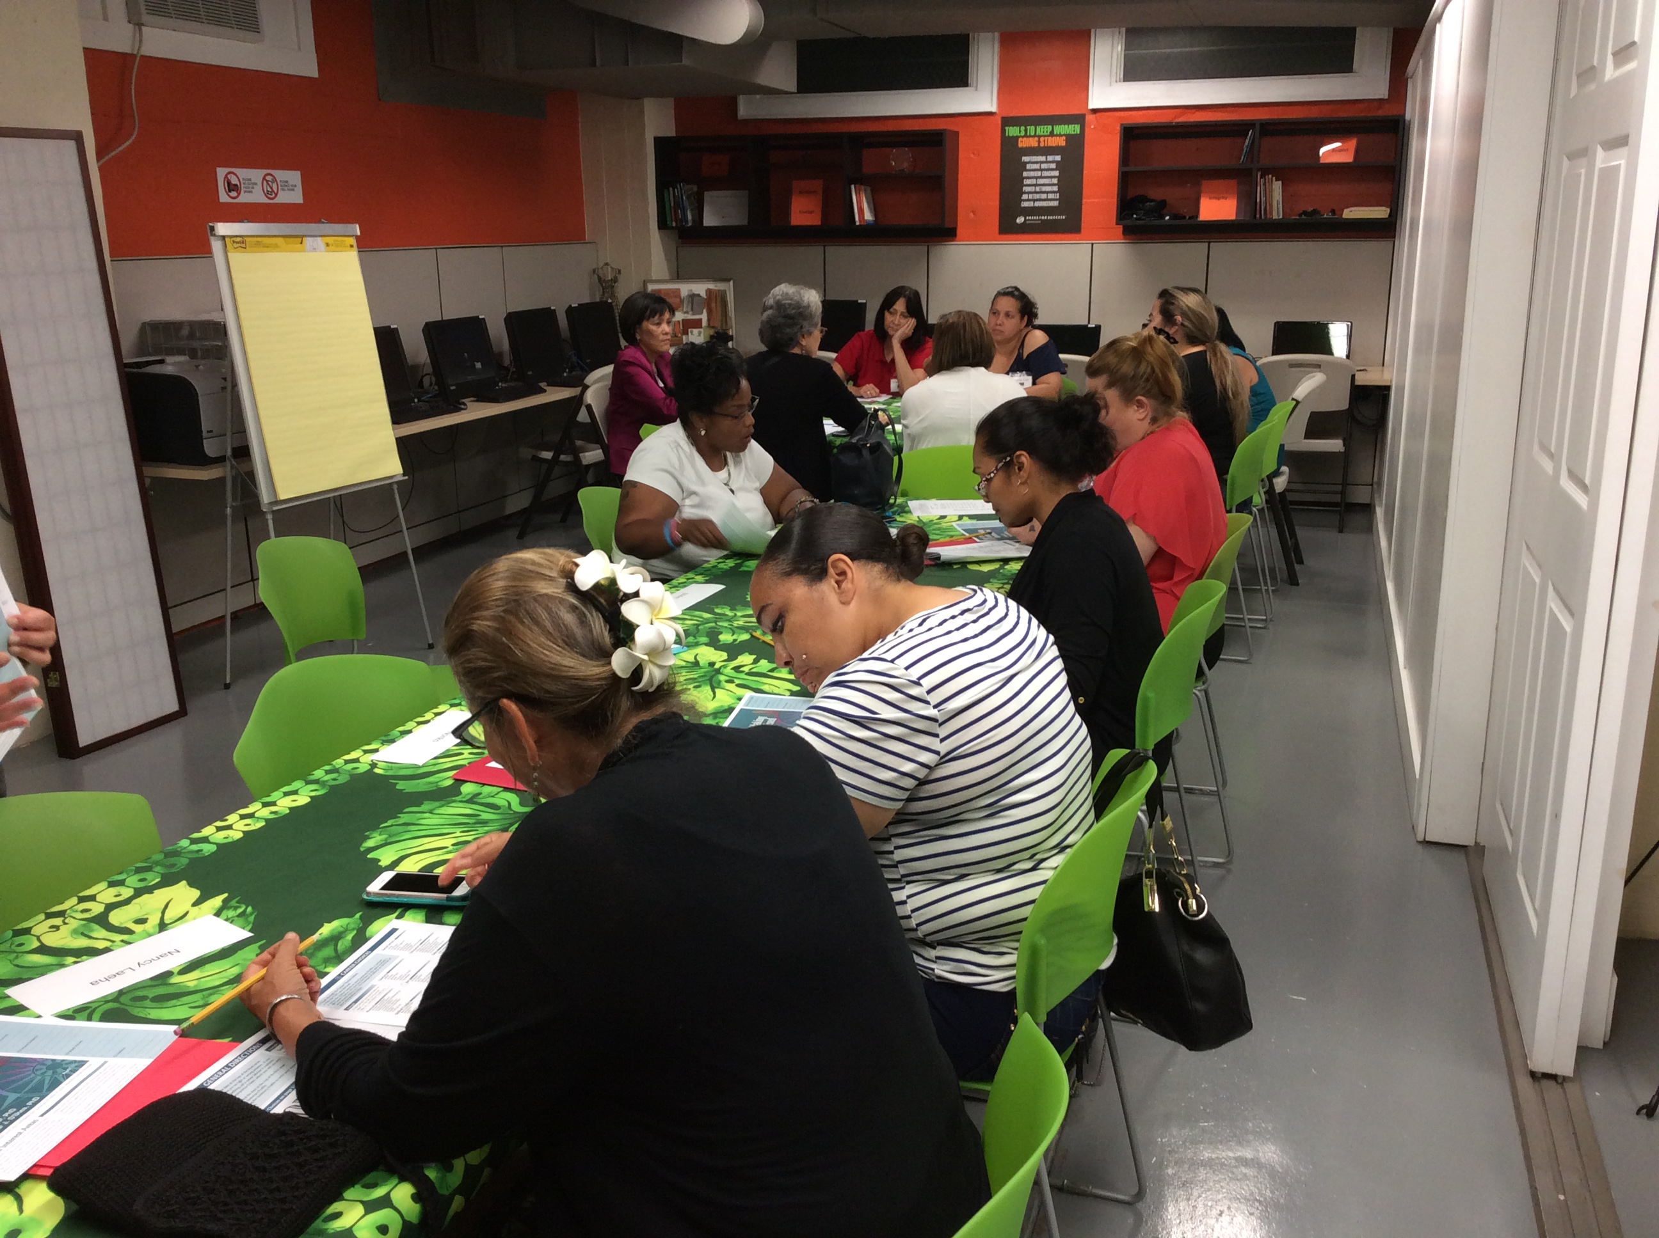
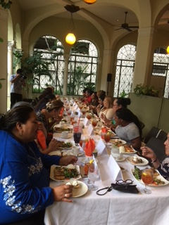
Professional Women’s Group monthly career development program every session begins with dinner and guests to network with

Slide 13
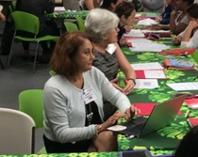
Career Counselor
One-on-one Career Counseling

Slide 14


Slide 15

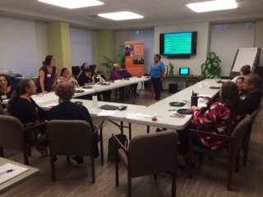
Personal Pathways
Personal & Professional Development Workshops
Hawaiian Values
Art
Beauty

Slide 16
Dress for Success Honolulu
Workforce Development Programs
Work Attire
8-Week Job Readiness
1 Year
Job Retention &
&
3-Week
Pre-employment Coaching
Over 6,300
appointments
Career Development

Slide 17
YWCA Economic Advancement Programs
A Continuum Of Services for Fernhurst
1
2
3
4
Work Furlough
Dress for Success
Transitional Housing
Dress for Success

Slide 18
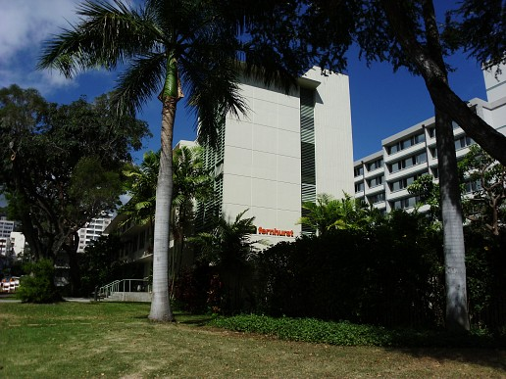
YWCA Fernhurst Residence
Dedicated to women coming out of incarceration

Slide 19
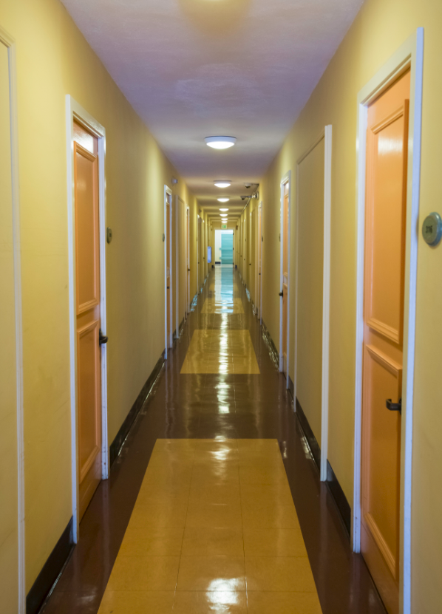
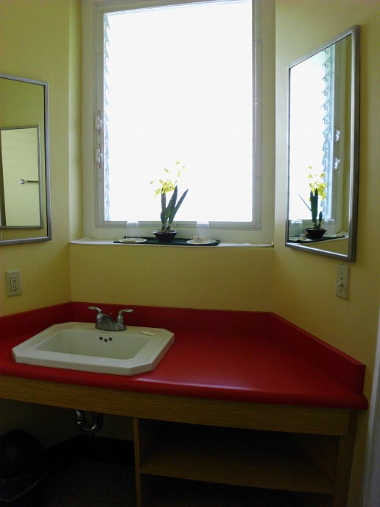
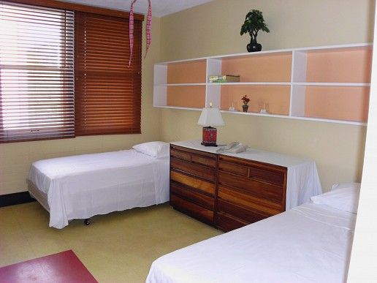
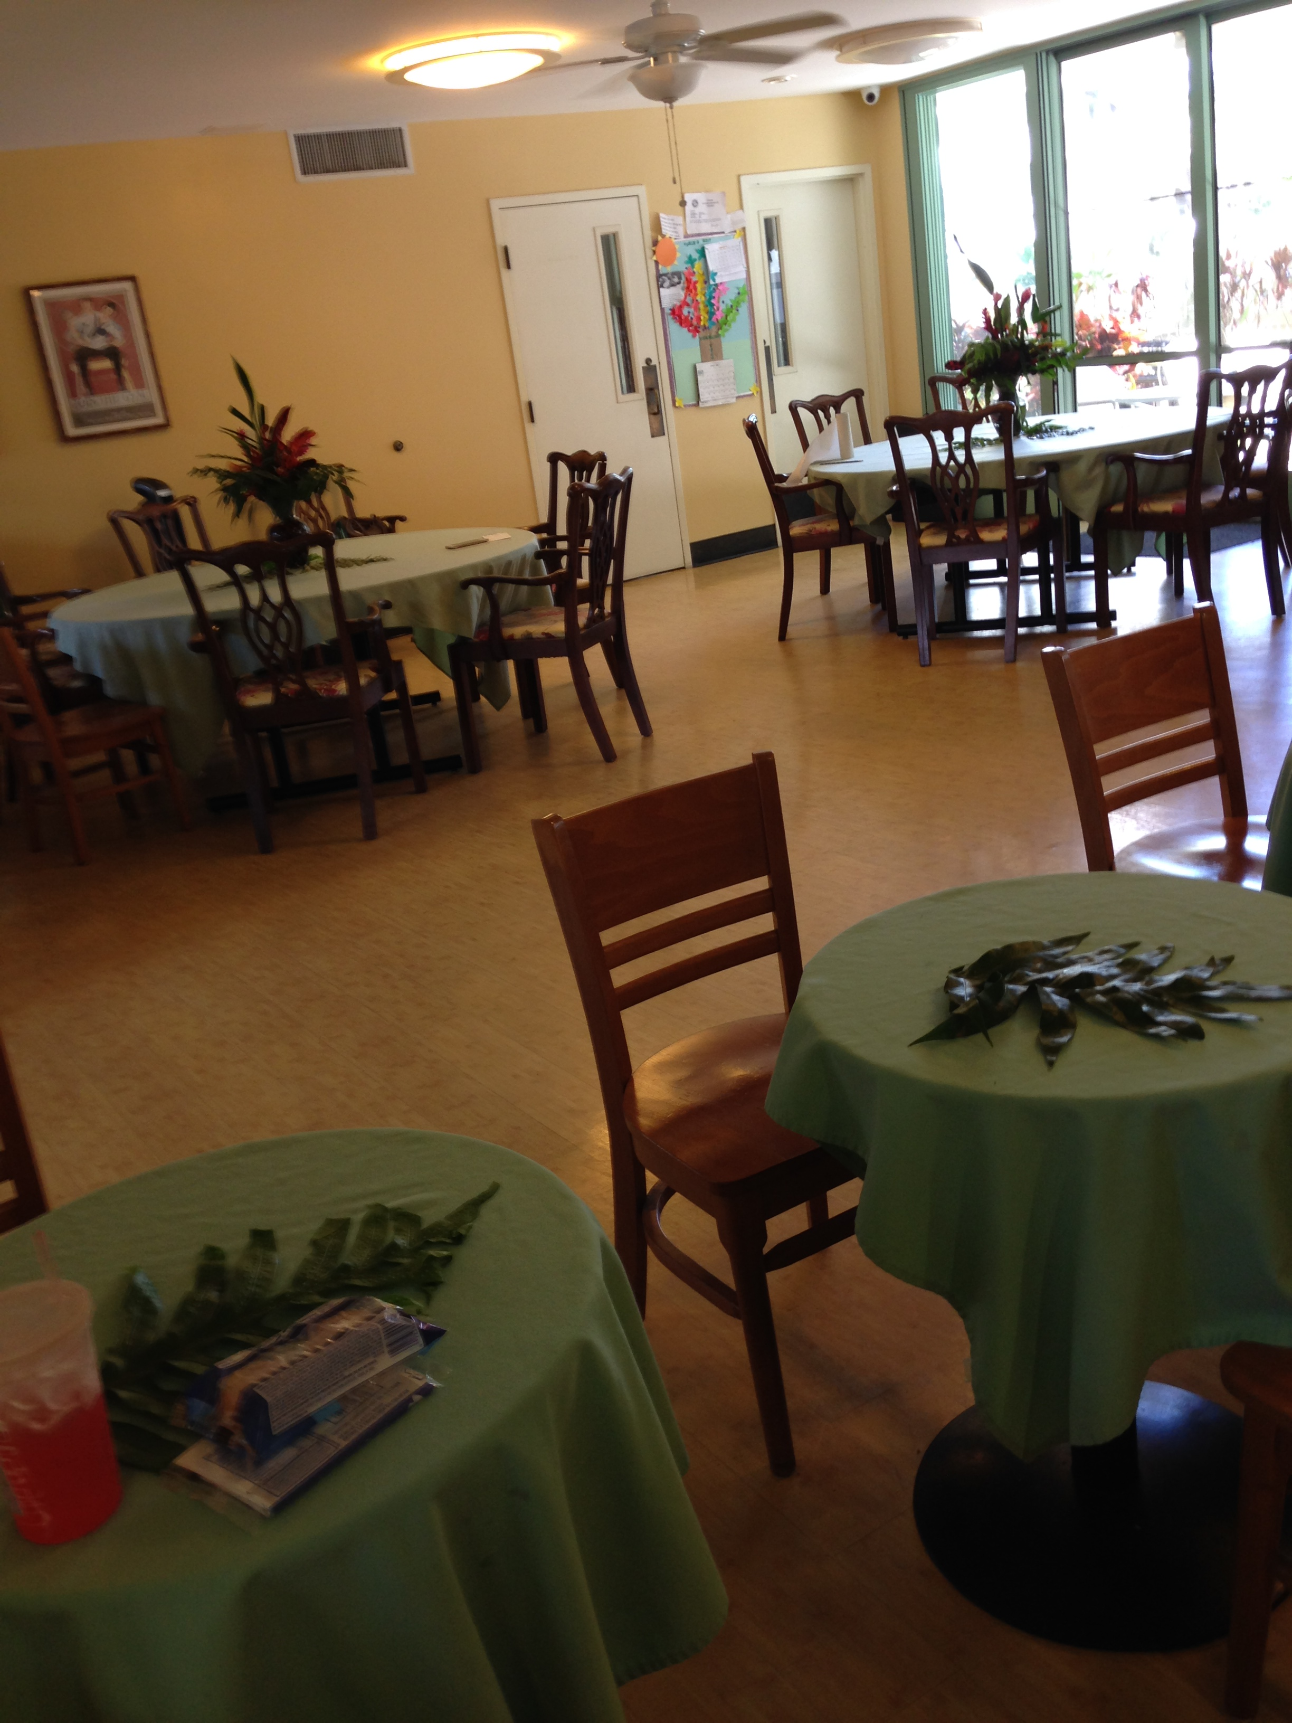
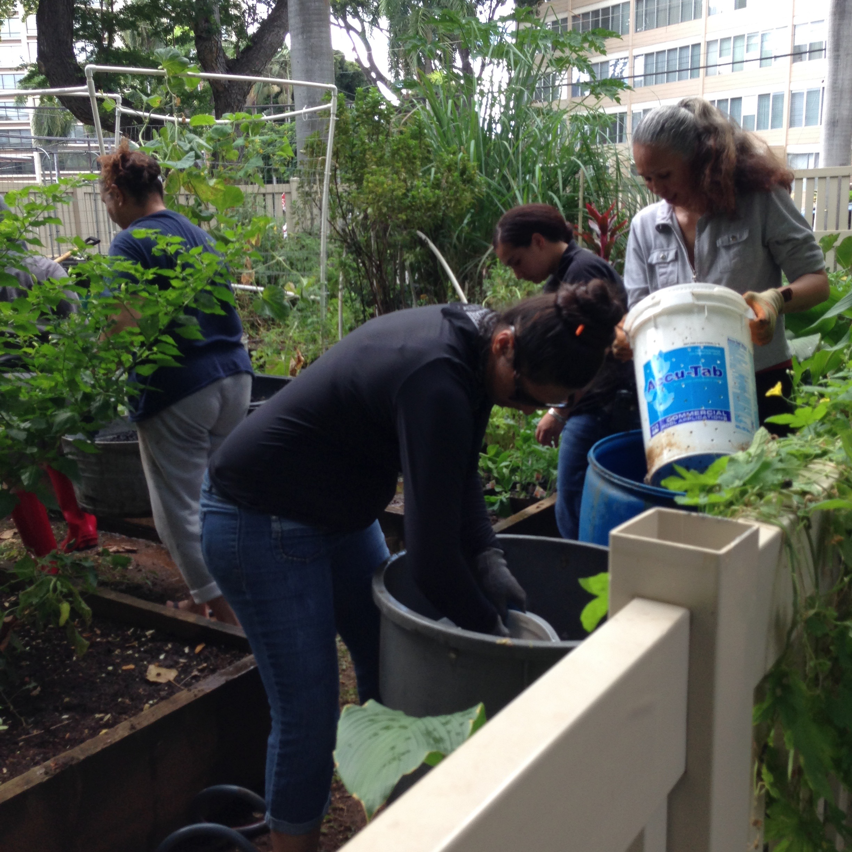
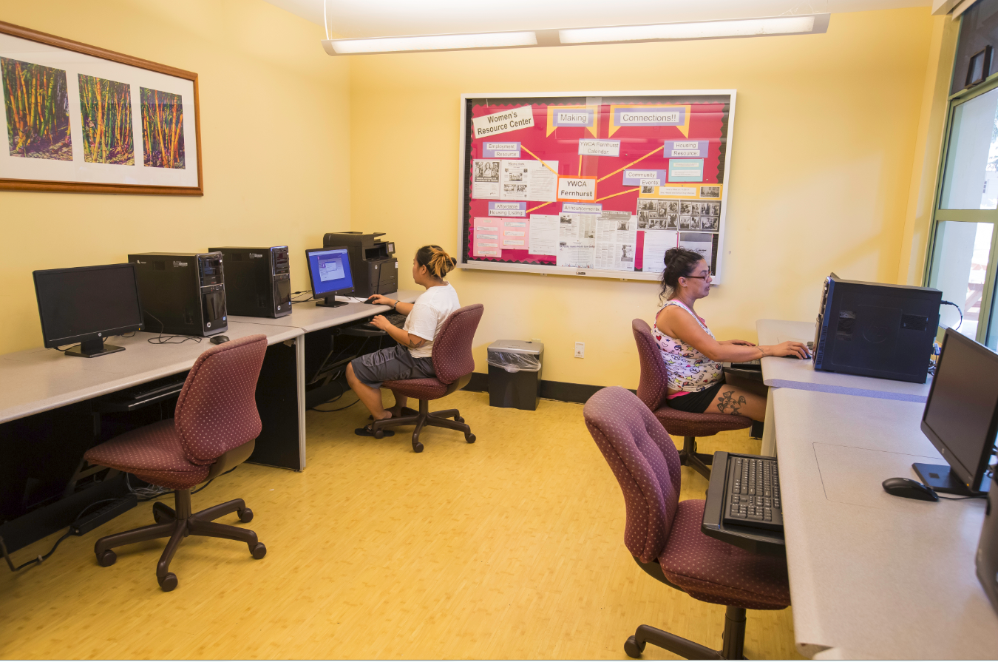
Fernhurst Facility

Slide 20
2 Fernhurst Programs
Transitional Housing
For Parolees
Work Furlough
For Inmates
6 months
60 women per year
6 months
30 women per year

Slide 21
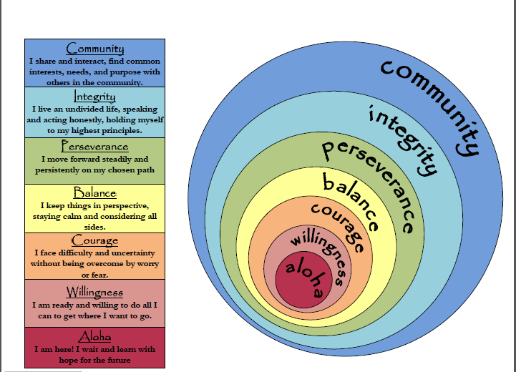
Work Furlough Program Model

Slide 22
Transitional Housing
Housing and supportive services that help paroled women gain stability and move toward independent living and permanent housing.

Slide 23
What Makes Us Different?
Community-based
Women’s Organization
Trauma-informed
Gender-responsive
Strengths-based
Culturally-sensitive

Slide 24

What Really Makes Us Different?

Slide 25
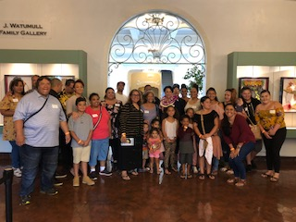
Why It Matters

Slide 26
Contact:
          YWCA Oahu – Economic Advancement Programs
          Phone: 808.695.2603
          Email: kcoleman@ywcaoahu.org
          Website: www.ywcaoahu.org

